Slide 1
River discharge to the sea for the whole of Iceland
CARRA-based estimate: methods, test results and the way to the whole country
Michaela Hrabalikova, NATT
14/10/2026

Slide 2
The Task
The goal is to get freshwater input from rivers for the ROMS ocean model
Formats: CSV or NetCDF (preferred)
Years: test 1991 and 2023, then dec 2017 to June 2020
Per river outlet: ID / name, latitude, longitude, catchment area, date, daily mean discharge [m³/s]
Coverage:
  Test area
  whole Iceland, coastal catchments
CARRA runoff - 2.5 km grid, daily
Catchments + outlets
Daily discharge per outlet Q [m³/s]

Slide 3
Data - Copernicus Arctic Regional Reanalysis (C3S)
2.5 km grid, 1991 – present; the West domain covers Iceland
Dataset used: reanalysis-carra-means – daily values computed
https://cds.climate.copernicus.eu/datasets/reanalysis-carra-means?tab=overview
Fluxes in kg m⁻² = mm per day
  1 mm/day over 86.4 km² = 1 m³/s
Availability problem
Daily fluxes (runoff, percolation, precipitation, evaporation) in reanalysis-carra-means are not in some years
Test years:
- 1991, 2023 (coverage of whole year)
Runoff in CARRA
  surface runoff: water that cannot get into the soil because the soil is already full (saturated). It runs off over the surface.
  percolation: water that drains out of the bottom of the deepest soil layer of the model
In nature, water that drains below the soil becomes groundwater. Groundwater feeds rivers slowly, over weeks or months, and that slow feed is baseflow. Some of it can also reach springs, a neighbouring catchment, or the sea directly.
In CARRA, there is no groundwater store and no river below the soil column. Percolation simply leaves the model on the same day -> 2023, Iceland: percolation ≈ 98 % of the runoff

Slide 4
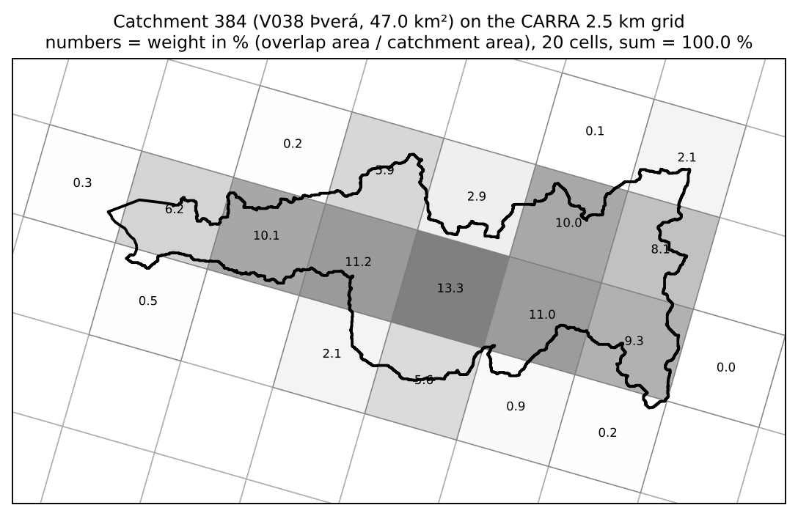


Processing chain
01
Download CARRA
CDS API, one request per year and product type
02
Catchment series
area-weighted mean per catchment and day
04 a/b/c
Methods A, B, C
runoff depth → Q, with and without routing
Python, one notebook per step
05
Comparison
with gauges: PBIAS, KGE, NSE
Numbers = weight in %. Cells drawn from the CARRA cell centres
Overlap of each cell with each catchment: weight = overlap area / catchment area
Catchment value of a day = Σ (weight × cell value) / Σ weights of cells with data
06
Export
CSV + NetCDF per outlet, README
Notes:
Every CARRA cell becomes a polygon (ISN93)
Overlap of each cell with each catchment: weight = overlap area / catchment area
Catchment value of a day = Σ (weight × cell value) / Σ weights of cells with data
Weights sum to 1; computed once per catchment layer, reused for every variable and year
Catchments smaller than one cell still get a value (rule "cell centre inside": 6 of 83 would get none) -> the test area
Sea cells have no runoff -> covered share is reported (lowest 0.64, a 3.9 km² coastal catchment)

Slide 5
Runoff calculation methods
Tested 3 ways to get the daily runoff depth R [mm/day]
But the question is if I am not integrating bias/error since I use for all carra data?
All methods: Q [m³/s] = R [mm/day] × A [m²] / 86 400 000 (A in ISN93), then optional routing (next slide)
 | A Direct CARRA runoff | B Water balance | C Degree-day snow
Formula | R = surface runoff + percolation | R = C · max(0, P − ET − ΔSWE) | R = C · max(0, rain + melt − ET) melt = min(DDF · max(0, T − T₀), snow store)
CARRA input | 2 fluxes | precipitation, evaporation, snow water equivalent (SWE) | precipitation, rain, evaporation, 2 m temperature, SWE on day 1
Parameters | none | C = 1.0 | C = 1.0, DDF = 3 mm/°C/day, T₀ = 0 °C
Idea | CARRA's land model has already done the water balance, including soil storage | daily budget: income P, spending ET, savings in the snowpack | own snow account: snowfall is stored, released by temperature
P − ET − ΔSWE: the water left each day after evaporation and after what went into (or came out of) the snowpack. The snow change comes from CARRA’s snow.
.clip(lower=0): days with a negative balance are set to 0.
C: the share of that surplus that reaches the river. The rest stays in the soil, or leaves as deep groundwater outside the catchment. I used C = 1.0, meaning all of the surplus runs off
DDF (degree-day factor) = how many mm of snow water melt per day for each °C above T₀. We used 3 mm/°C/day.
  Example: a day at 4 °C gives 3 × 4 = 12 mm of melt, if that much snow is in the store. Values published for snow in Iceland are generally higher (e.g. Jóhannesson et al. 1995), so our value is at the low end. It is just a first guess, not calibrated
T₀ (threshold temperature) = the temperature above which melt starts. I used 0 °C

Slide 6
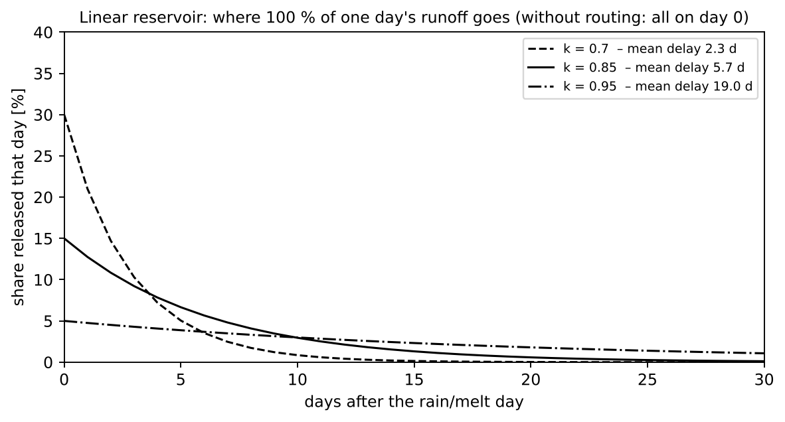
Routing: why it is needed and what k means
=> Discrete linear reservoir. Mean delay = k / (1 − k) days. Without routing, all water leaves on day 0.
CARRA runoff = water produced on the ground that day; the river needs days to drain it
Linear reservoir (a bucket with a hole):
Q(t) = k · Q(t−1) + (1 − k) · R(t) · A / 86 400 000
Each day a share (1 − k) of the stored water leaves
k = 0.85: 15 % on the first day, mean delay ≈ 5.7 days
The volume is unchanged – only the timing
k = 0.85 is a starting value, not calibrated
Notes:
CARRA's runoff has no travel time. On a rainy day the whole day's runoff would arrive at the sea the same day, and on the next dry day the river would drop to almost zero. Real rivers rise and fall more slowly

Slide 7
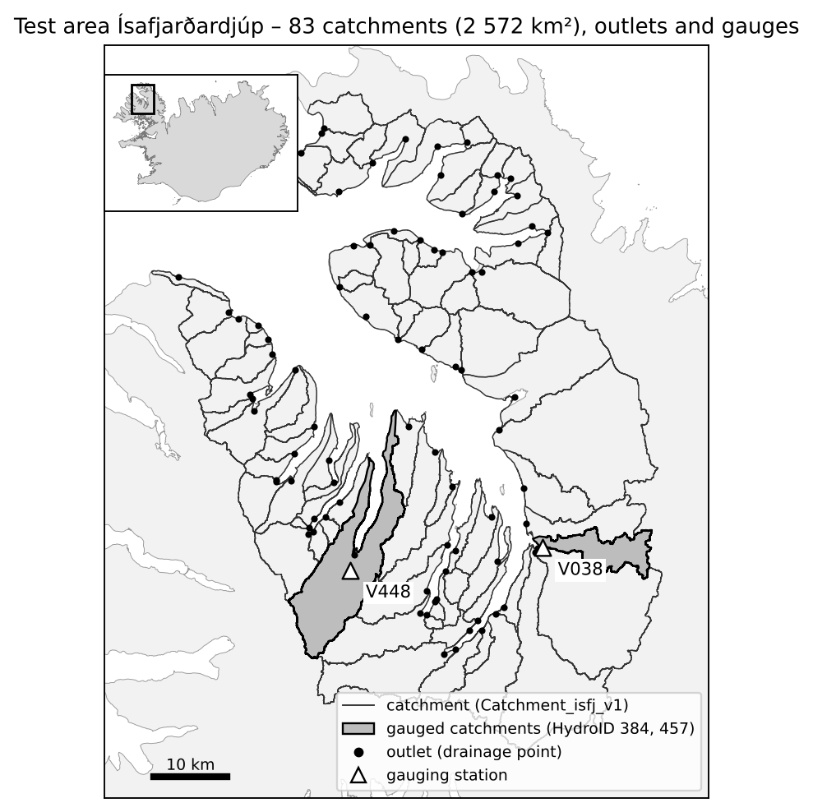
Test area: Ísafjarðardjúp (Westfjords)
83 catchments, 2 572 km², each with one outlet at the coast
Gauges with daily data (VÍ), compared on the catchment above the gauge:
  V038 Þverá – catchment to the sea 47.0 km², above the gauge 44.7 km²
  V448 Fjarðará – catchment to the sea 144.0 km², above the gauge 60.1 km² – the gauge sees only 42 % -- LamaH-Ice used for this
  V148 Fossá, East Iceland – 113.5 km²
Test years
  1991: CARRA daily runoff, no percolation included
  2023: CARRA daily runoff, included percolation and weighted catchment
Notes:
The test area is the whole Ísafjarðardjúp fjord system: 83 catchments from the coast inland, 2 572 km² in total. Areas computed in ISN93. Catchments made in ArcGIS Pro / Arc Hydro from IslandsDEM (12/2025); one outlet per catchment where the river reaches the sea.
Correction made on 14/10: a gauge measures only the water from the area ABOVE it. Our test catchments go down to the sea. For V448 the catchment to the sea is 144 km², but the gauged area is only 60 km² (LamaH-Ice). Comparing them made Method A look 41 % too high. All comparisons now use the gauge catchments from LamaH-Ice (Helgason & Nijssen 2024): V038 44.7 km², V448 60.1 km², V148 113.5 km². V148 (Fossá at Eyjólfsstaðir, East Iceland) is a third gauge outside the test area.
2023 gauge data: flags G and E used; 79 days at V38 and 108 at V448 are flagged as estimated.

Slide 8
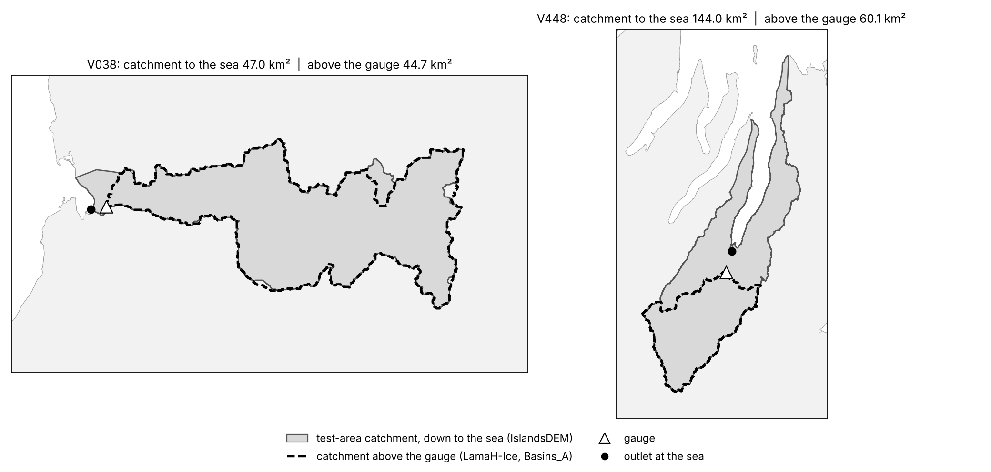
Results 2023
PBIAS – volume
(Σ model − Σ measured) / Σ measured × 100 %
> 0: too much water
< 0: too little
|PBIAS| < 25 %: satisfactory (monthly streamflow, Moriasi et al. 2007)
KGE – overall
1 − √((r−1)² + (α−1)² + (β−1)²)
r correlation, α variability ratio, β bias ratio
1 = perfect
> −0.41: better than the mean flow (Knoben et al. 2019)
Gauge | Method | Volume (PBIAS) | KGE routed | KGE direct
V038 Þverá 44.7 km² | A | −31 % | 0.45 | 0.53
 | B | −17 % | 0.50 | 0.31
 | C | −22 % | 0.58 | 0.28
V448 Fjarðará 60.1 km² | A | −17 % | 0.68 | 0.50
 | B | -8 % | 0.71 | 0.36
 | C | -16 % | 0.53 | 0.31
Notes:
Volume (PBIAS): all methods give too little water at the Westfjords gauges.
KGE: one overall score. 1 is perfect, and −0.41 is what you get by always using the mean. Ours are 0.45–0.71 with routing.
V038, Method A: NSE improves, but KGE drops a little: routing smooths the swings (α moves further from 1), and the volume is still −31 %.
V448, Method A: Peaks come too early or too sharp. Routing moves them to the right days, so NSE jumps up.
PBIAS answers "how much water in total" – the most important number for HAFRO (freshwater volume). Positive = the model gives more water than measured.
KGE (Gupta et al. 2009) splits the error into three parts: timing (correlation r), size of the ups and downs (α = std model / std measured), and volume (β = mean model / mean measured).
Note: KGE = 0 is NOT "as good as the mean". Using the mean flow as a model gives KGE ≈ −0.41 (Knoben et al. 2019). So KGE 0.5 is clearly better than the mean.

Slide 9
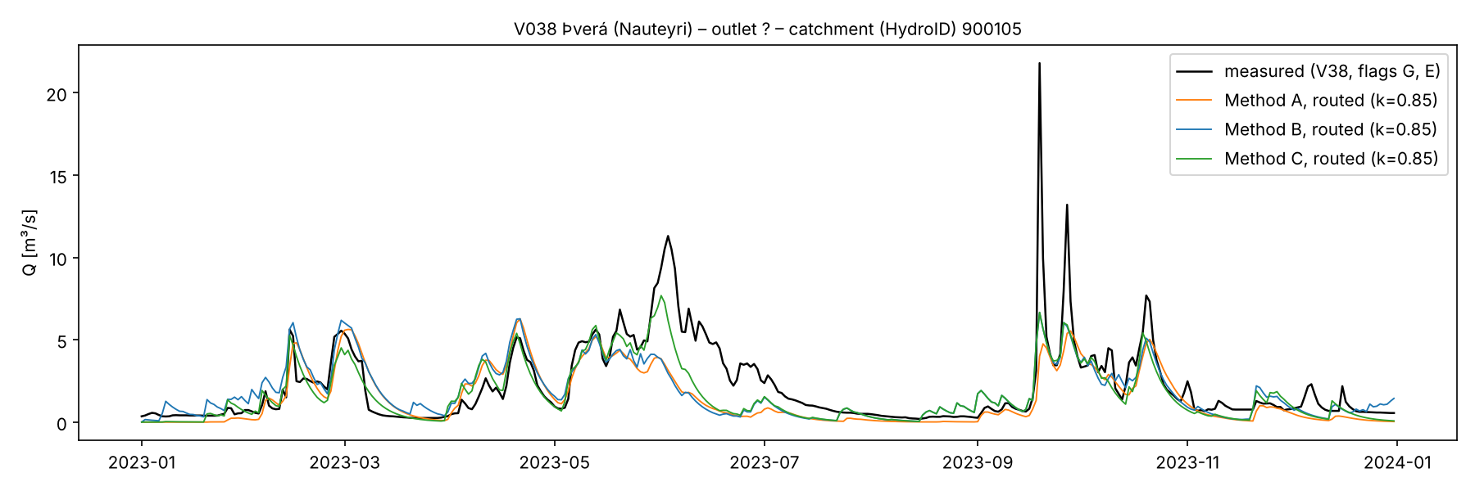
Daily discharge 2023: V038 Þverá
Timing of rain and melt events is right (Feb–May, Sep–Oct)
Early-summer melt peak (June, up to 11 m³/s) missing in all methods → too little water May–August
March–April: modelled flow higher than measured (melt too early)
Notes:
Black = measured, colours = the three methods, routed with k = 0.85, on the 44.7 km² catchment above the gauge.
- Events in winter and autumn are caught at the right time and roughly the right size.
- The June peak (snowmelt from the higher parts) is missing: the models melt the snow earlier (March–April too high). Method C (green) gets part of it.
- The September peak of 22 m³/s is underestimated: a heavy local rain event that CARRA's 2.5 km precipitation does not fully show.

Slide 10
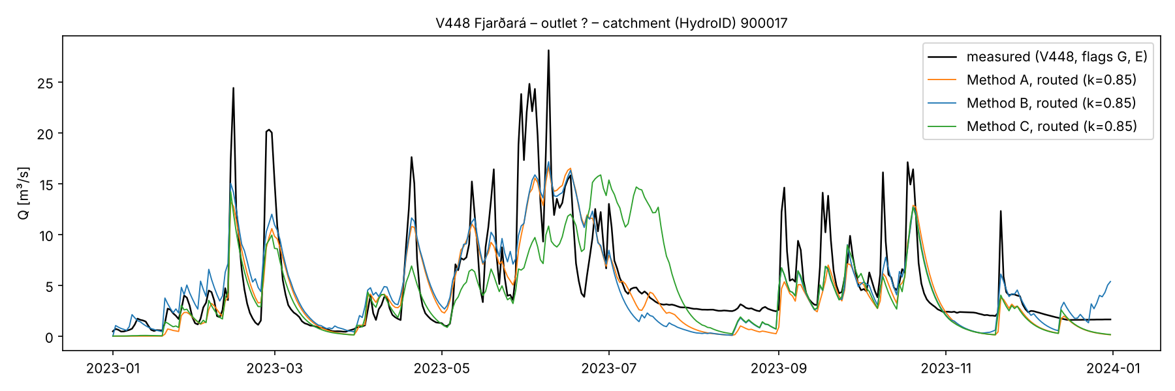
Daily discharge 2023: V448 Fjarðará
Measured discharge: Icelandic Met Office (VÍ) data, for use within this project only.
On the correct area (60 km²) the size of the peaks fits well (KGE A 0.68 routed)
In dry periods measured flow stays at 2–3 m³/s, the models drop to < 1 m³/s → missing slow groundwater flow
Notes:
On the 60.1 km² above the gauge the modelled peaks have about the right size and timing.
Baseflow: in July–August and November–December the river stays at 2–3 m³/s while the models fall below 1 m³/s. One linear reservoir cannot give both a fast reaction after rain and a slow, steady groundwater flow; a second, slow reservoir could fix this later.

Slide 11
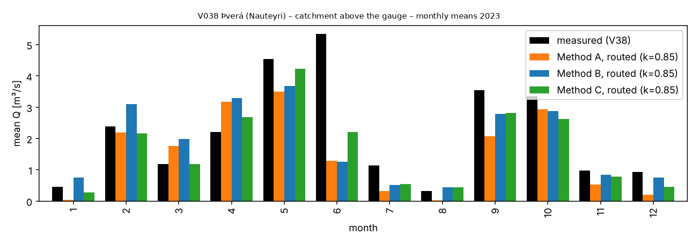
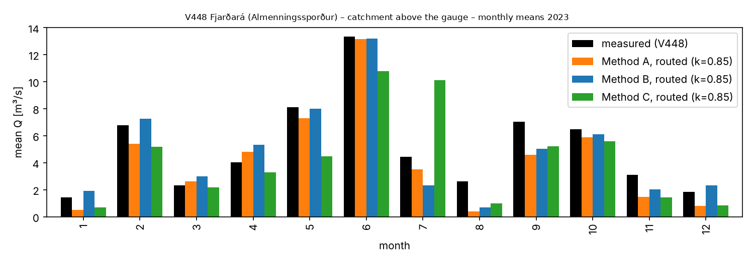
Seasonal pattern: monthly means 2023
V038: under in June–August, over in March–April
V448: close in most months; too low in late summer (baseflow)
Same seasonal shape in all methods

Slide 12
Which method? Fit, data and computation
 | A Direct CARRA runoff | B Water balance | C Degree-day snow
Fit 2023, gauge catchments V038 / V448 | volume −31 / −17 | volume −17 / −8 | volume −22 / −16
Parameters | none | 1 (C) | 3 (C, DDF, T₀)
CARRA data per year | 2 variables, ≈ 1 GB | 3 variables, ≈ 4 GB | 5 variables, ≈ 6 GB
Computation | lowest: add and multiply | low | low (day-by-day snow account)
Pros | uses CARRA's full water balance incl. soil storage; nothing to tune; easy to repeat for any year | simple, transparent budget | best timing of snowmelt at V038
Cons | depends fully on CARRA's land model; no lakes, no groundwater across divides | negative days set to 0 add water (≈ 24 % of the yearly runoff); no soil storage | uncalibrated parameters; most data; no soil storage
Proposal/Conclusion:
Method A + routing for the delivery (whole Iceland).
B and C kept as cross-checks.
Calibrate k and quantify the bias on more gauges (LamaH-Ice: 107 gauged catchments, daily flow to 2021 → years 1991–1994, 2017–2018).

Slide 13
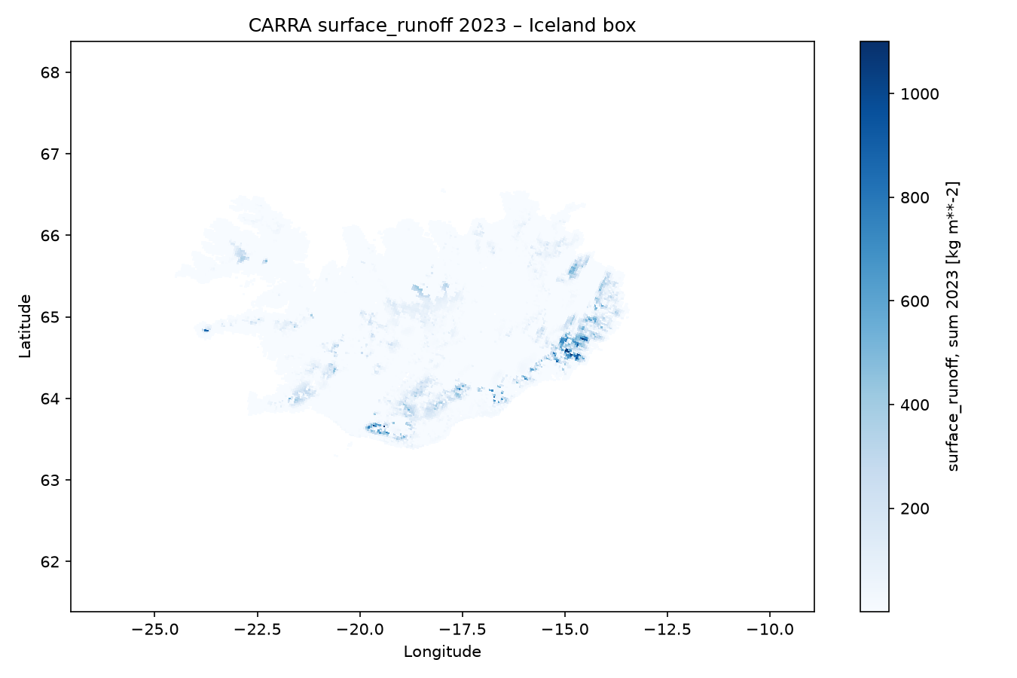
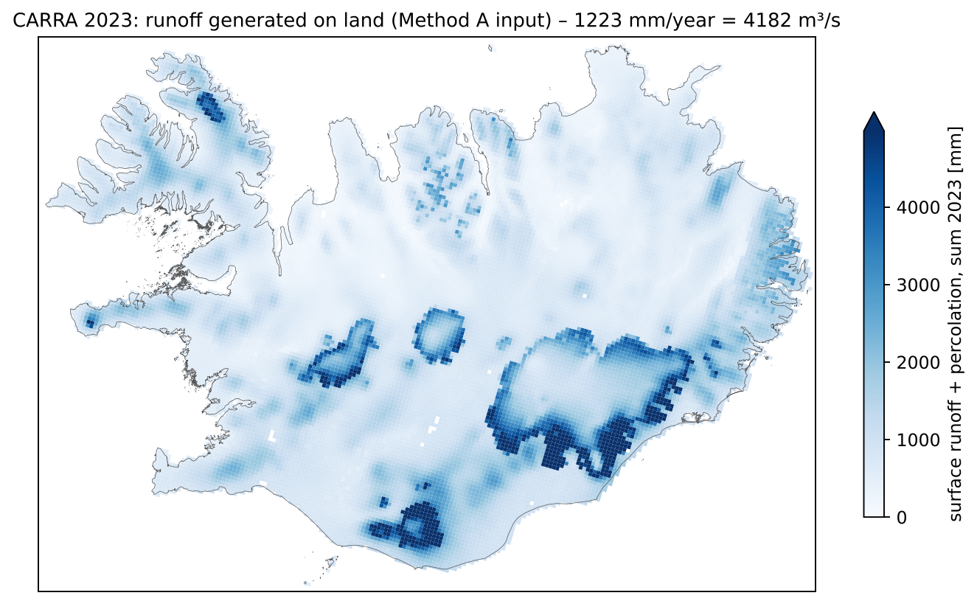
CARRA runoff over the whole of Iceland, 2023
Left: surface runoff only (notebook 01). Right: surface runoff + percolation = Method A input, ISN93.
Runoff from all land cells 2023: ≈ 4 200 m³/s (≈ 1 220 mm/year); surface runoff only ≈ 90 m³/s
Reference: modelled mean 1961–1990 ≈ 4 770 m³/s, 1 460 mm/year (Einarsson & Jónsdóttir, WaSiM) – other period and model, same order
Notes:
Left: the map from notebook 01 – surface runoff only, sum 2023. It looks almost empty because surface runoff is small (27 mm/year on average); the water is in percolation.
Right: surface runoff + percolation, the input of Method A, on the CARRA cells in ISN93.
Country total (my calculation from the 2023 daily file): every land cell × its yearly runoff → ≈ 4 182 m³/s (surface 91, percolation 4 091); area-weighted 1 223 mm/year. It counts coastal cells in full (≈ 107 900 km² of cells), so it is rough.
Reference: Einarsson & Jónsdóttir (VÍ, WaSiM model) give a mean discharge for the water years 1961–1990 of 4 770 m³/s or 1 460 mm/year. Different period and model, but the same order of magnitude – CARRA is about 12 % lower here. This is a plausibility check, not a validation.
This total is also the check for the whole-country run: the sum over all outlets must equal this number (minus sea-cell effects) whichever catchment layer we use.

Slide 14
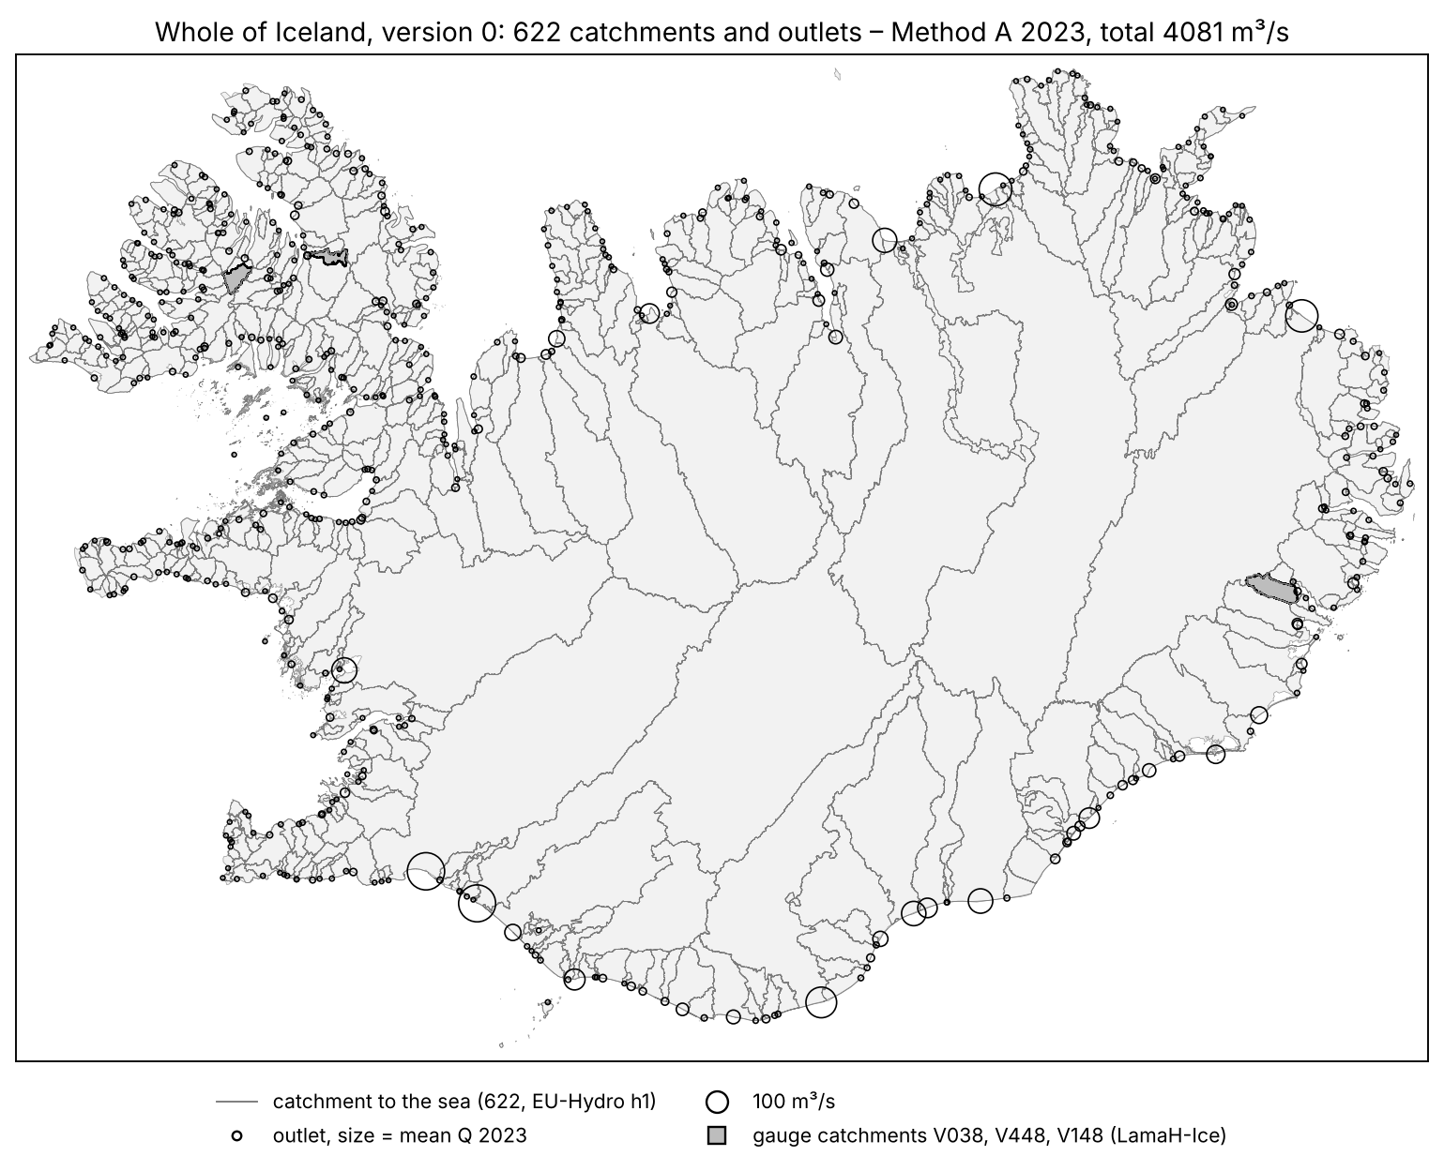
Whole of Iceland, version 0: catchments and outlets
Catchments: EU-Hydro basins to the sea (iceland_eudem2_basins_h1, Copernicus), not edited
  632 basins → 622 (10 inland basins merged with a neighbour)
  102 642 km²; 689 km² of IS 50V land not covered (coastline differences)
Outlets: 523 EU-Hydro river mouths (longest river), 95 points on the coast, 4 to check
River names from the VÍ WFD river layer – indicative
The layer decides where the water enters the sea, not how much
Notes:
Built on 14/10 (workflow_hydrography notebook 01):
- Catchments: the EU-Hydro drainage-network product for Iceland (Copernicus, layer iceland_eudem2_basins_h1). Level h1 = basins draining to the sea. 1 545 polygons with 632 IDs; dissolved by ID → 632 catchments. 10 of them never touch the coast (closed inland basins, 2 445 km², the largest north of Vatnajökull, 1 740 km²); for v0 each was merged with the coastal neighbour sharing the longest border – to be checked.
- Coverage: 102 642 km² against 102 713 km² of IS 50V land; 689 km² not covered (small islands, coast drawn differently in EU-DEM).
- Outlets: EU-Hydro "Outlet" nodes (river mouths); per catchment the mouth of the river with the longest upstream network. 95 catchments have no river mouth: point in the middle of their coast. 4 got a point inside (no coast found) – to check in QGIS. Outlet ID = catchment ID.
- Names: from the VÍ WFD river layer (same WFD code as the EU-Hydro river, or the longest VÍ river in the catchment). Indicative only; e.g. the Ölfusá basin is labelled Stóra-Laxá.
- Grey patches: the three gauge catchments used for the validation.

Slide 15
First result for the whole of Iceland: Method A, 2023
Outlet (catchment ID) | Area km² | Model A 2023 m³/s | Published mean m³/s
Ölfusá (100542) | 6 193 | 310 | 440
Þjórsá (100559) | 7 611 | 305 | 383 (natural)
Jökulsá á Fjöllum (100357) | 8 324 | 239 | 212
All 622 outlets | 102 642 | 4 081 | ??
Files ready: CSV + NetCDF, 622 outlets × 365 days = 227 030 rows, direct and routed
Sum over outlets = 98 % of CARRA land runoff (4 182 m³/s) – the rest: land outside the layer, coastal cells
Large southern rivers lower than the published means, as at the gauges → Method A tends to too little water
Published: NATT river pages (mean, other years); Einarsson & Jónsdóttir (VÍ)
Notes:
What we have now (run 14/10/2026, Method A, 2023): daily discharge for 622 outlets around the whole coast, in the agreed format (CSV + NetCDF, the same structure as the test file sent to Masoumeh).
Checks:
- 227 030 rows = 622 × 365, no gaps, no negative values; CSV and NetCDF equal the model output.
- Sum of mean discharge over all outlets 4 081 m³/s; CARRA land runoff over all land cells 4 182 m³/s → 98 %. The 2 % missing: 689 km² of land outside the EU-Hydro layer and coastal cells partly on sea.
- Large rivers against published long-term means (other years, so only order of magnitude): Ölfusá 310 vs 440 m³/s (−30 %), Þjórsá 305 vs 383 (−20 %), Jökulsá á Fjöllum 239 vs 212 (+13 %).
- Consistent with the gauges: Method A tends to give too little water. This will be reported as uncertainty, not corrected.
Not yet: hand check of outlets and names, 2017/2018, calibration of k.

Slide 16
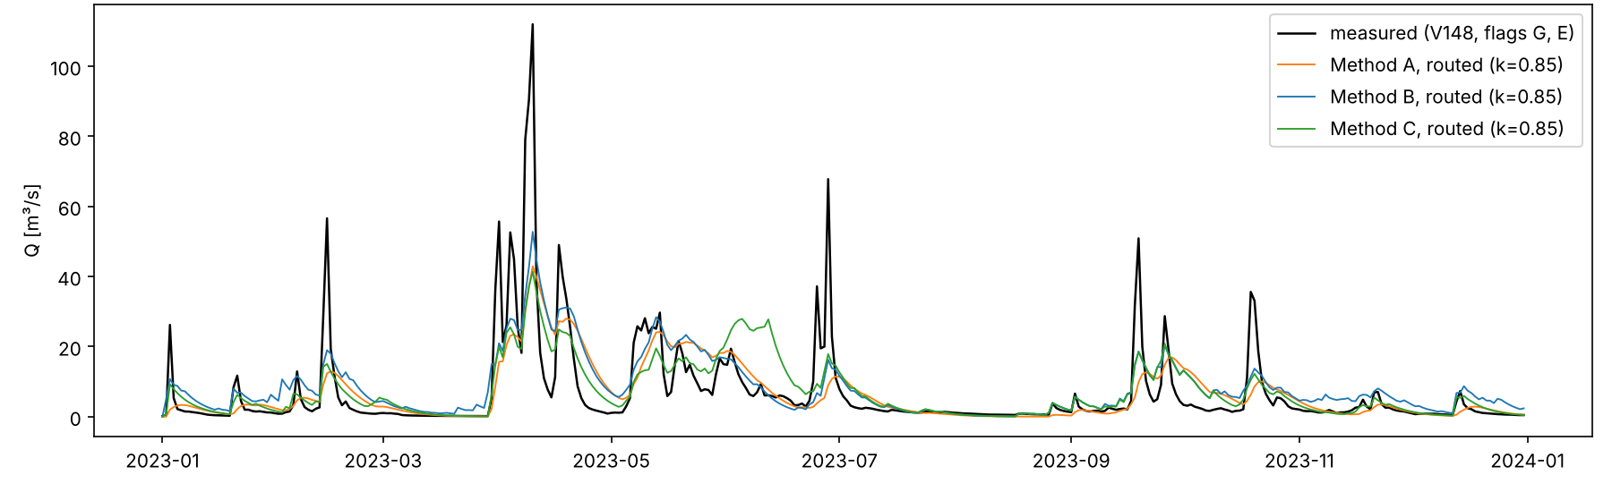
Third gauge outside the test area: V148 Fossá (East Iceland)
Measured discharge: Icelandic Met Office (VÍ) data, for use within this project only.
Catchment above the gauge 113.5 km² (LamaH-Ice 109.7 km²); volume: A −5 %, B +17 %, C +2 %
Fast river: without routing Method A KGE 0.84; with k = 0.85 only 0.48 → k must differ between rivers
Notes:
V148 (Fossá at Eyjólfsstaðir) is in East Iceland, not in the test area. Its measured series was in the HAFRO workbook from the start; with the whole-Iceland run it can be compared on its own gauge catchment.

Slide 17
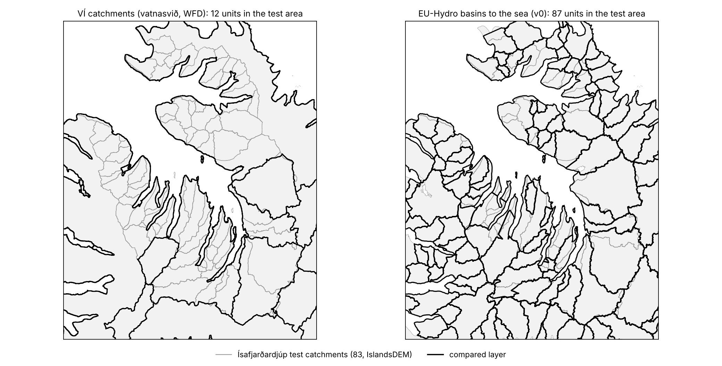
Catchment layers compared in the test area
VÍ catchments (WFD): 12 units for the whole fjord – too coarse for river outlets
EU-Hydro basins: 87 units, similar to our 83 test catchments
Both drawn from coarser DEMs than IslandsDEM
→ EU-Hydro as version 0; VÍ layer for WFD codes and names
Notes:
Left: the VÍ catchments (vatnasvið, 141 for the whole country, median 376 km²). In the test area there are 12 units: whole stretches of the fjord coast are one unit, so many rivers would share one outlet.
Right: the EU-Hydro basins to the sea (v0): 87 units in the same area, close to our 83 Arc Hydro catchments. The borders differ in places (coarser DEM).
That is why v0 uses EU-Hydro. The VÍ data are the official WFD layer: we use its river water bodies for names and WFD codes.

Slide 18
Options for the country-wide catchment layer
Source | Coverage | Detail | Status | Use
VÍ catchments | whole country, 141 units | coarse: 12 units in the test area | not sufficient for outlets | WFD codes, names
EU-Hydro basins h1 (Copernicus) | whole country, 622 to the sea | 87 units in the test area | used for v0 (14/10) | version 0
LamaH-Ice basins | 107 gauged basins | good | public; daily flow to 2021 | validation, not outlets
Ísafjarðardjúp layer | test area | detailed (IslandsDEM) | done | detailed part
New hydrography → own catchments | whole country | best | QA in progress | version 1
What is done and what left at the moment:
EU-Hydro as version 0 (done)
check outlets and names in QGIS visualy
move to catchments built from the new hydrography when it is ready
Notes:
Criteria: covers the whole coast, one outlet per catchment at the sea, no gaps or overlaps. Detail matters less because CARRA cells are 2.5 km.
- VÍ: coarse; failed in the test area.
- EU-Hydro basins (Copernicus, iceland_eudem2_basins_h1): used for version 0 on 14/10 – 622 catchments to the sea.
- LamaH-Ice (Helgason & Nijssen): 107 gauged basins with daily streamflow – good for validation and calibrating k, but it stops at the gauges, so it is not a coast-complete layer.
- Our test layer stays as the detailed part.
- Long term: own catchments from the new hydrography + IslandsDEM.
Method A is cheap, so we can run both v0 layers and compare the per-outlet differences.

Slide 19
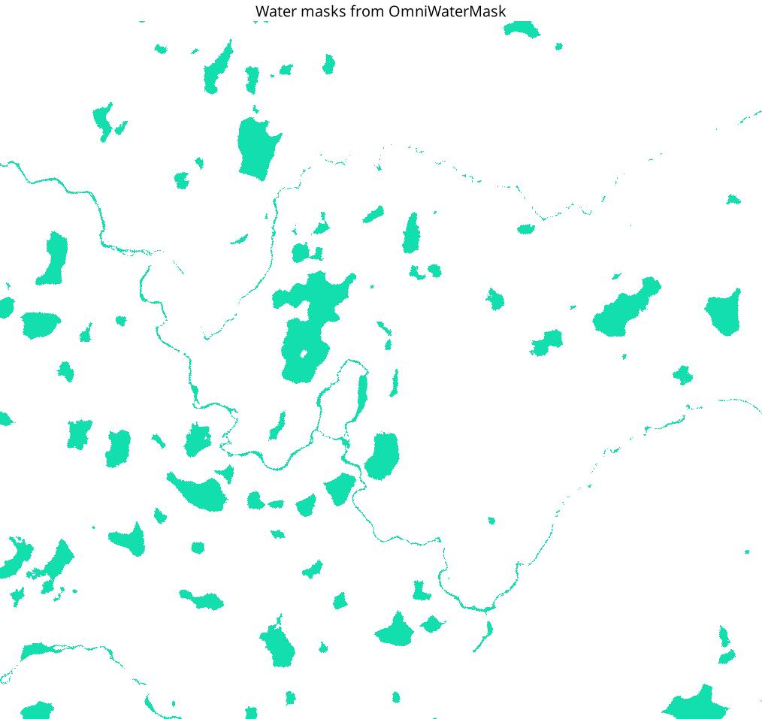
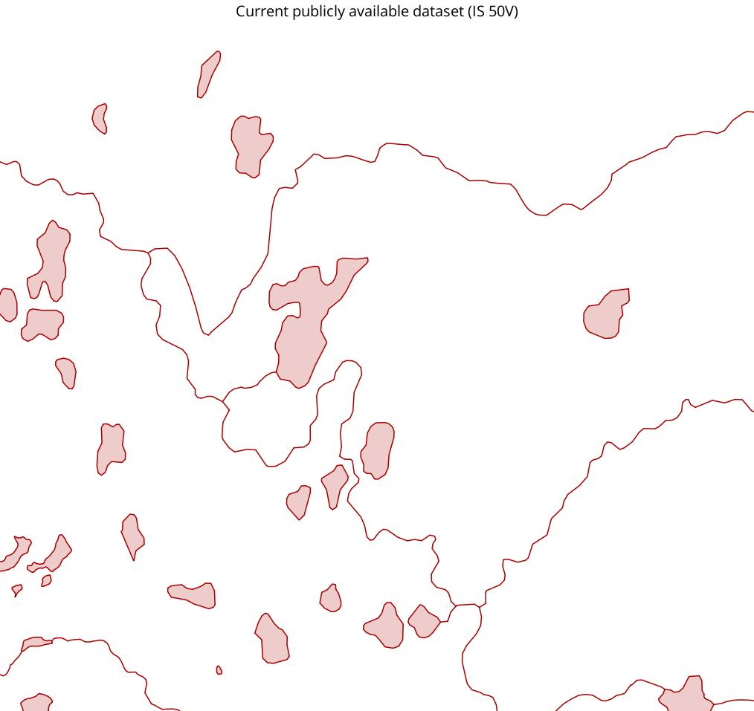
New hydrography basis: water mask by Ragnar (VÍ, Glóð)??
OmniWaterMask (deep learning + water index + vector data; Wright et al. 2025)
Input: Copernicus Contributing Missions VHR 2024 images, 2 m, from 2023–2025, the whole of Iceland
Ragnar Heiðar Þrastarson, Icelandic Met Office, Aug 2026
We are now going through the layer (QA)
In my view an excellent basis for the hydrography update → better rivers and lakes → better catchments and outlets
Same area: OmniWaterMask (left) and IS 50V (right). Figures: R. H. Þrastarson.
Notes:
What Ragnar did (from his notebooks, August 2026, part of the Glóð initiative):
- He ran the open-source OmniWaterMask model (Wright et al. 2025, ISPRS Journal) on cloud-free very-high-resolution satellite images of Iceland: the Copernicus Contributing Missions collection VHR_IMAGE_2024, 2 m pixels, images from 2023–2025, available to national public authorities.
- OmniWaterMask combines a deep-learning segmentation with a normalised difference water index (NDWI) and existing vector data (e.g. OpenStreetMap) to find water.
- He ran it on a GPU machine for the whole country; the result is a water mask per image tile (in EPSG:3035). He compared it with IS 50V, OSM and hand-digitised lakes, and tested a version with and without OSM.
- The pictures: same area, left the water found by the model, right the current IS 50V water. Many lakes and the river courses are much more complete and better placed.
Status: we are going through the layer now to see if the model needs improvement (false water, gaps, connectivity). It is not yet a network with flow direction – that is the next step (topology).
Why it matters for HAFRO: correct rivers and lakes → correct flow paths on the DEM → better catchments and outlets for the whole country.

Slide 20
Plan: from the test area to the whole of Iceland
Country-wide catchment layer v0 – jup, done
EU-Hydro basins, 622 catchments and outlets; next: hand check of outlets and names
1
Method A, 2023, all outlets – done
4 081 m³/s, files in the agreed format; HAFRO feedback wanted
2
List possible years for calculation - partially
Look how to replace the missing year - sub-daily CARRA (single levels) summed to days, then the same chain??
3
Calibrate k, quantify the bias - started
More measured data or gauges: option is to get measured data for other rivers, and/or use LamaH-Ice (daily flow to 2021) with CARRA 1991–1994 and 2017–2018,
4
5
Hydrography update → catchments v1
new water layer + IslandsDEM, then rerun --> also several options to go over: Copernicus land service layer, Ragnars layer and/or combination with LammH-ice
Delivery
CSV + NetCDF per outlet --> should I stated uncertainty
6

Slide 21
Sources
CARRA: Arctic regional reanalysis daily and monthly data (reanalysis-carra-means), C3S/CDS, doi:10.24381/43a81317; single levels: doi:10.24381/cds.713858f6
Einarsson, B. & Jónsdóttir, J. F.: Runoff modelling in Iceland with the hydrological model WaSiM. Icelandic Met Office report (vedur.is)
Gupta, H. V., Kling, H., Yilmaz, K. K., Martinez, G. F. (2009): J. Hydrol. 377, 80–91 (KGE)
Knoben, W. J. M., Freer, J. E., Woods, R. A. (2019): HESS 23, 4323–4331
Moriasi, D. N. et al. (2007): Trans. ASABE 50(3), 885–900
Nash, J. E. & Sutcliffe, J. V. (1970): J. Hydrol. 10(3), 282–290 (NSE)
Vogel, R. M. & Kroll, C. N. (1996): Water Resour. Manage. 10, 303–320 (recession constants)
Hock, R. (2003): J. Hydrol. 282, 104–115; Jóhannesson, T. et al. (1995): J. Glaciol. 41(138), 345–358 (degree-day models)
Wright, N. et al. (2025): ISPRS J. Photogramm. Remote Sens. 227, 714–732 (OmniWaterMask)
Helgason, H. B. & Nijssen, B. (2024): LamaH-Ice, Earth Syst. Sci. Data 16, 2741–2771
EEA / Copernicus: EU-Hydro v1.3 Iceland and drainage network (iceland_eudem2_basins); VÍ WFD layers (vatnasvið, river water bodies)

