Slide 1
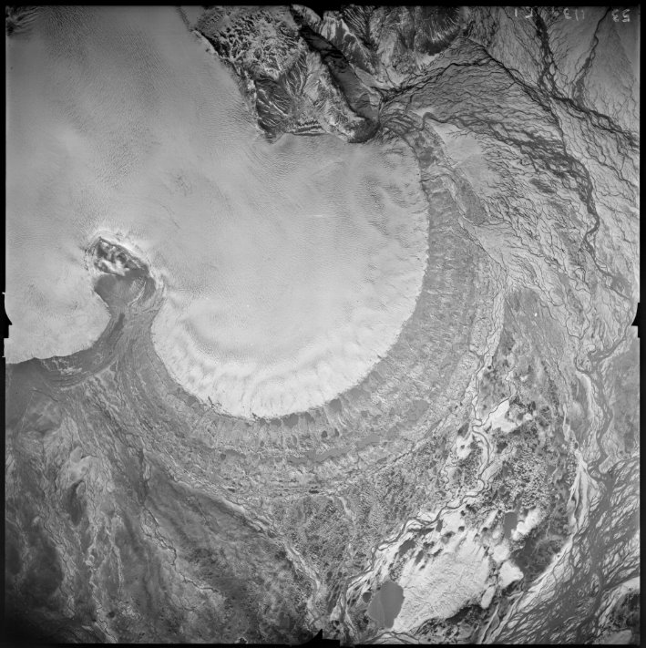
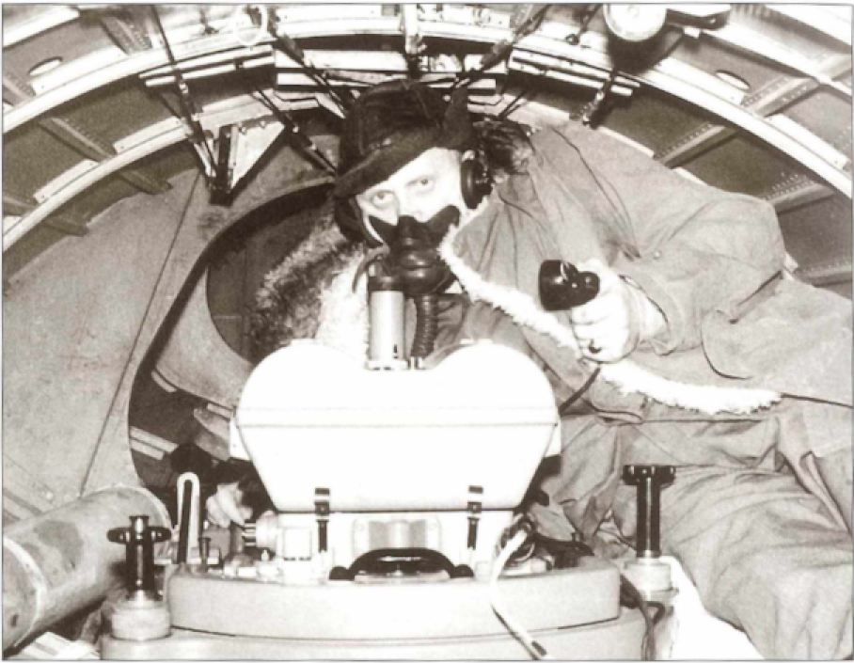
Unleashing the archive of aerial photographs of Iceland
Múlajökull (1945)
Ágúst Boðvarsson (pioneer Icelandic photogrammetrist)
Joaquín M.C. Belart, Sydney Gunnarson, Etienne Berthier, Amaury Dehecq,
Tómas Jóhannesson, Hrafnhildur Hannesdóttir, Kieran Baxter
Notes:
1

Slide 2
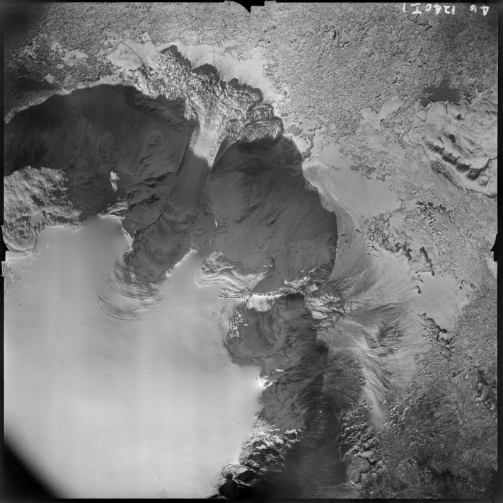
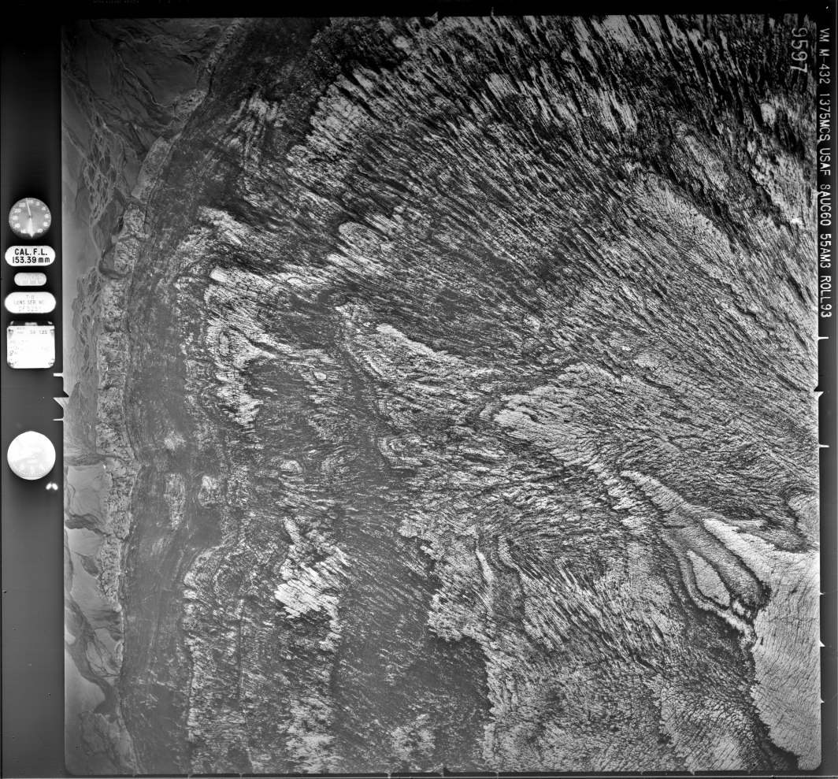
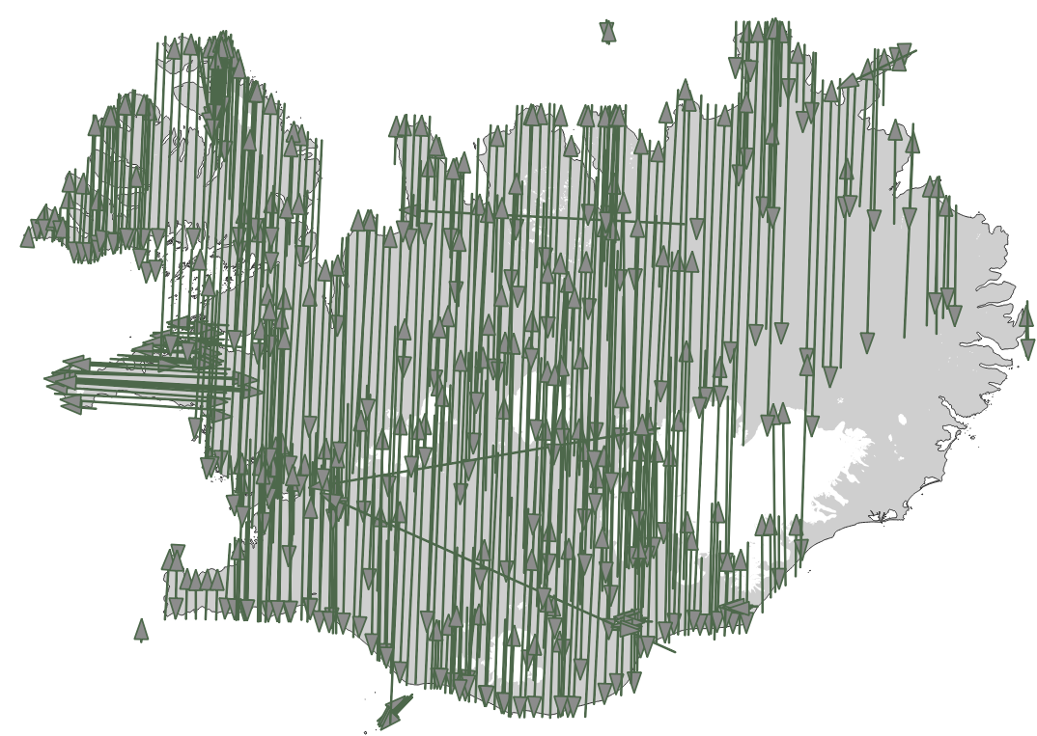
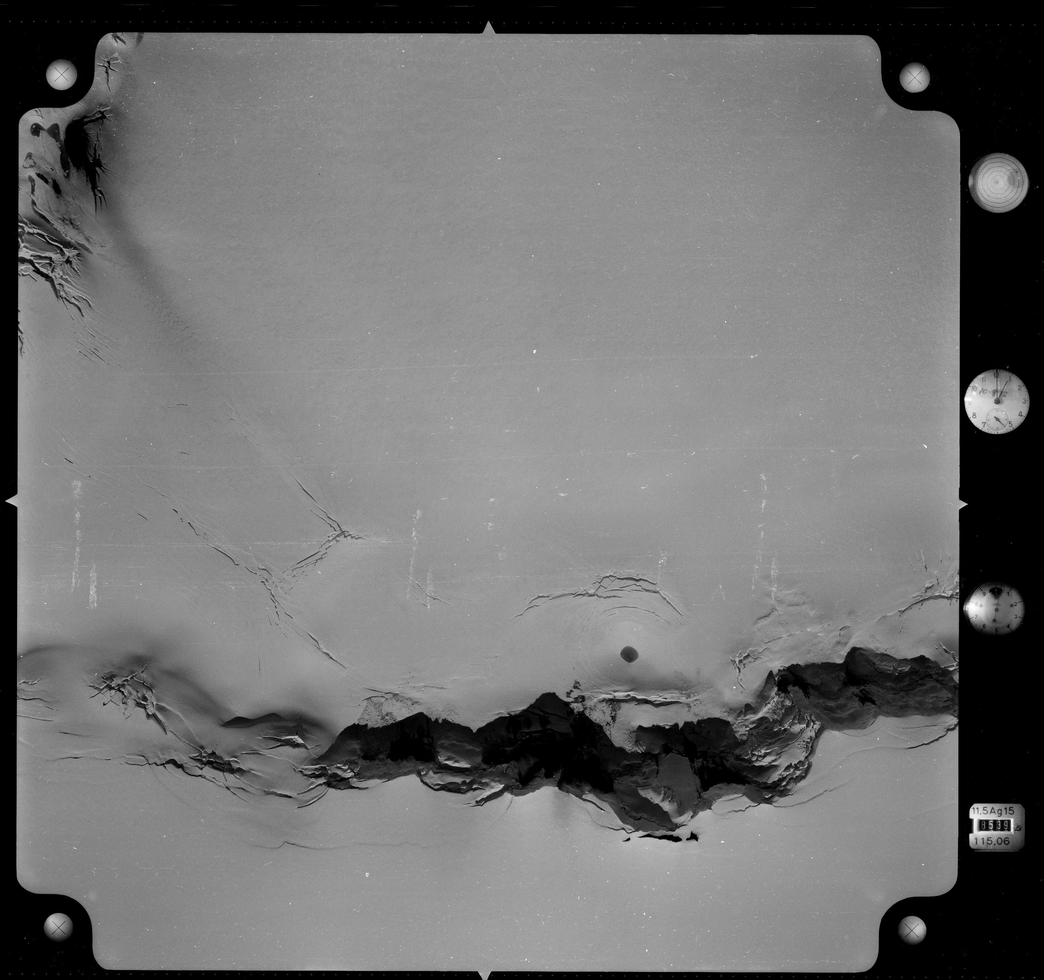
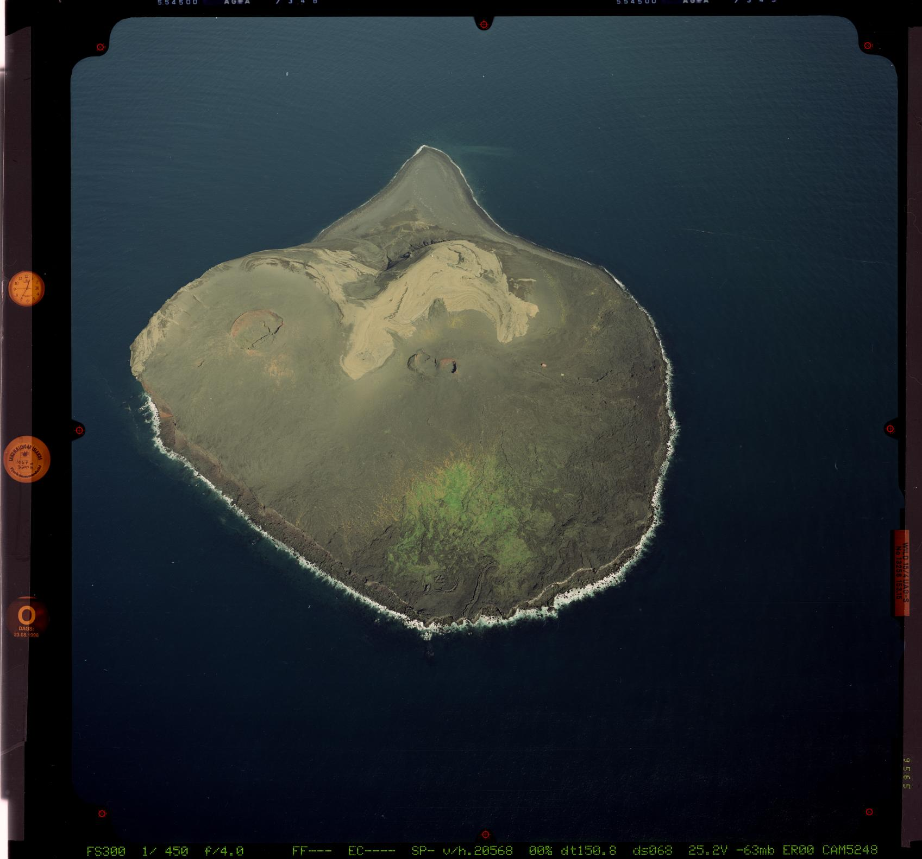
From 1945 to 2000
140,000 frames (films)
12x12 cm, 18x18 cm, 23x23 cm
128,735 frames scanned
16Tb of raw images
Eiríksjökull (1945)
Dingjujökull (1960)
Flightlines American Surveys 1956-1961
Grímsvötn (1972)
Surtsey (1998)
Notes:
2

Slide 3
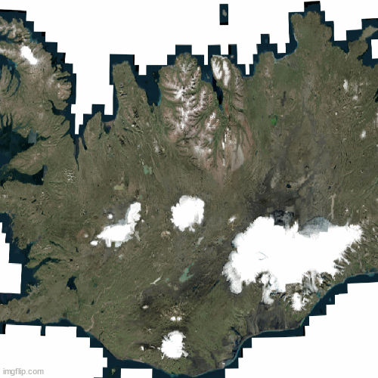
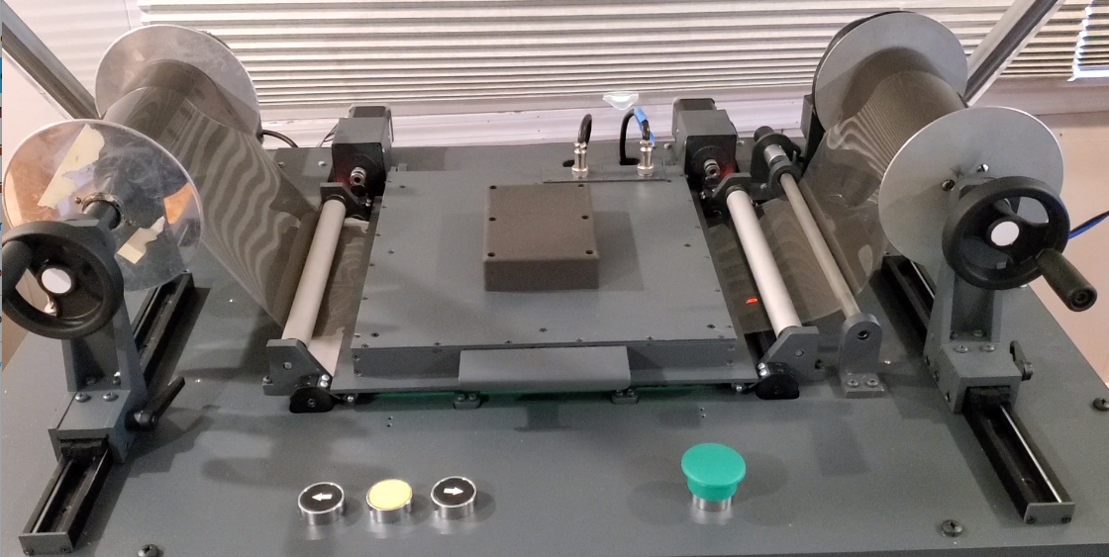
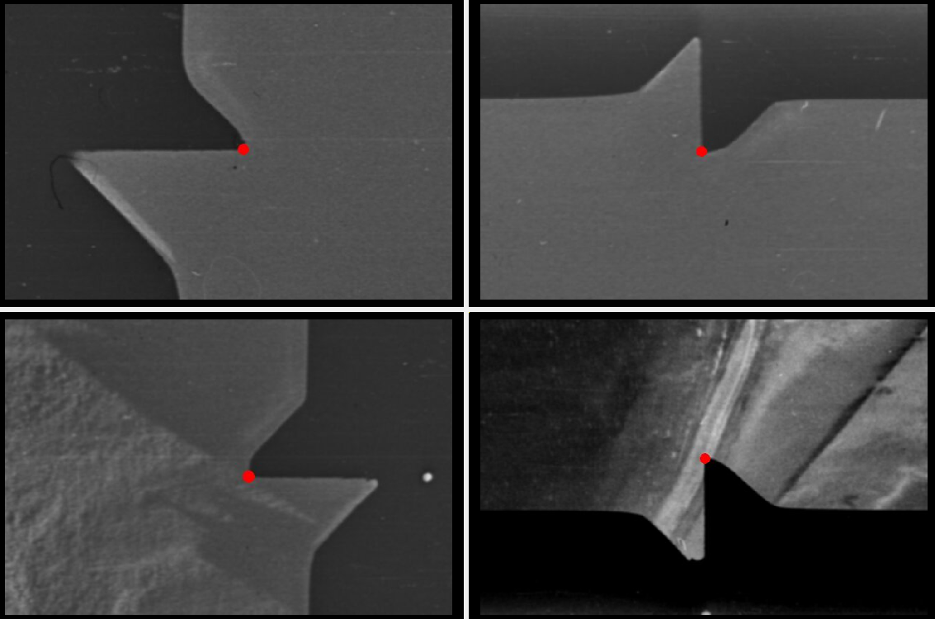
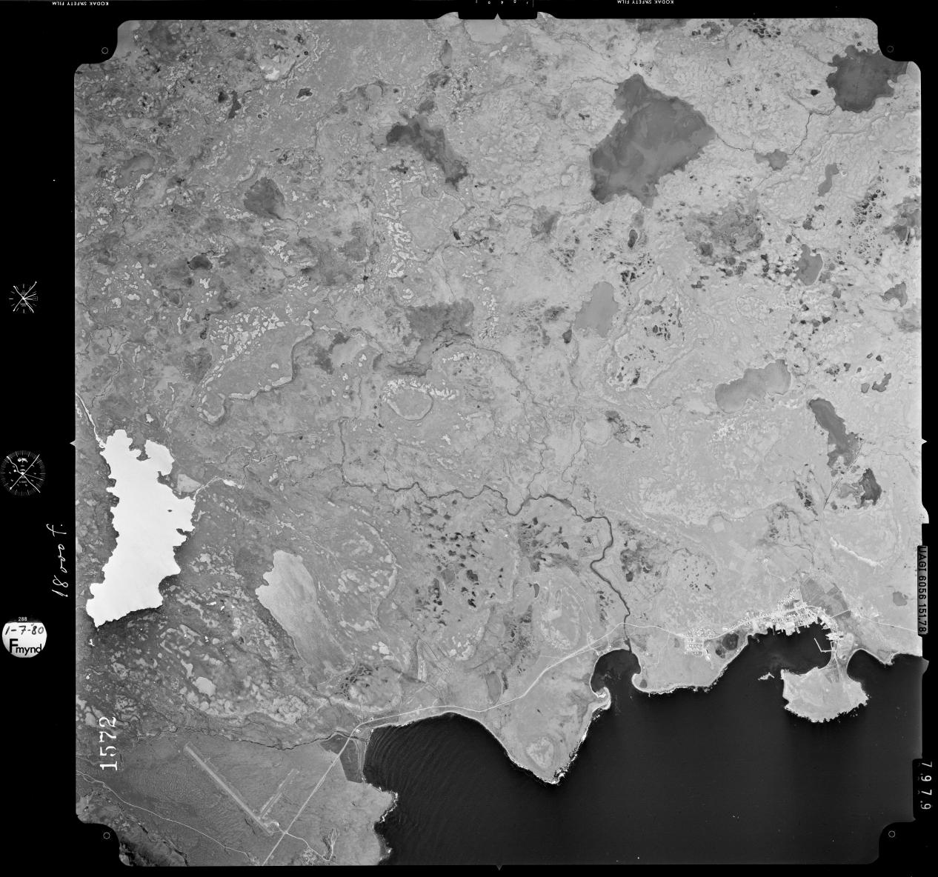
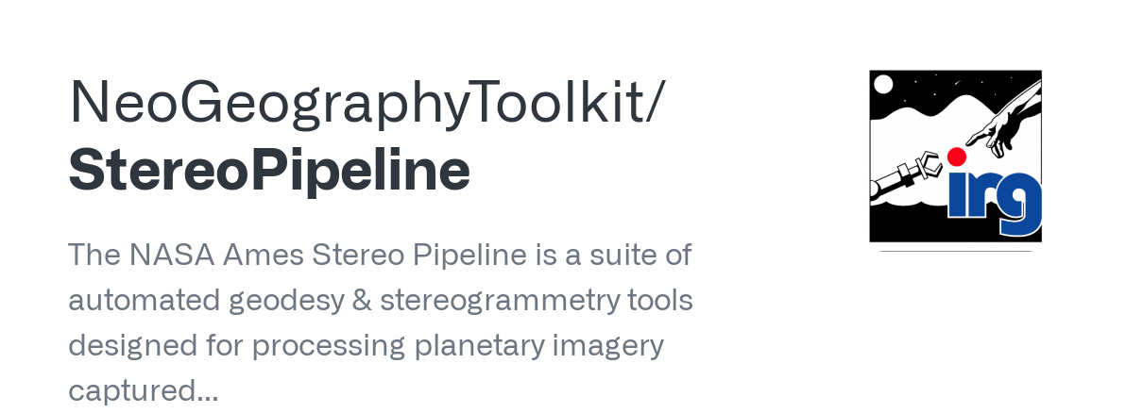
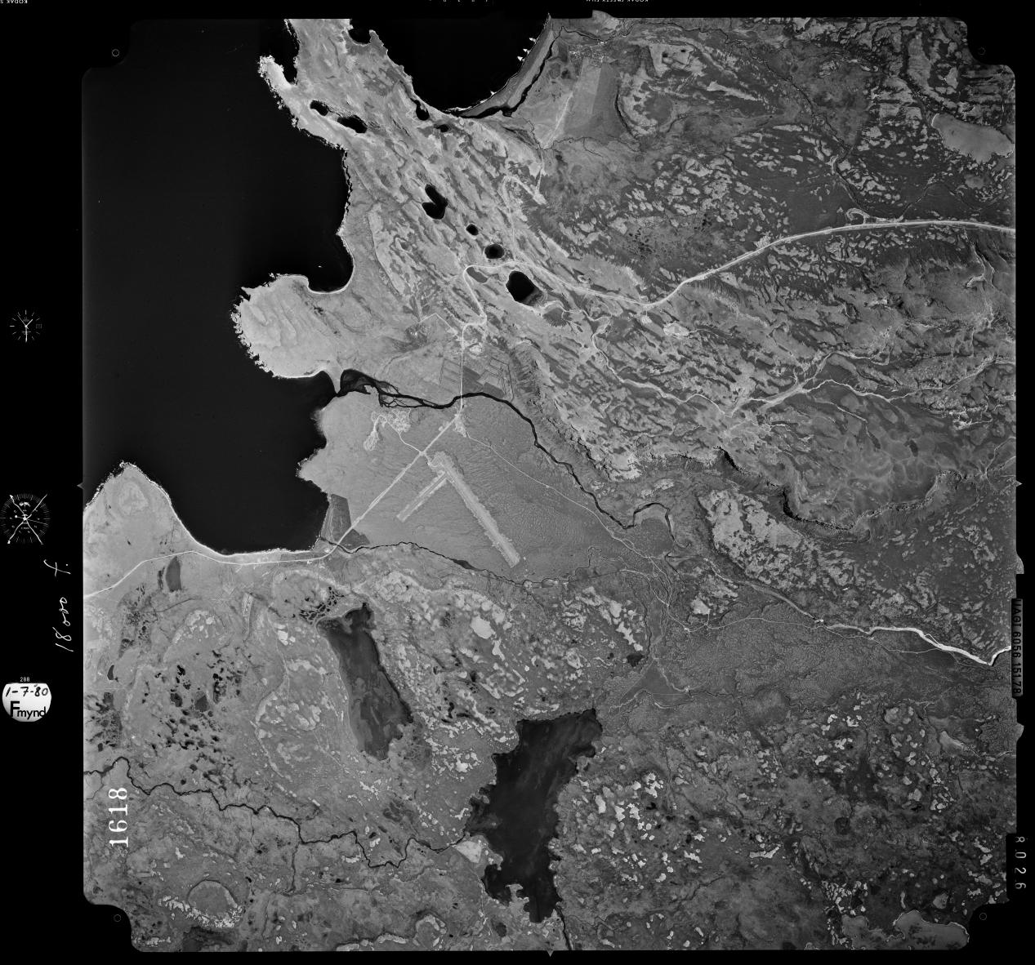
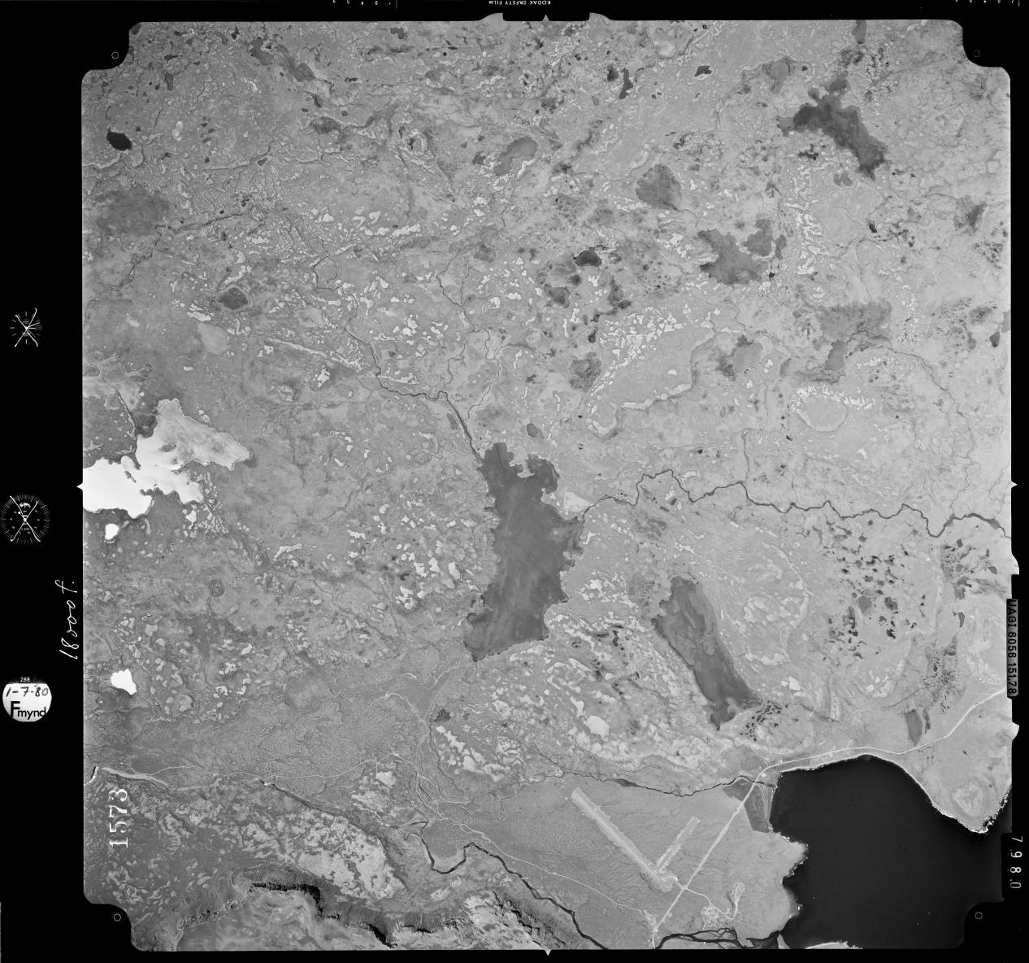
Processing
AFS150 Scanner
Fiducial detection in 1960 frames

Slide 4
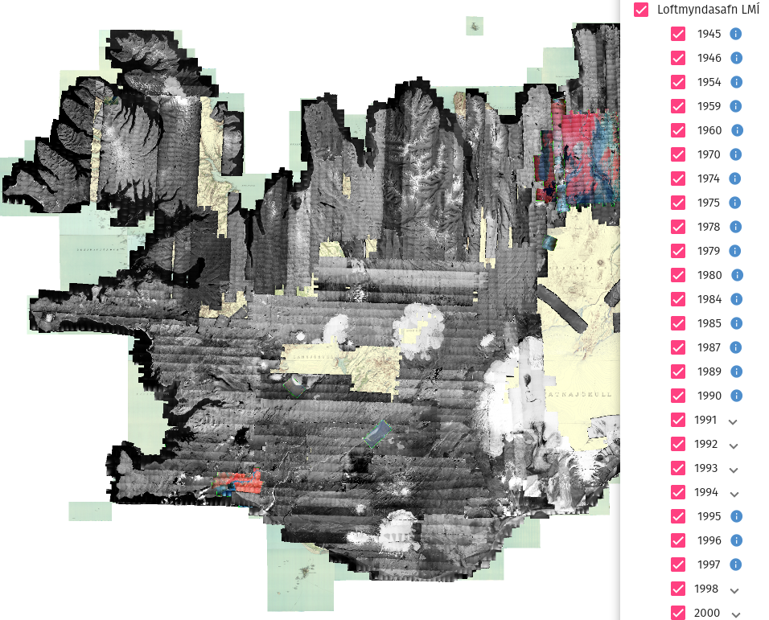
Open access
Status so far (10% done):
1,100 Orthos & DEMs
15,000 Oriented images
765 Gb of data
Validation in stable terrain:
Pléiades orthoimages
Pléiades DEMs
Lidar DEMs
Positional accuracy >10 m (XYZ)
loftmyndasja.lmi.is

Slide 5
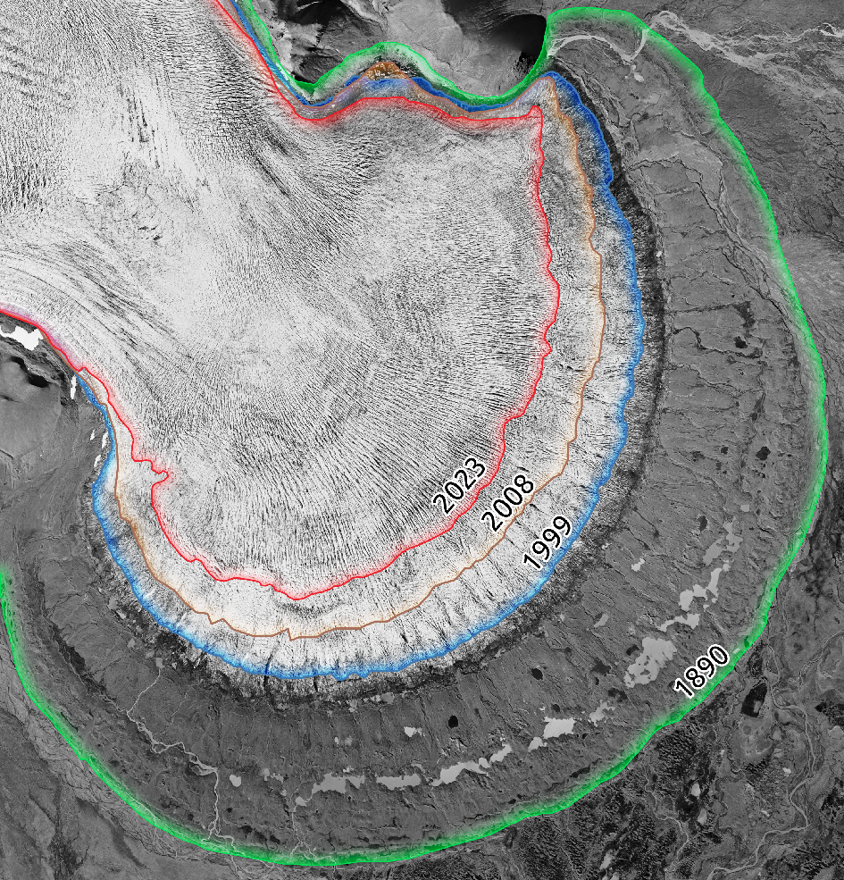
Glacier changes
Múlajökull (1995)

Slide 6
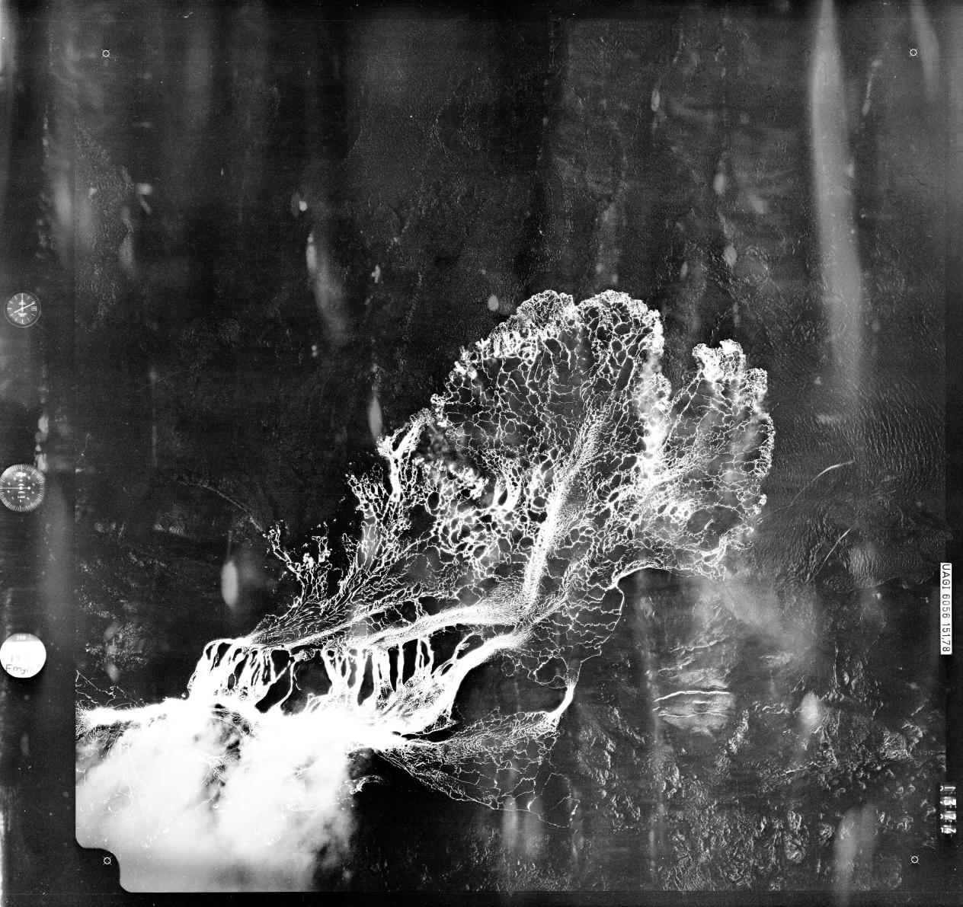
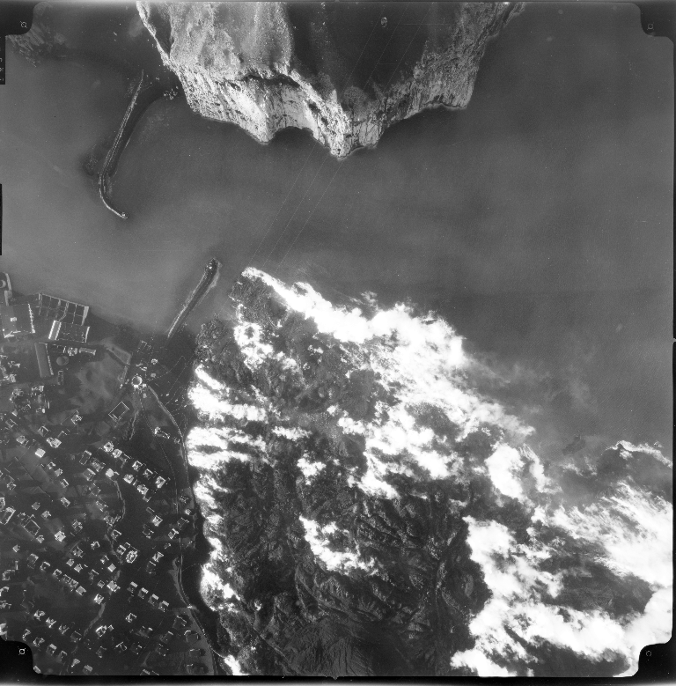
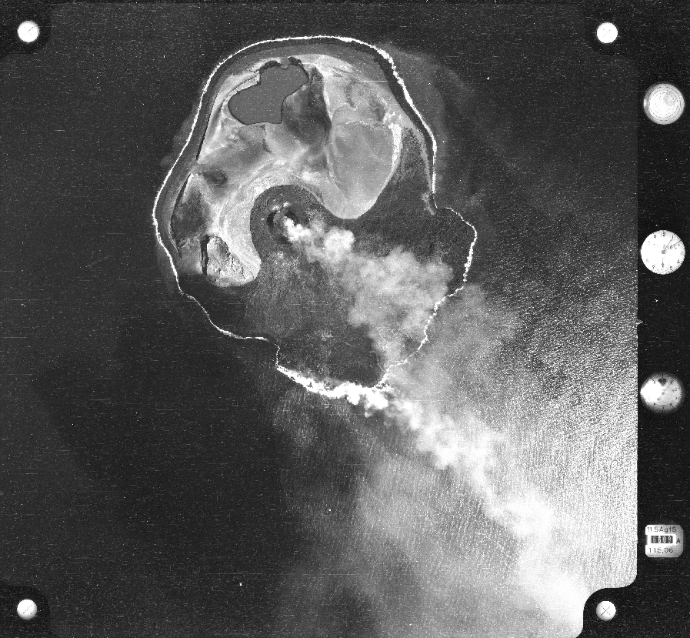
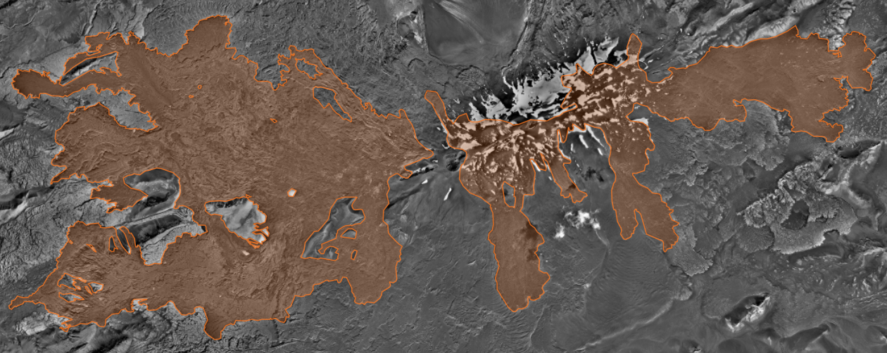
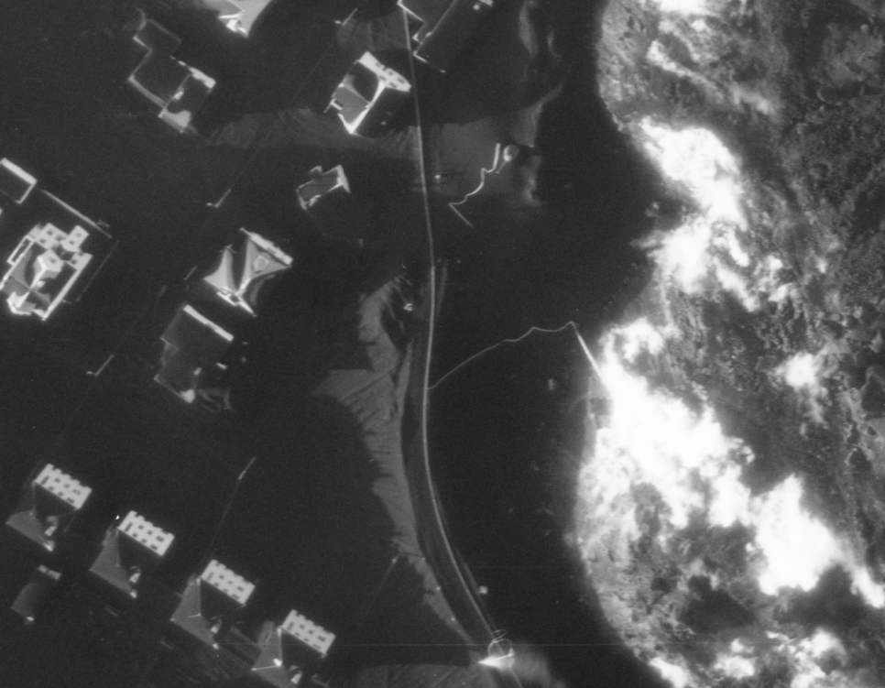
Volcanic changes
Surtsey (1964)
Krafla (1977)
Heymaey (1973)
Hekla (1960). Lava outlines from 1947
Heymaey (1973)

Slide 7
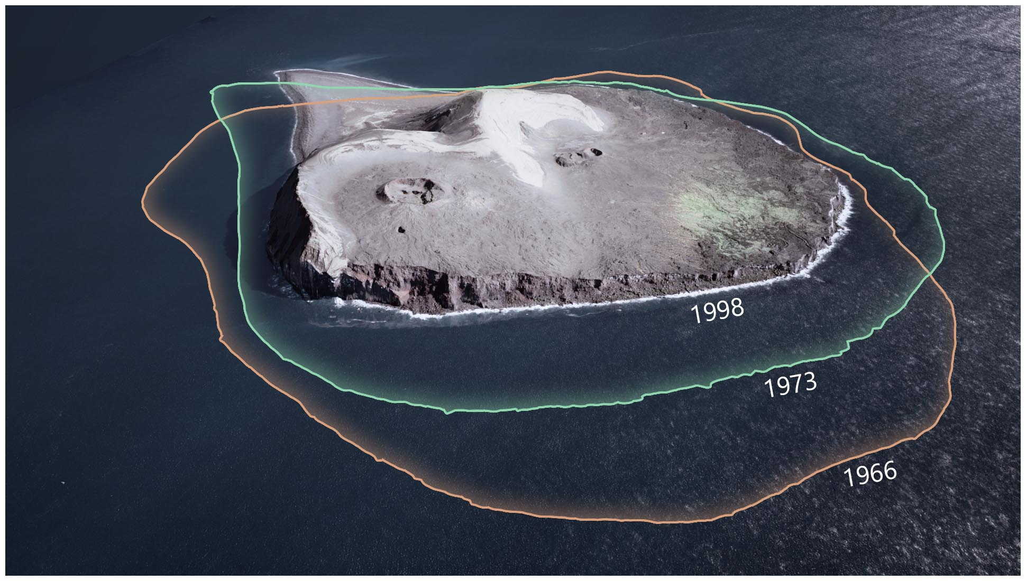
Coastal erosion
Surtsey (1998)

Slide 9
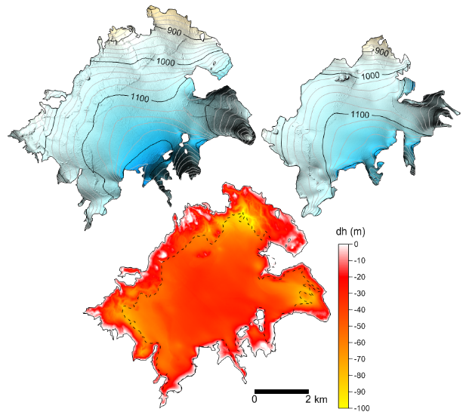
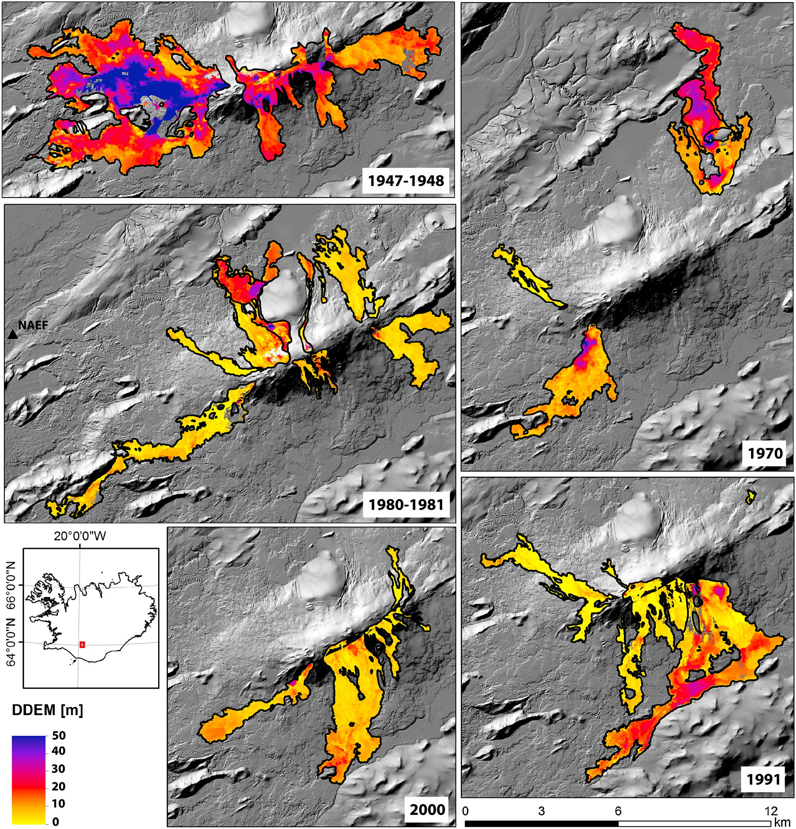
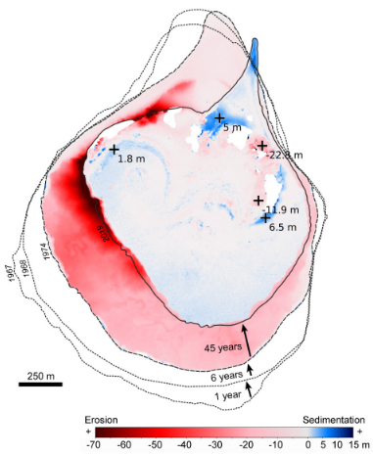
Elevation changes and volume changes from DEMs
Glacier Volume Change & Geodetic Mass Balance
Lava volumes & Mean Output Rate
(E.g. Pedersen et al., 2018, GRL)
Coastal erosion
(E.g. Óskarsson et al., 2020, Surtsey Res.)

