Slide 1
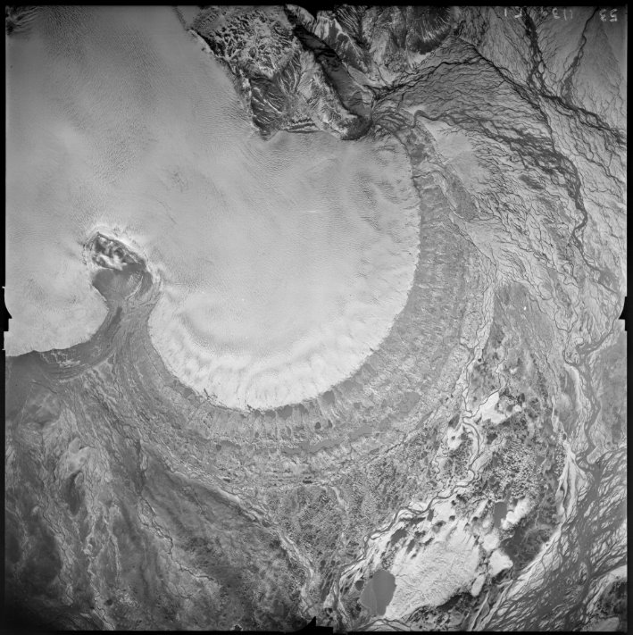
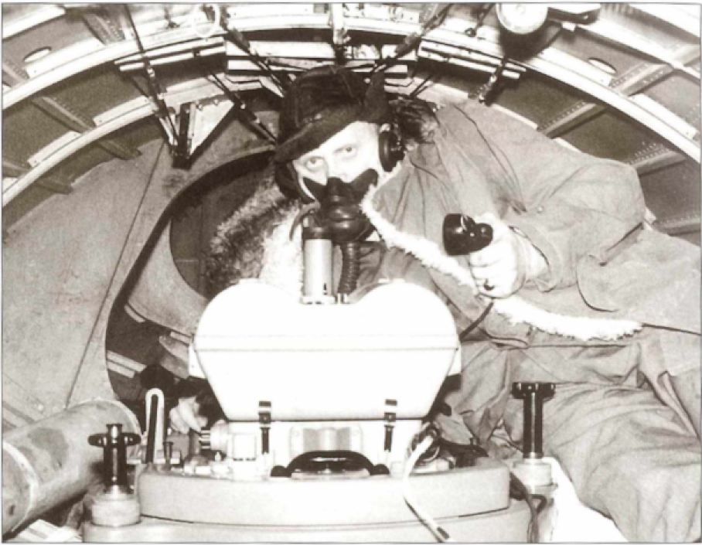
Unleashing the archive of aerial photographs of Iceland
Múlajökull (1945)
Águst Boðvarsson (1955)
Joaquín M.C. Belart, Sydney Gunnarson, Etienne Berthier, Amaury Dehecq,
Tómas Jóhannesson, Hrafnhildur Hannesdóttir, Kieran Baxter
Notes:
9

Slide 2
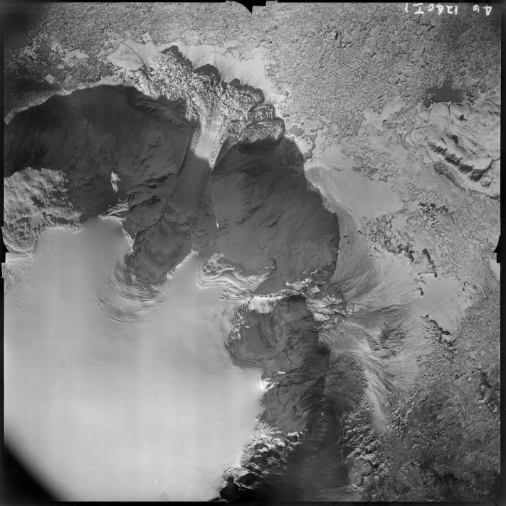
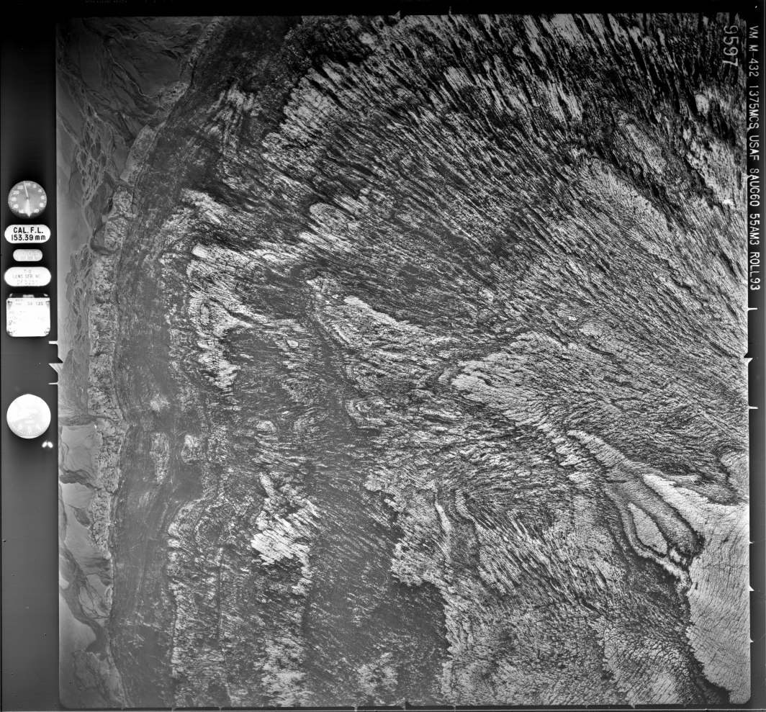
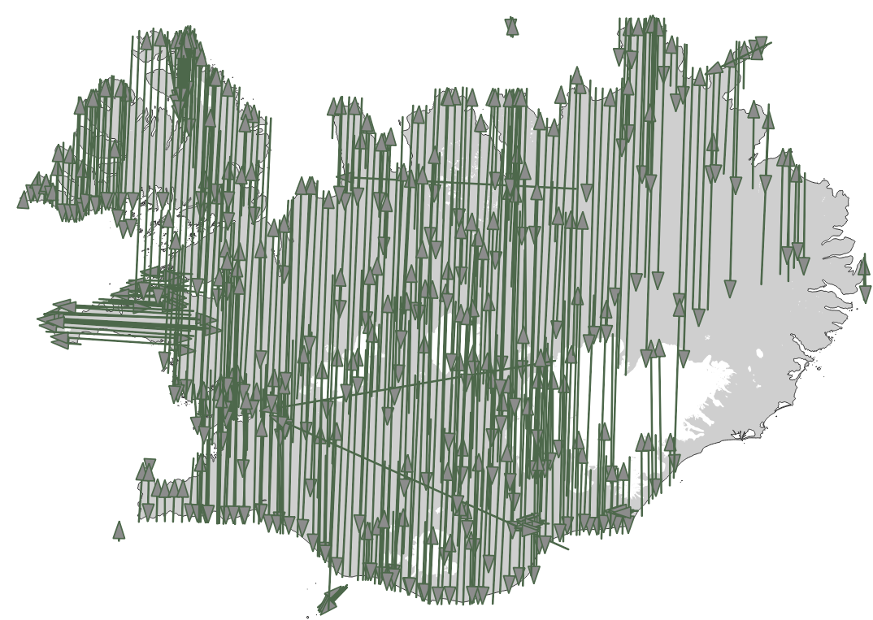
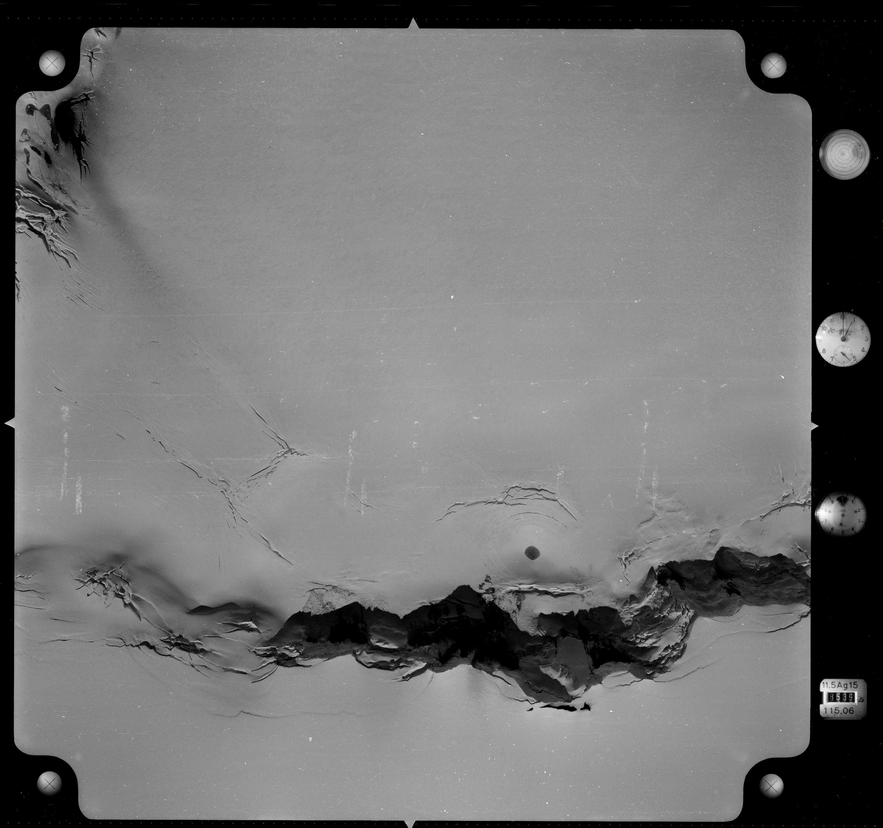
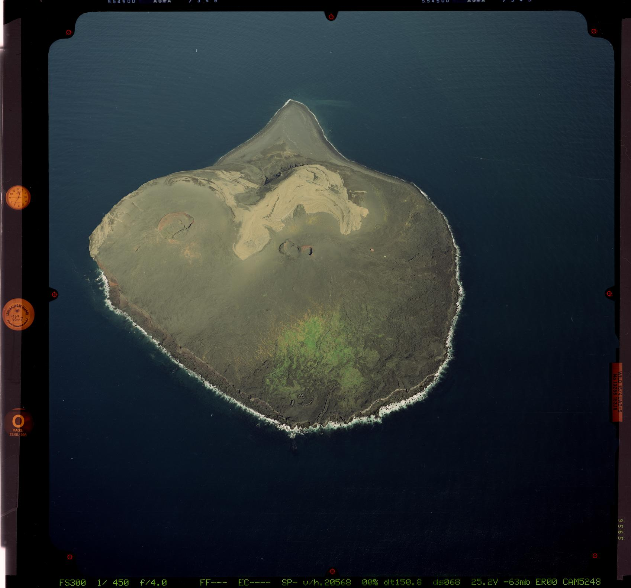
From 1945 to 2000
140,000 frames (films)
12x12 cm, 18x18 cm, 23x23 cm
128,735 frames scanned
16Tb of raw images
Eiríksjökull (1945)
Dingjujökull (1960)
Flightlines American Surveys 1956-1961
Grímsvötn (1972)
Surtsey (1998)
Notes:
9

Slide 3
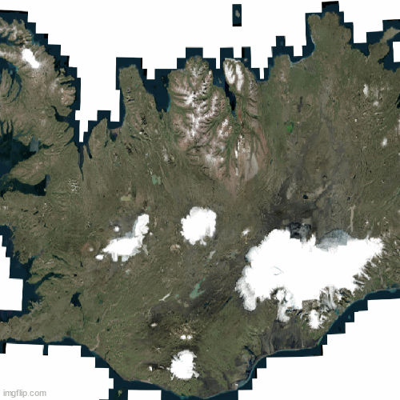
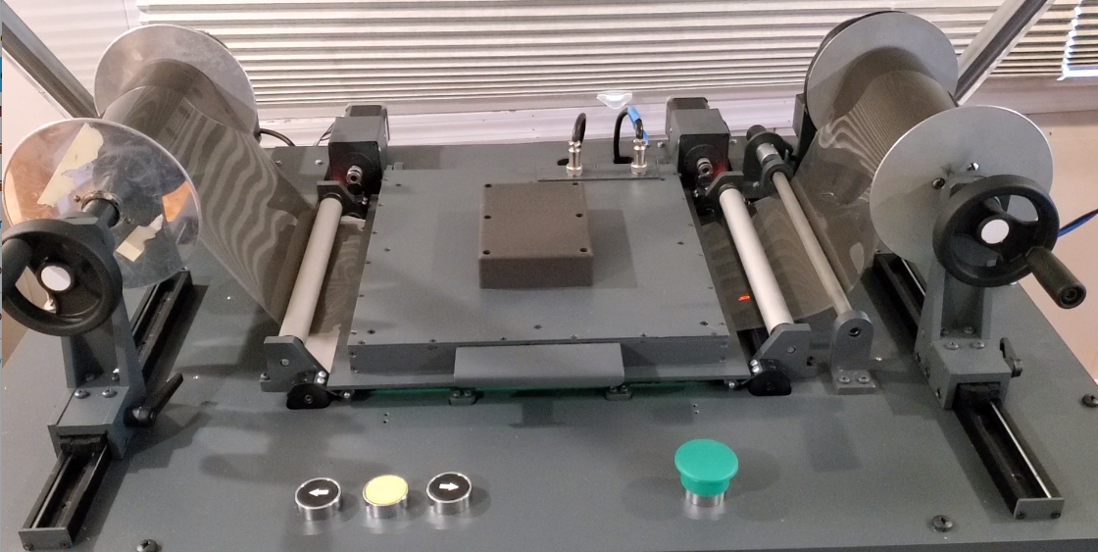
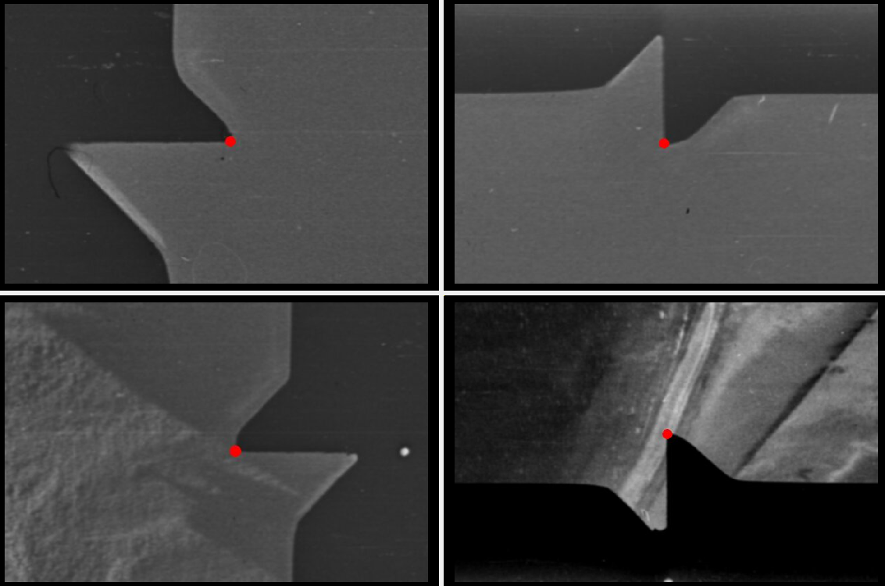
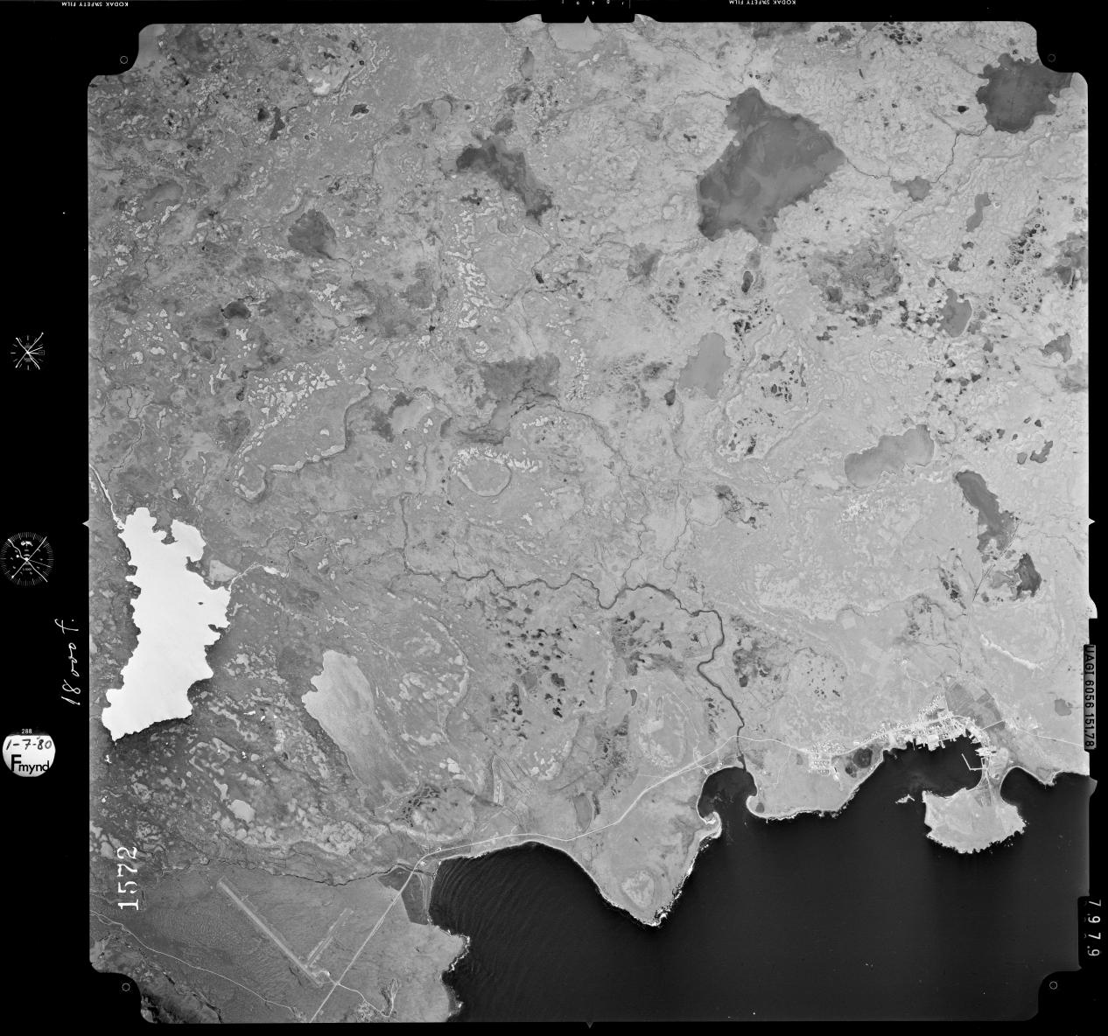
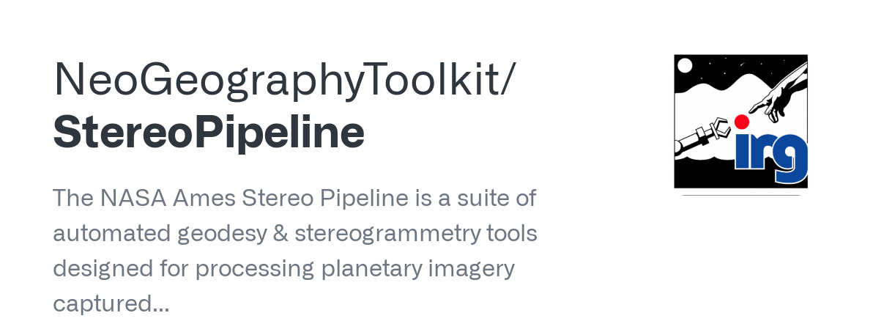
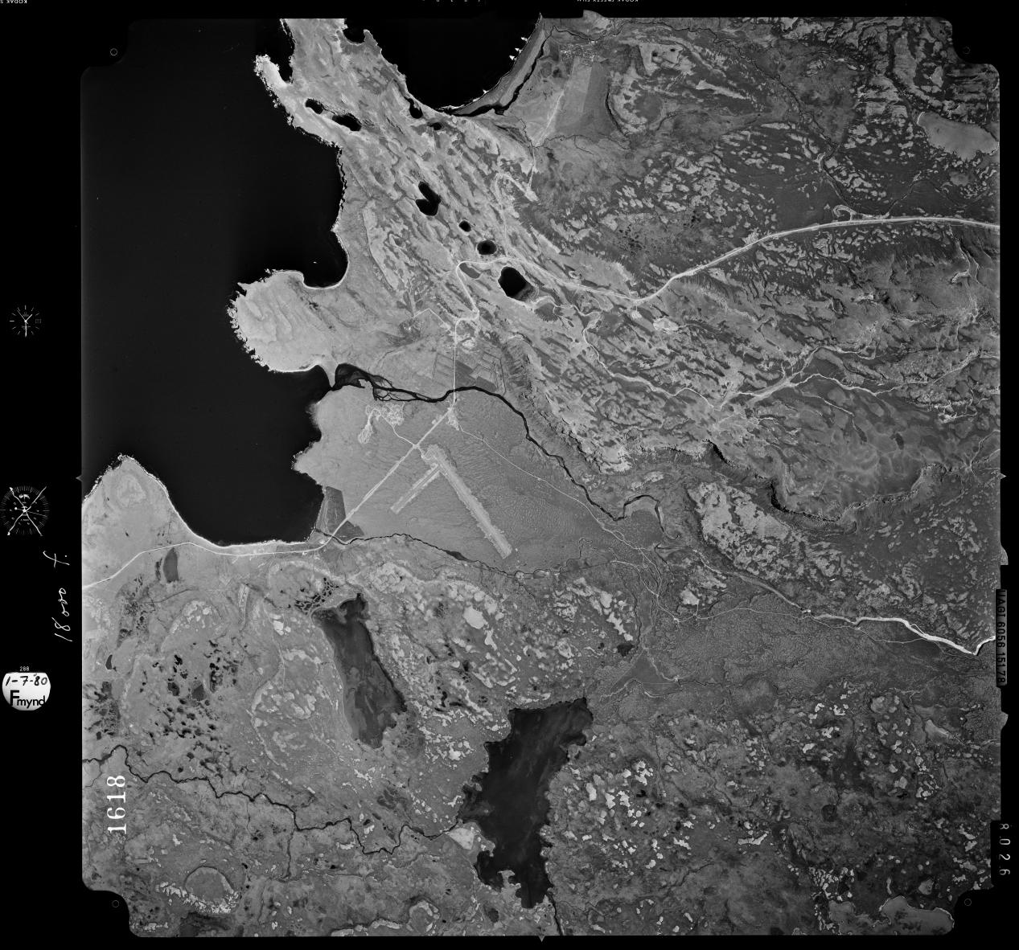
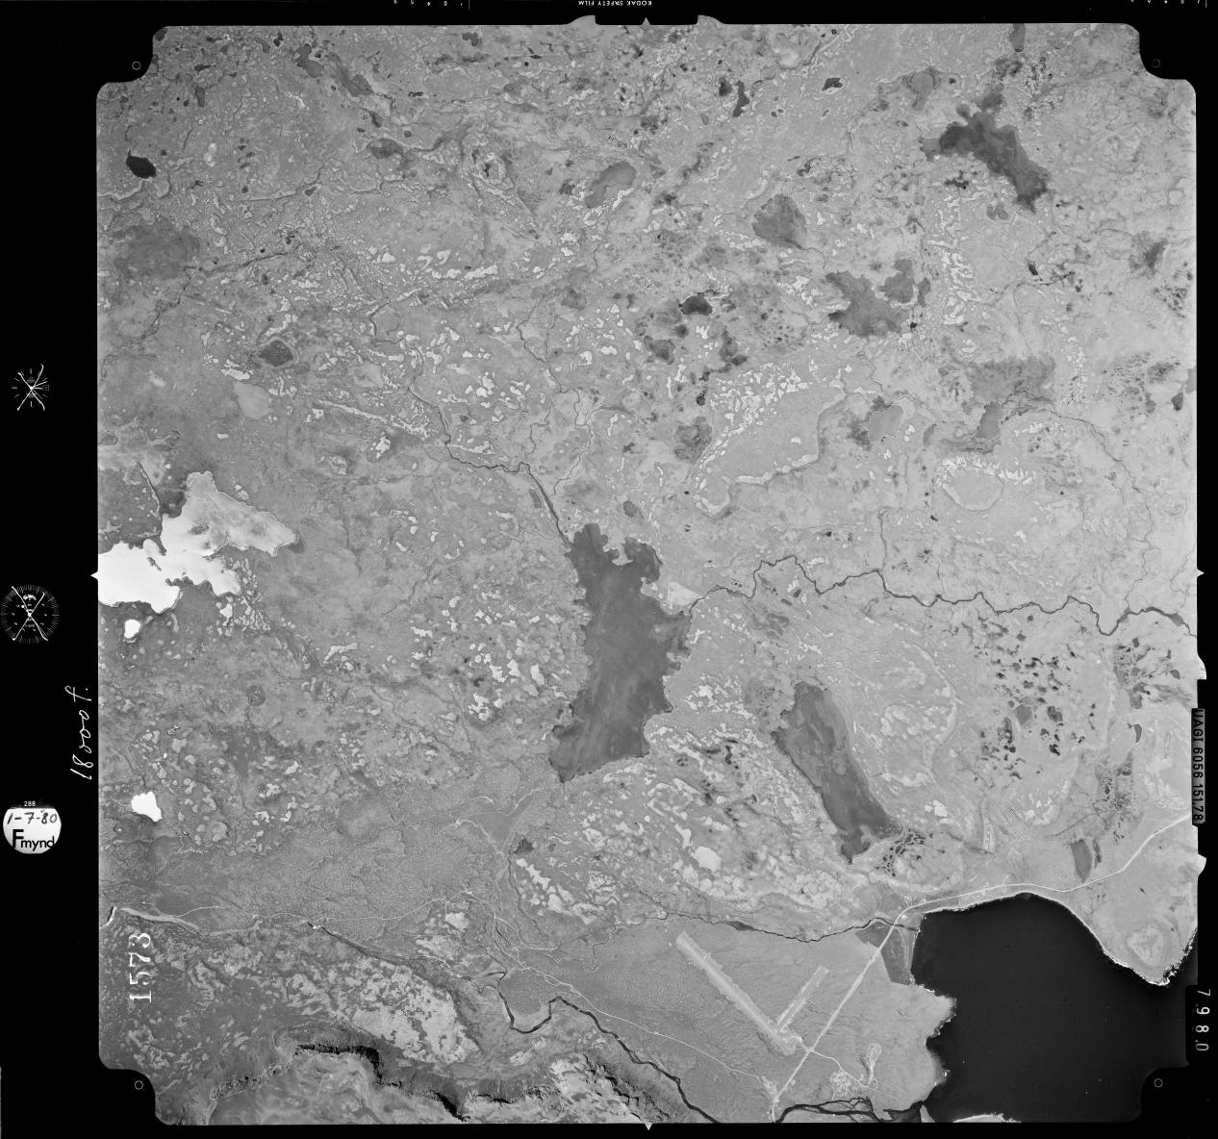
Processing
AFS150 Scanner
Fiducial detection in 1960 frames

Slide 4
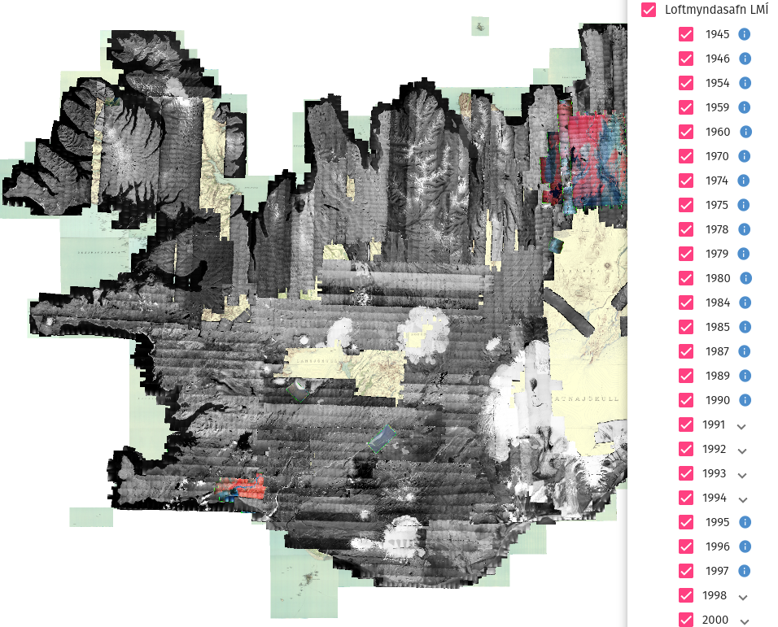
Open access
1,100 Orthos & DEMs
15,000 Oriented images
765 Gb of data
Validation in stable terrain:
Pléiades orthoimages
Pléiades DEMs
Lidar DEMs
Positional accuracy >10 m (XYZ)
loftmyndasja.lmi.is

Slide 5
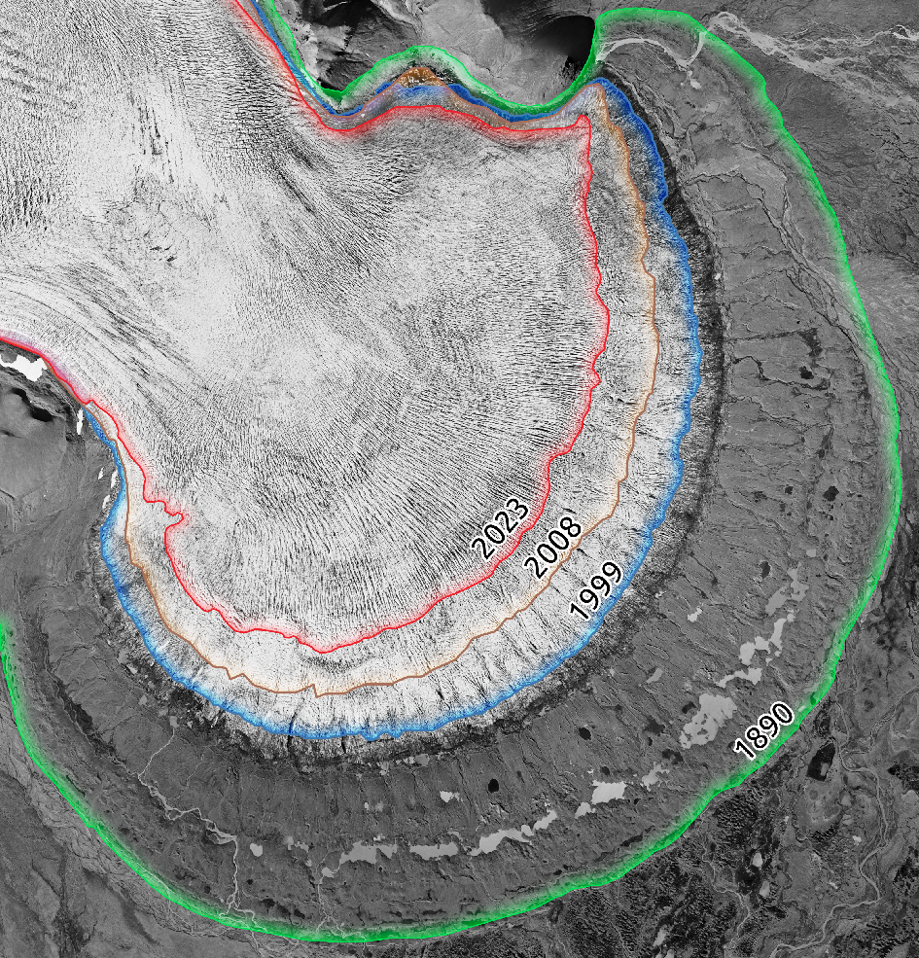
Glacier changes
Múlajökull (1995)

Slide 6
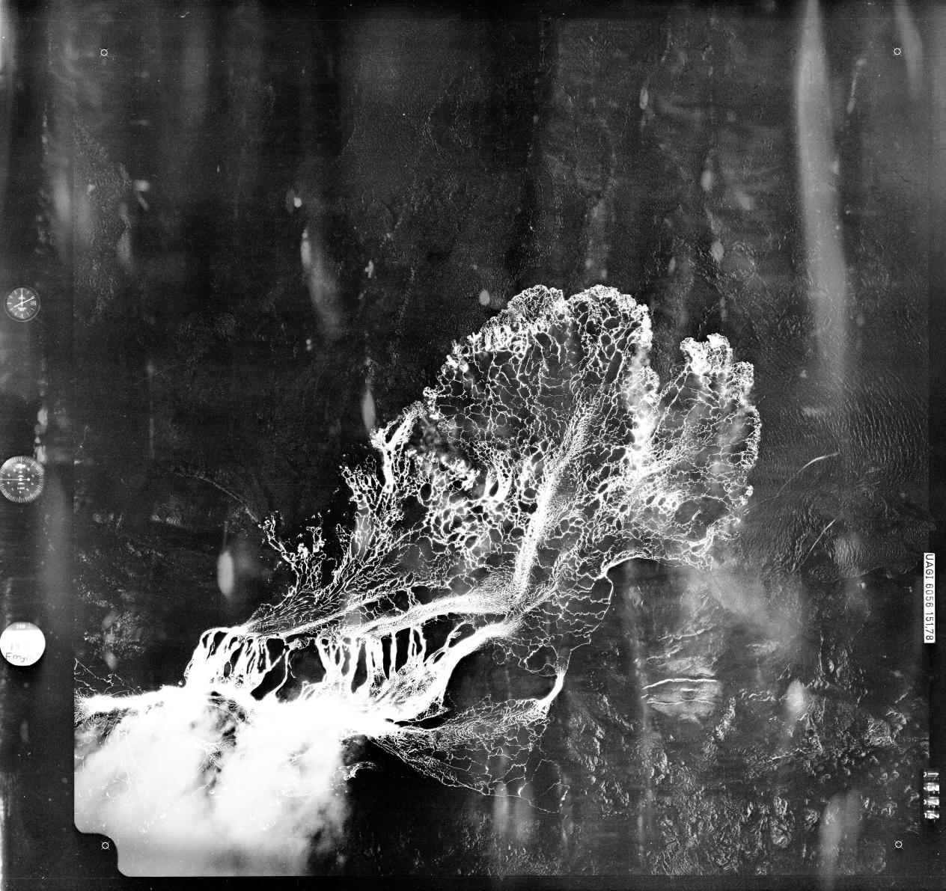
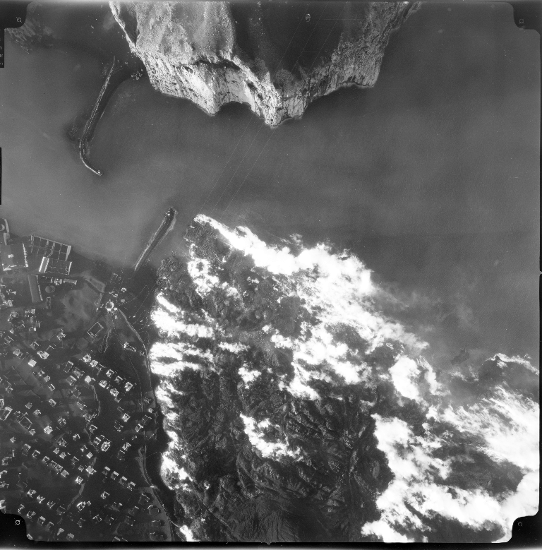
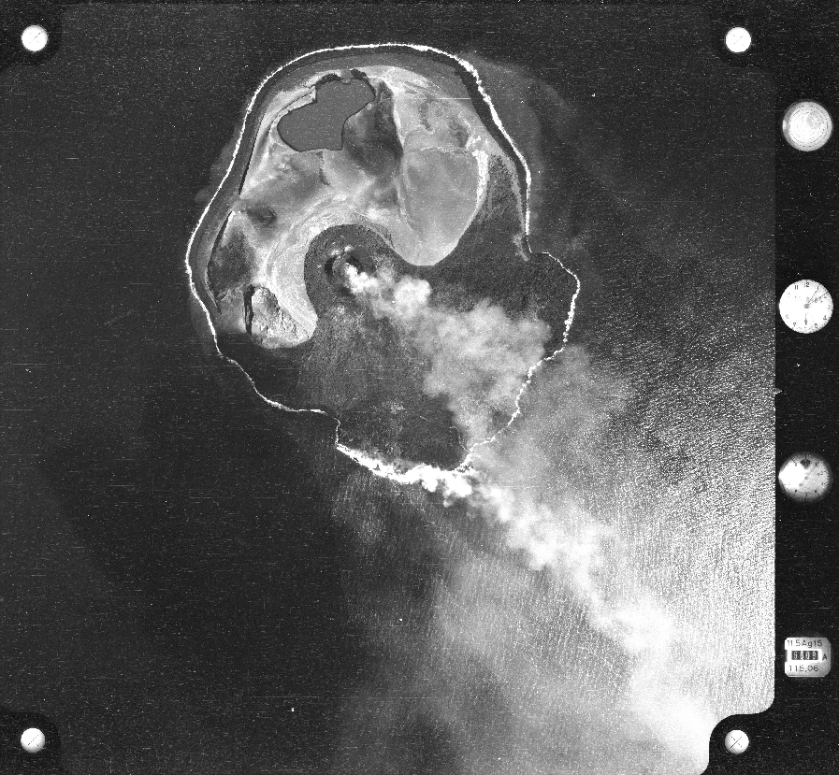
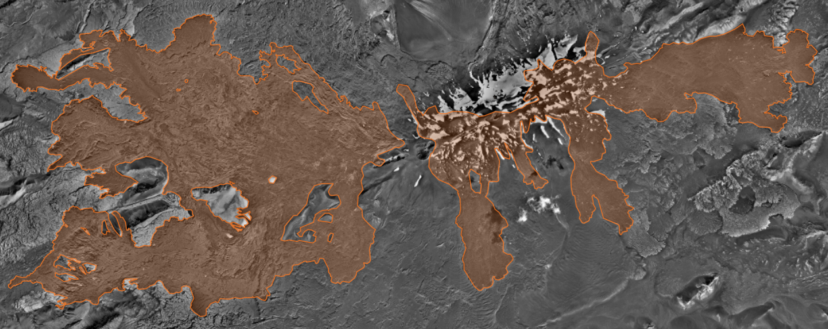
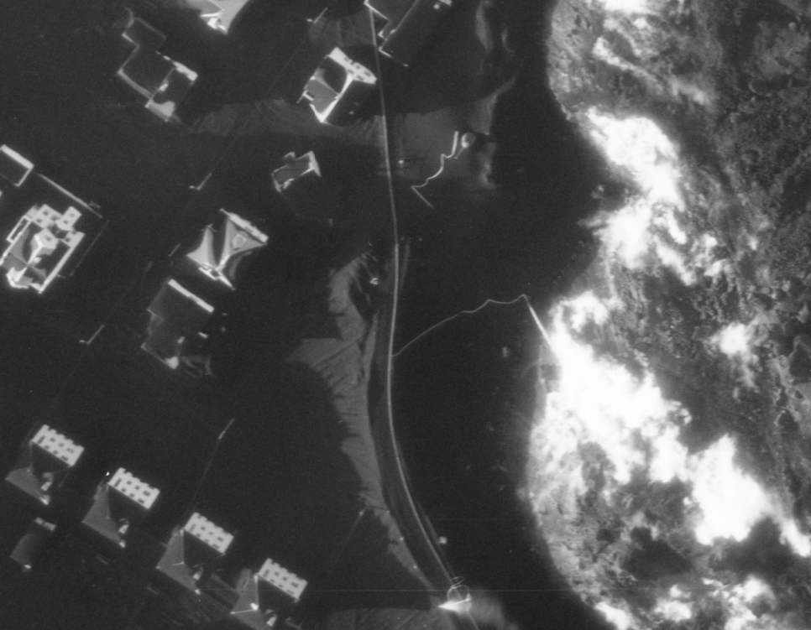
Volcanic changes
Surtsey (1964)
Krafla (1977)
Heymaey (1973)
Hekla (1960). Lava outlines from 1947
Heymaey (1973)

Slide 7
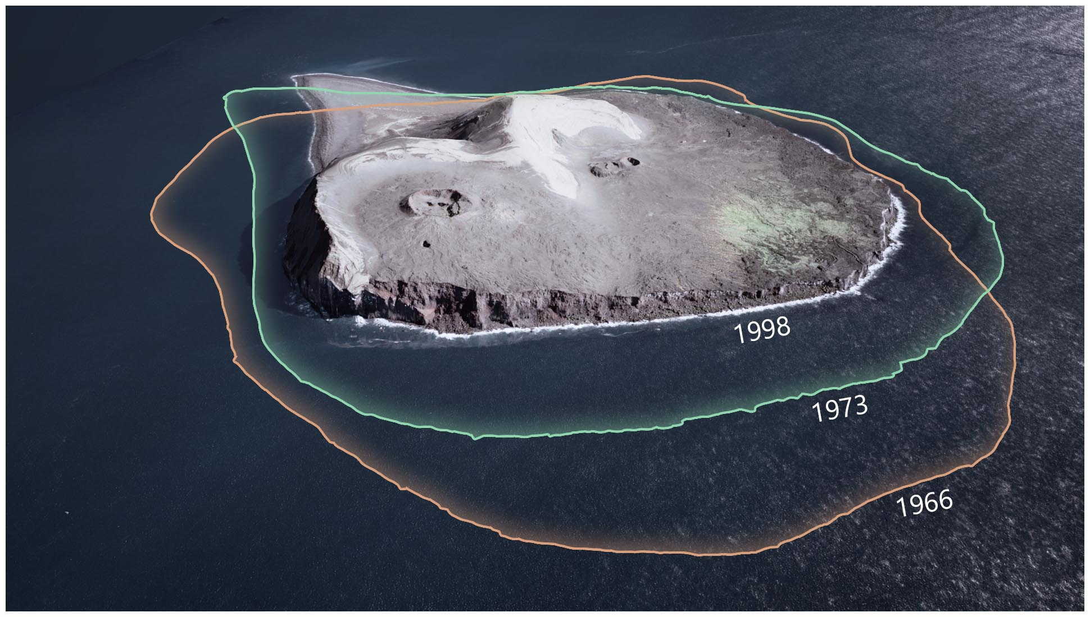
Coastal erosion
Surtsey (1998)

Slide 9
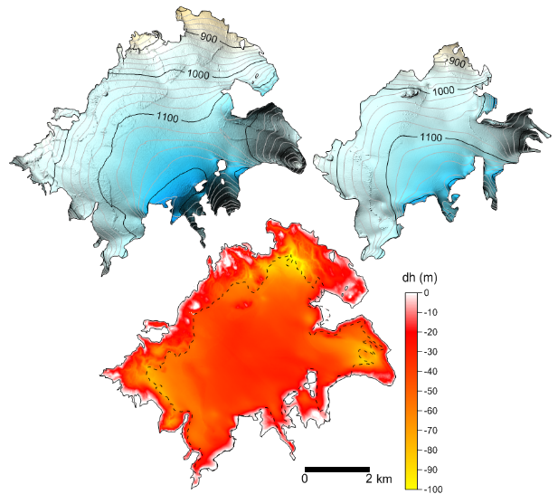
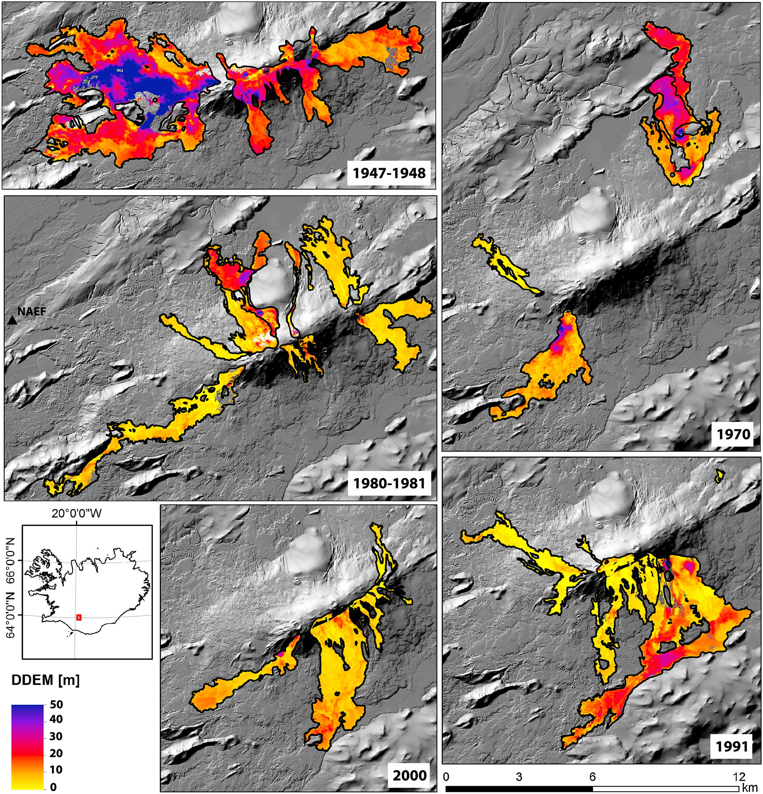
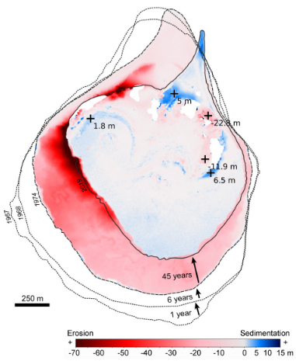
Elevation changes and volume changes
Glacier Volume Change & Geodetic Mass Balance
Lava volumes & Mean Output Rate
(E.g. Pedersen et al., 2018)
Coastal erosion
(E.g. Óskarsson et al., 2020)

