Slide 1
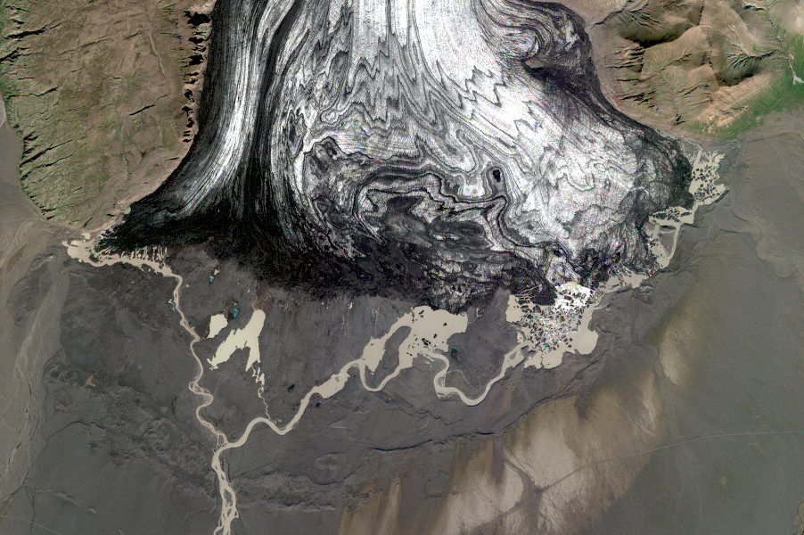
Dinamis mapping of Icelandic glaciers 2020-2022
Joaquín M.C. Belart
LEGOS, Toulouse, 15 Mar 2023
Notes:
<number>

Slide 2
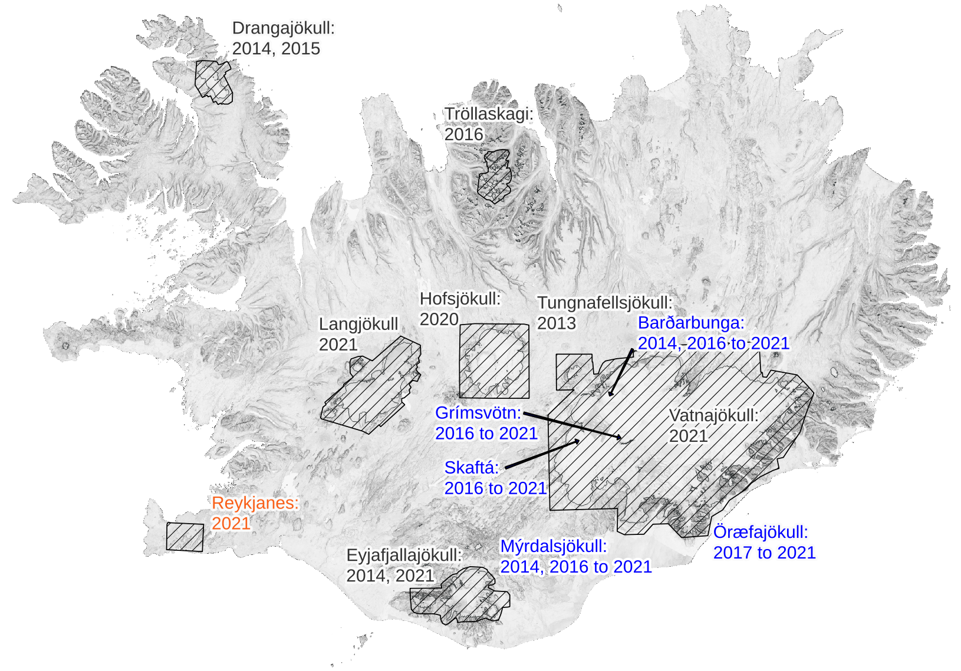
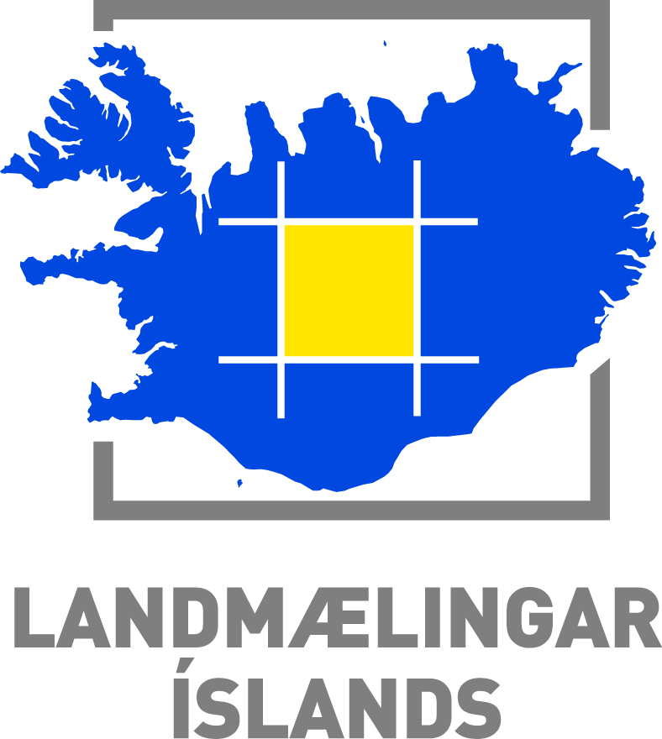
Pléiades surveys in Iceland since launch of satellites
Main mapping initiatives:
CIEST² Initiative
Dinamis
CEOS-Volcano Supersite

Slide 3
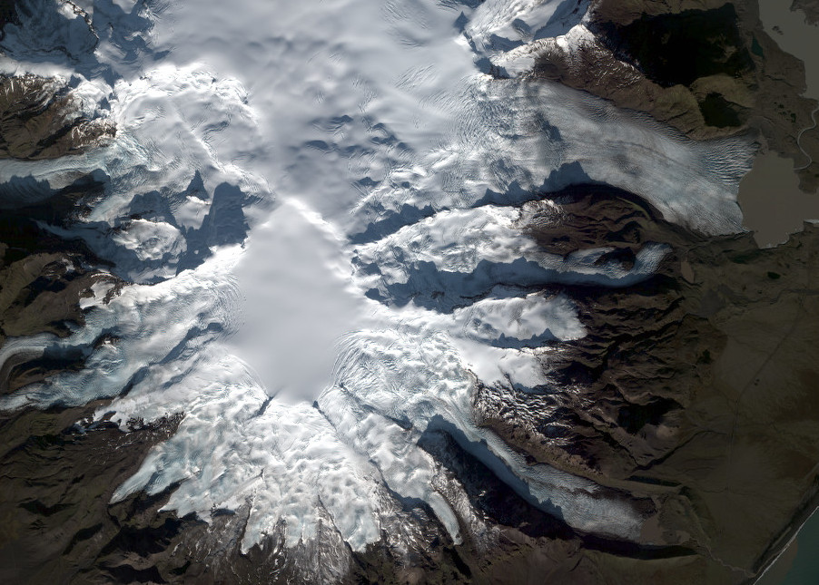
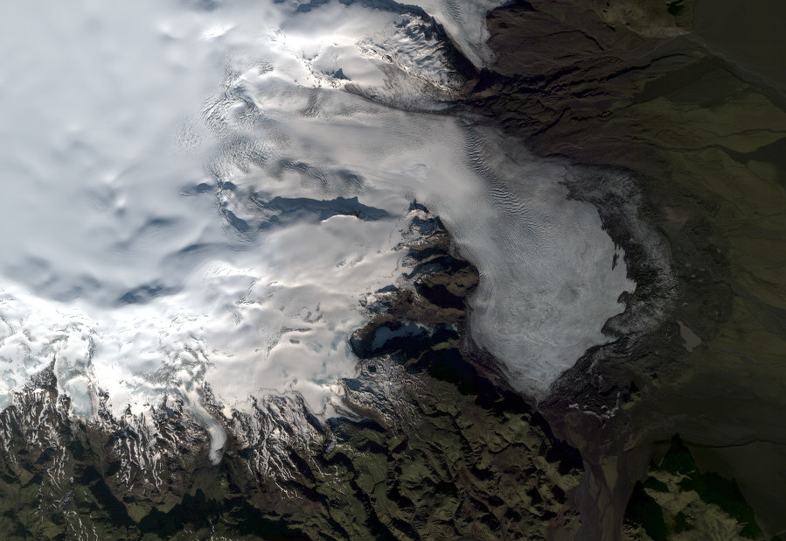
© CNES. Distribution Airbus DS
© CNES. Distribution Airbus DS
Glacier mapping from Pléiades stereo images:
2020: ~2,000 km²
2021: ~15,000 km²
2022: ~4,000 km²
© CNES. Distribution Airbus DS

Slide 4
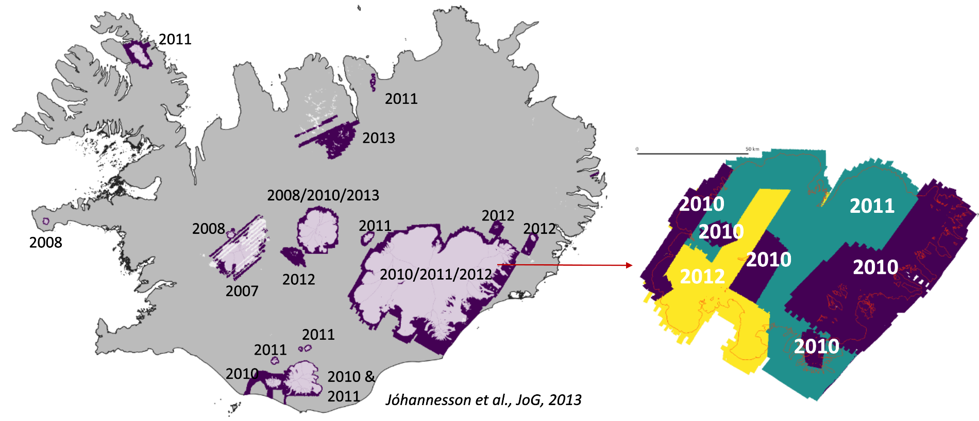
Lidar surveys of Icelandic glaciers

Slide 5
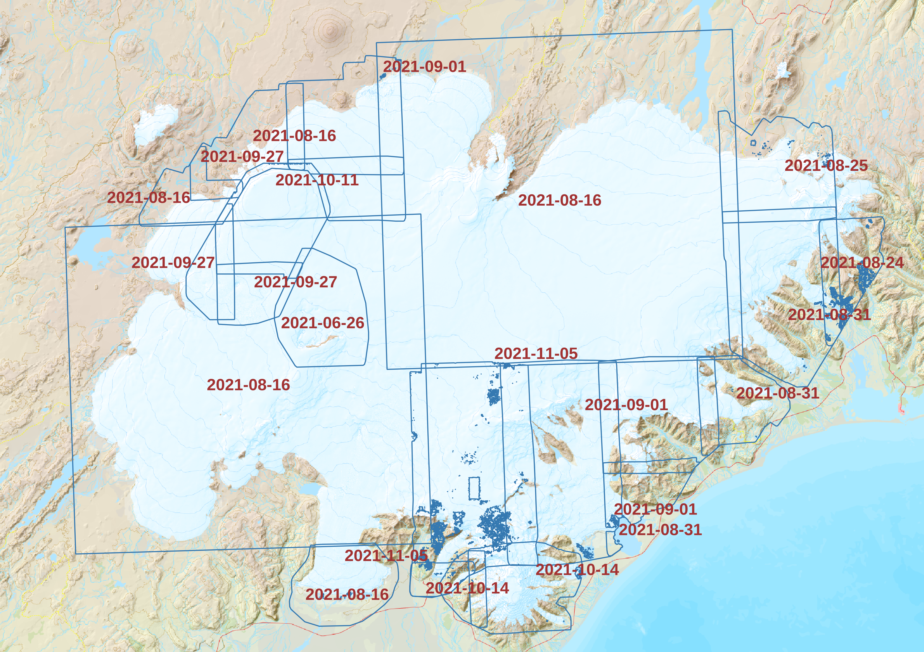

Slide 6
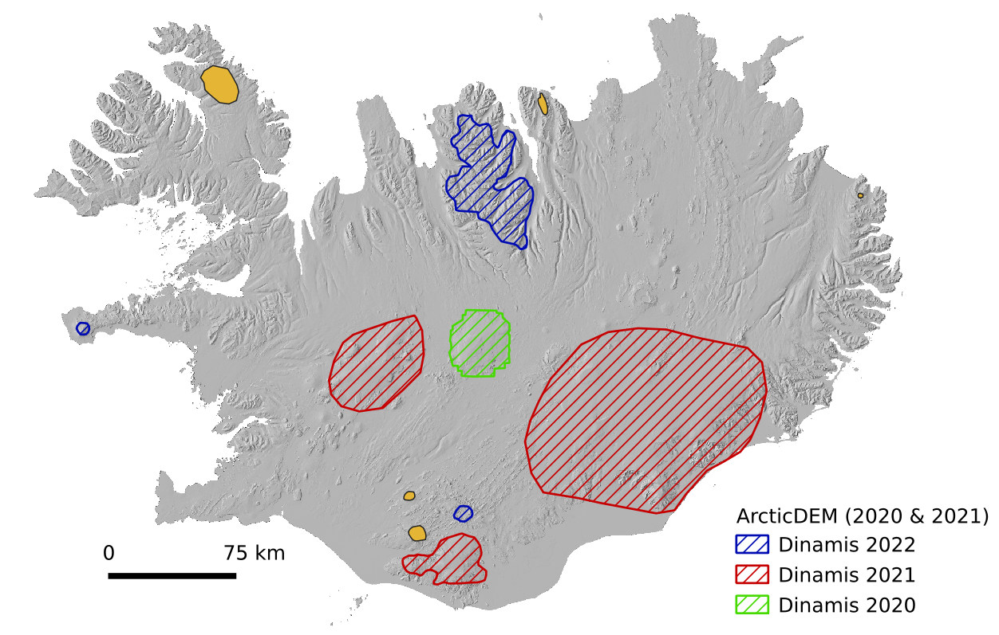
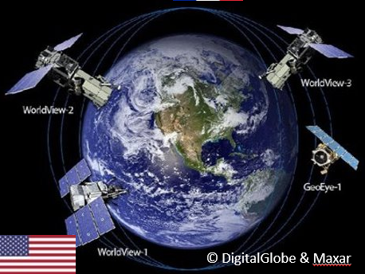
Project 1: New database of glacier surfaces of Iceland, 2020-2022
https://www.pgc.umn.edu/data/arcticdem/

Slide 7
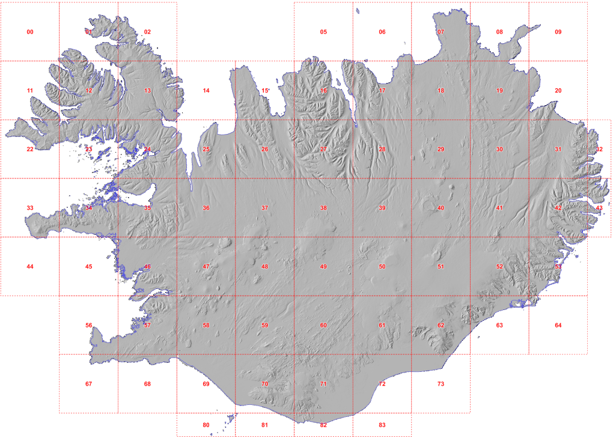
Project 2: National DEM of Iceland (2x2 m, vert acc <50cm)
https://atlas.lmi.is/mapview/?application=DEM

Slide 8
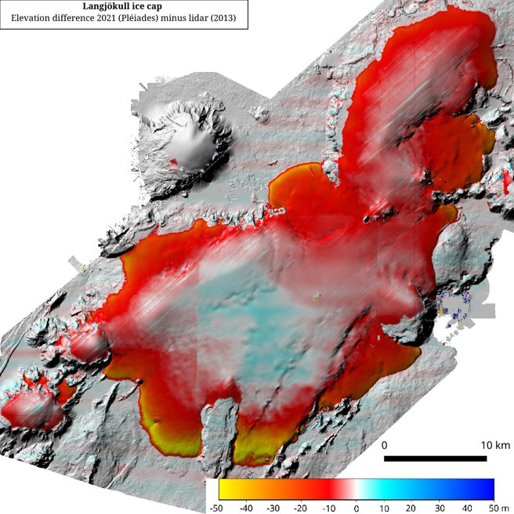
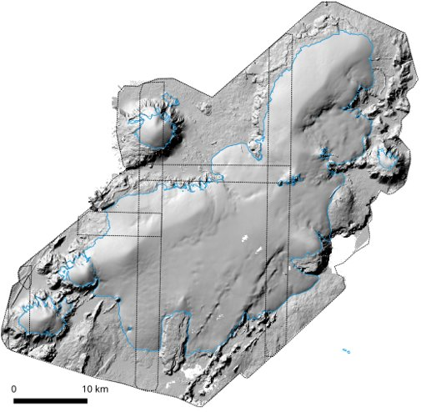
Langjökull Pléiades 2021 surveys:
September: 9th
October: 6th, 11th

Slide 9
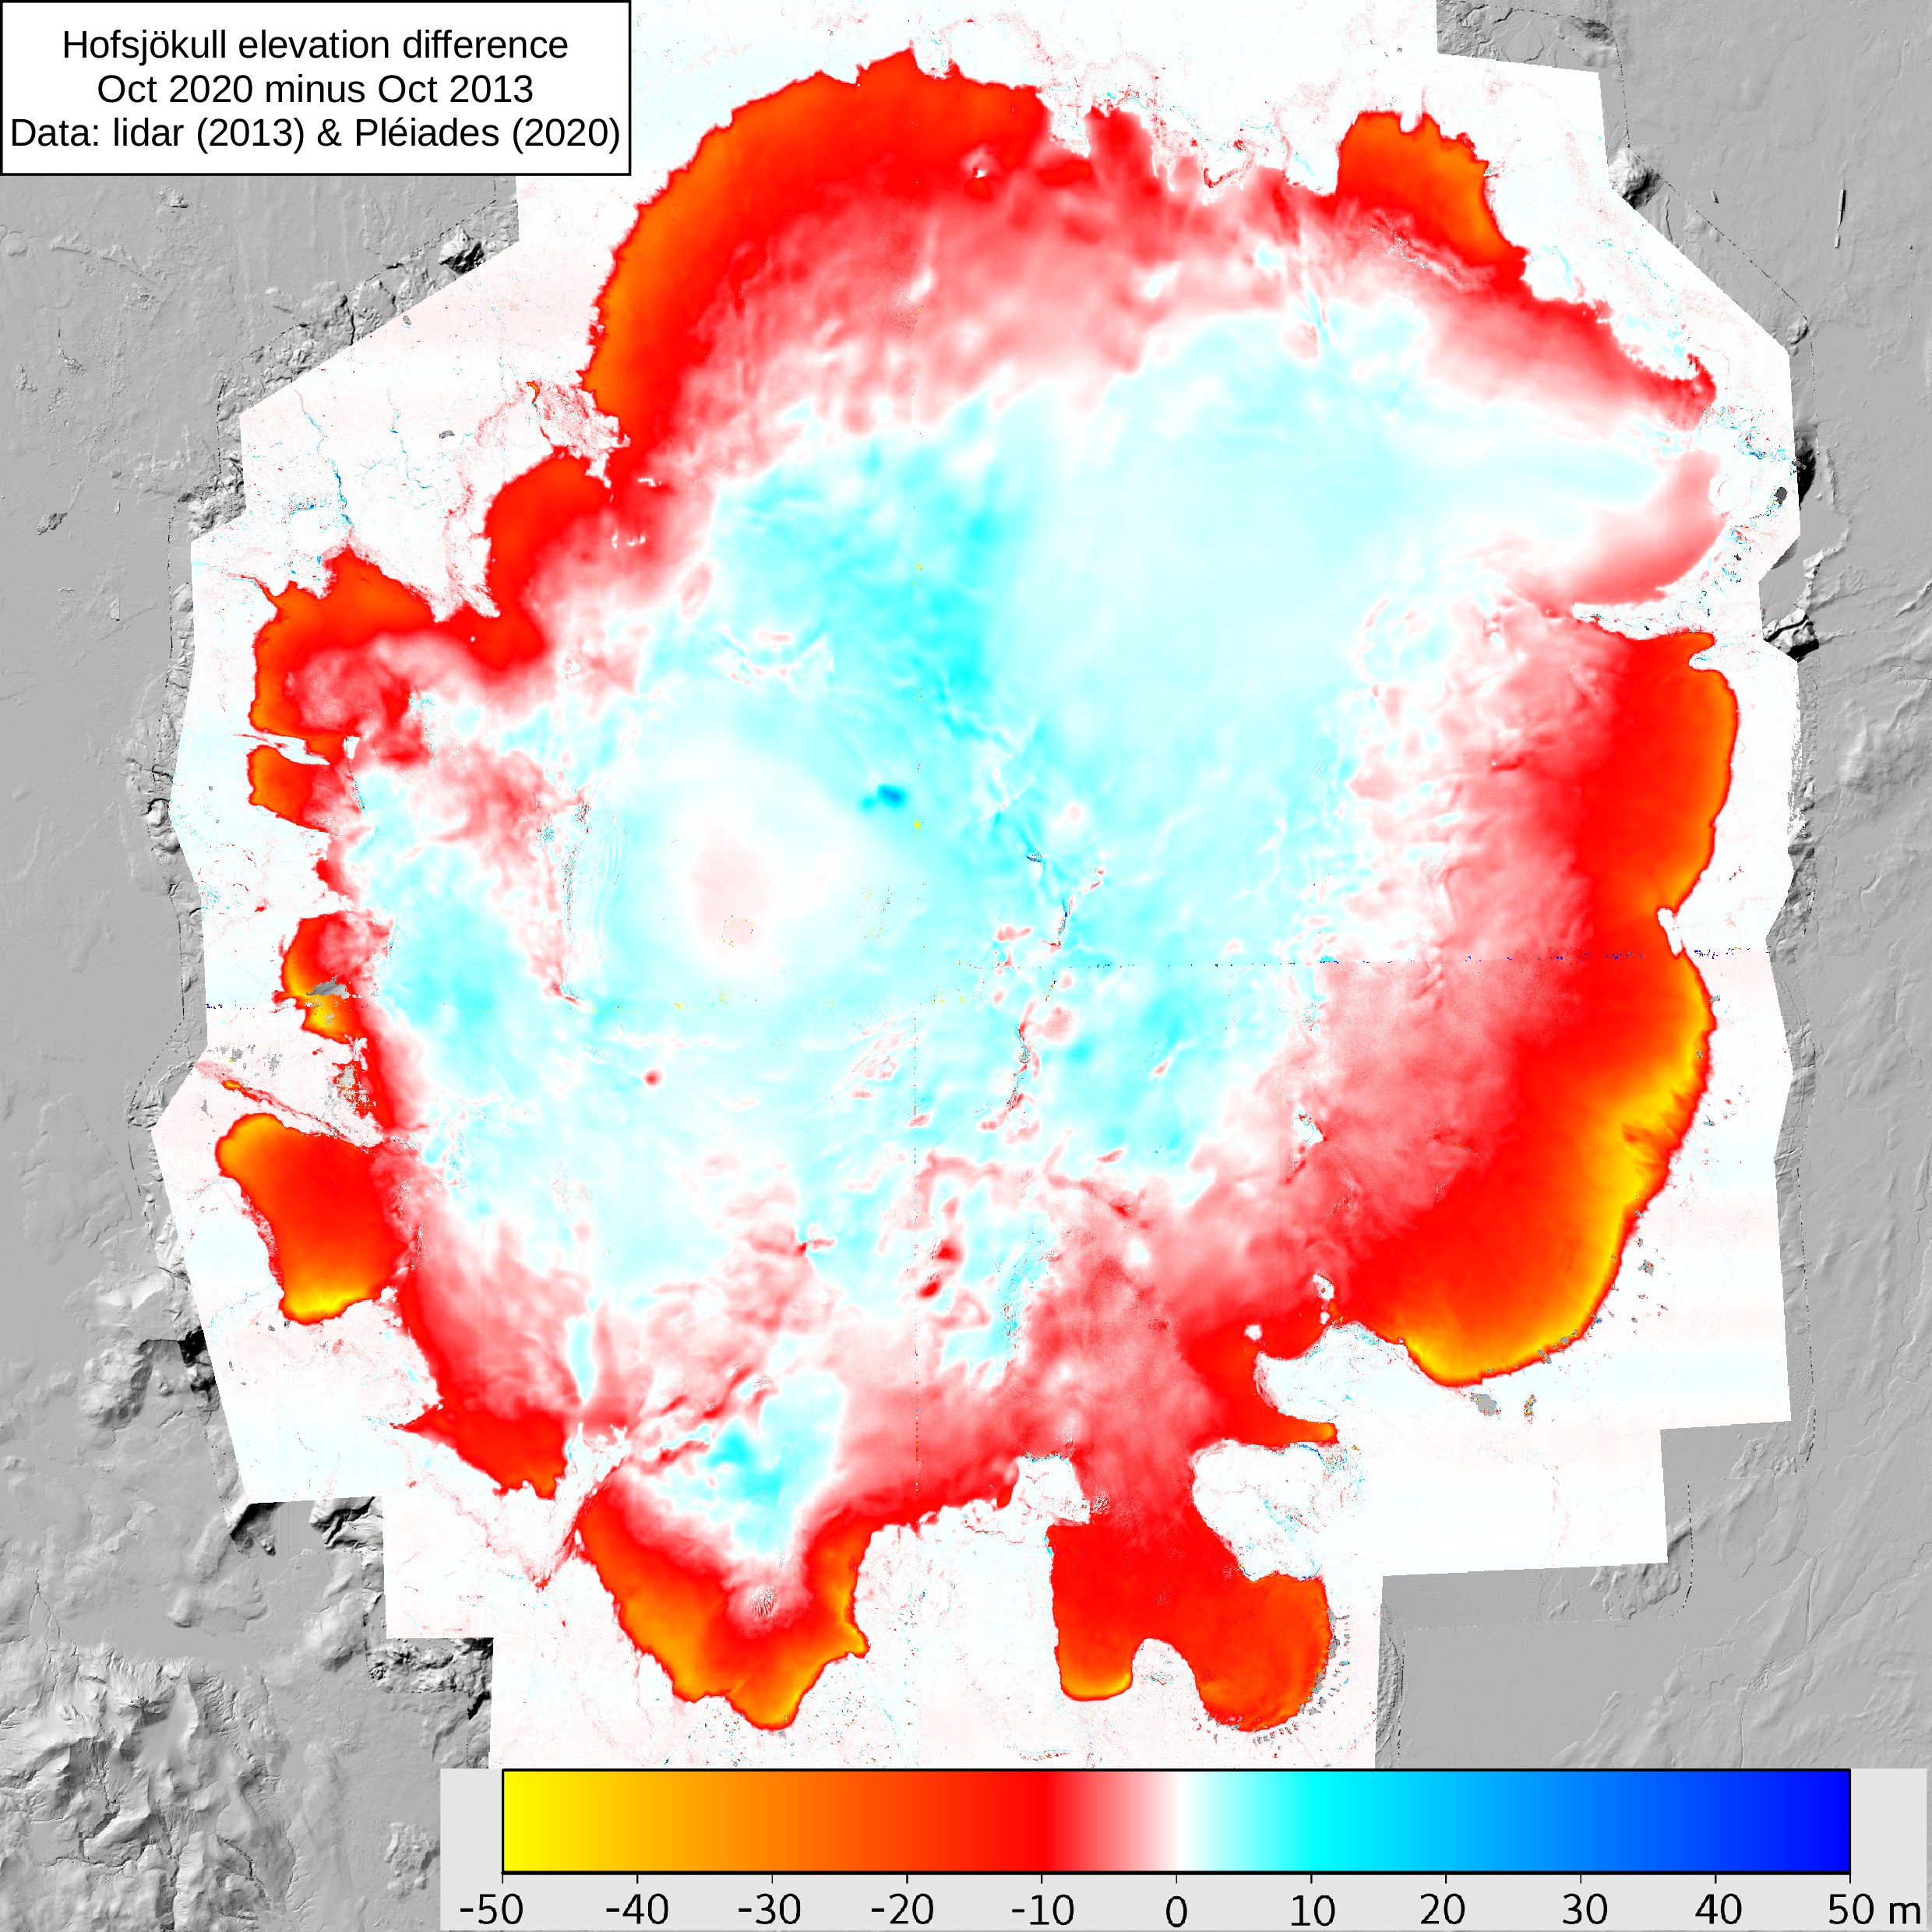
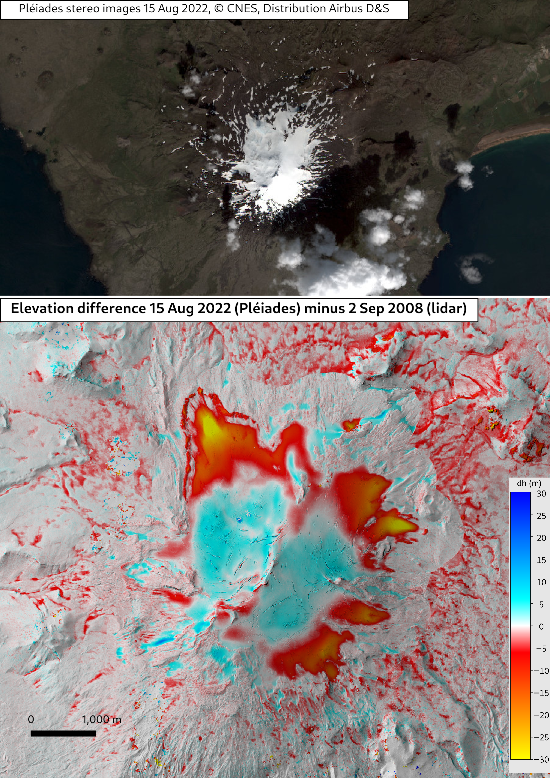

Slide 10
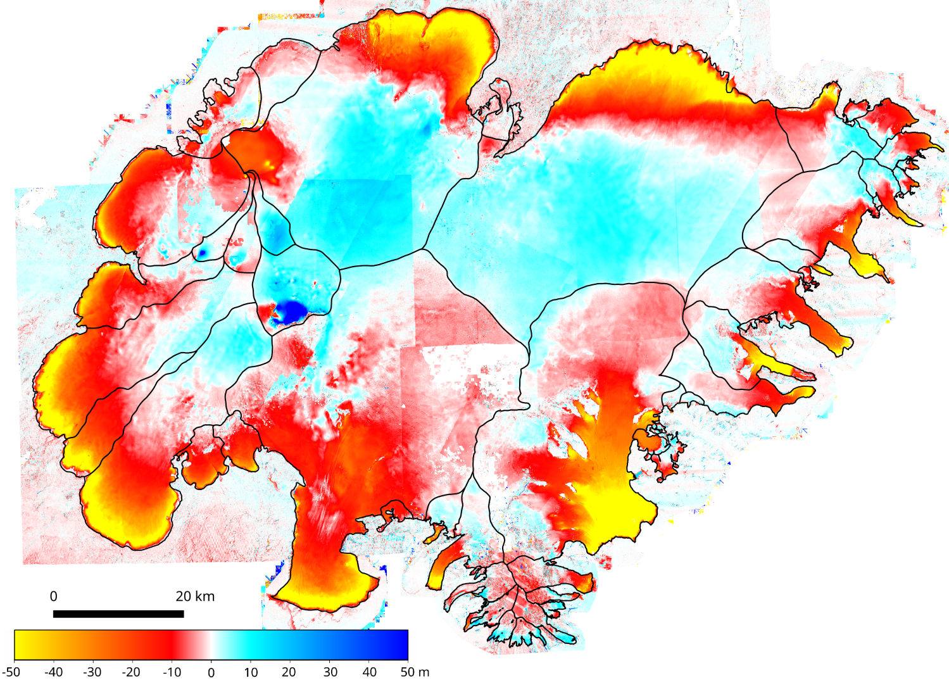
Vatnajökull: SPOT7 & Pléiades 2021
Vatnajökull: SPOT7 & Pléiades 2021
minus lidar (2010-2012)

Slide 11
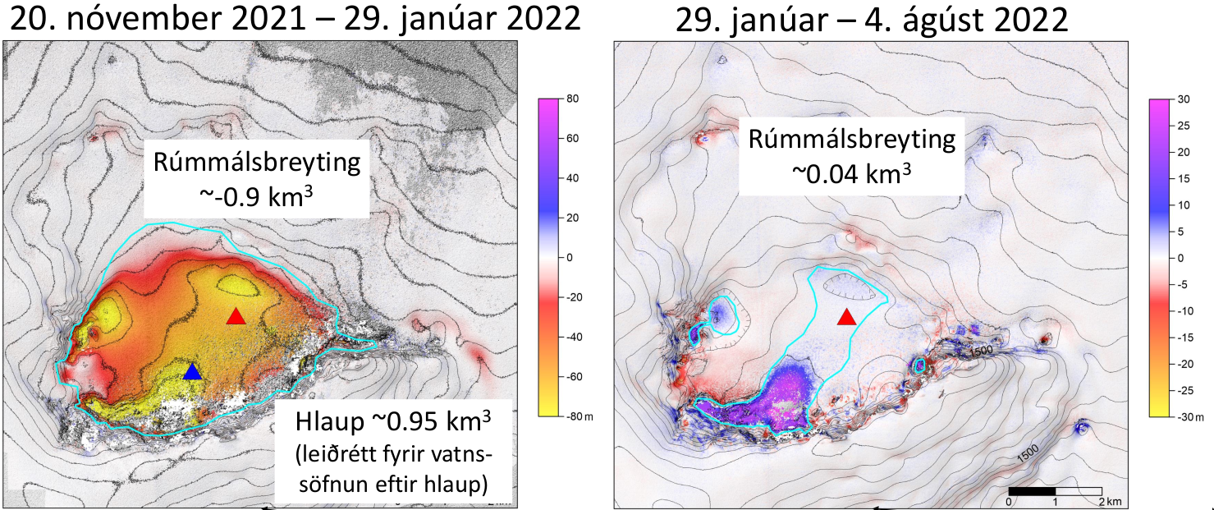
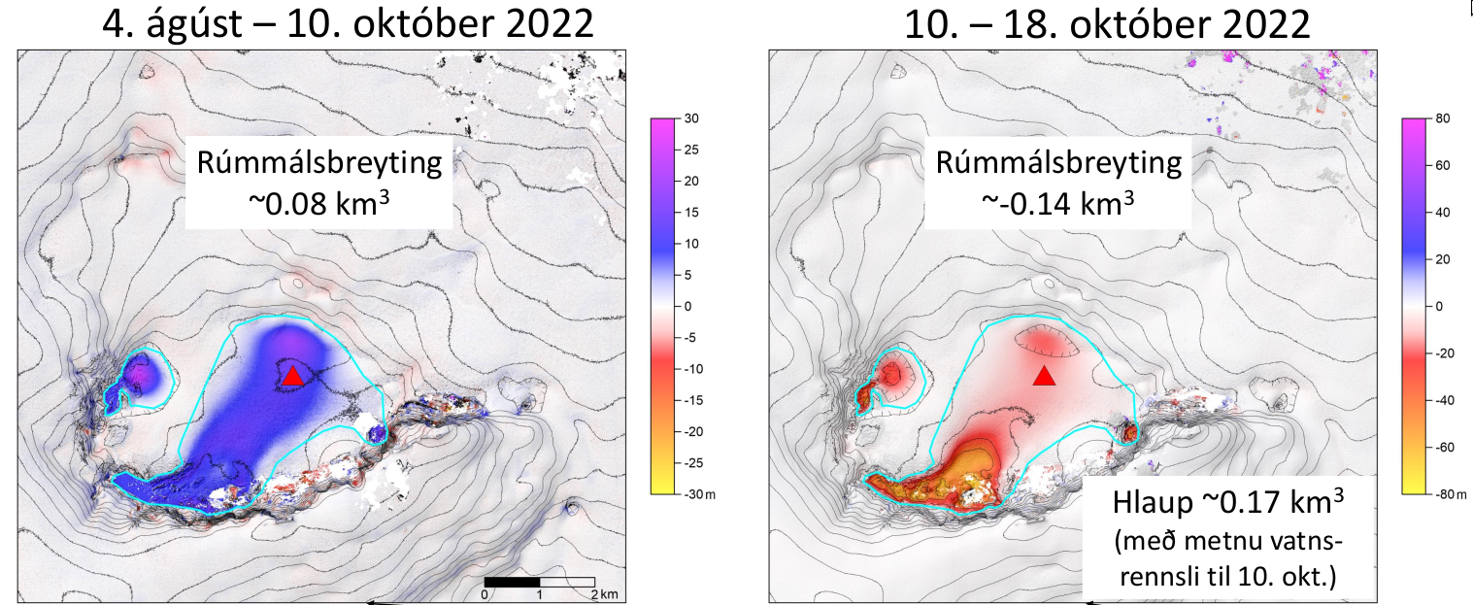
Monitoring of geothermal areas:
Grímsvötn
Eyjólfur Magnússon, JHÍ

Slide 12
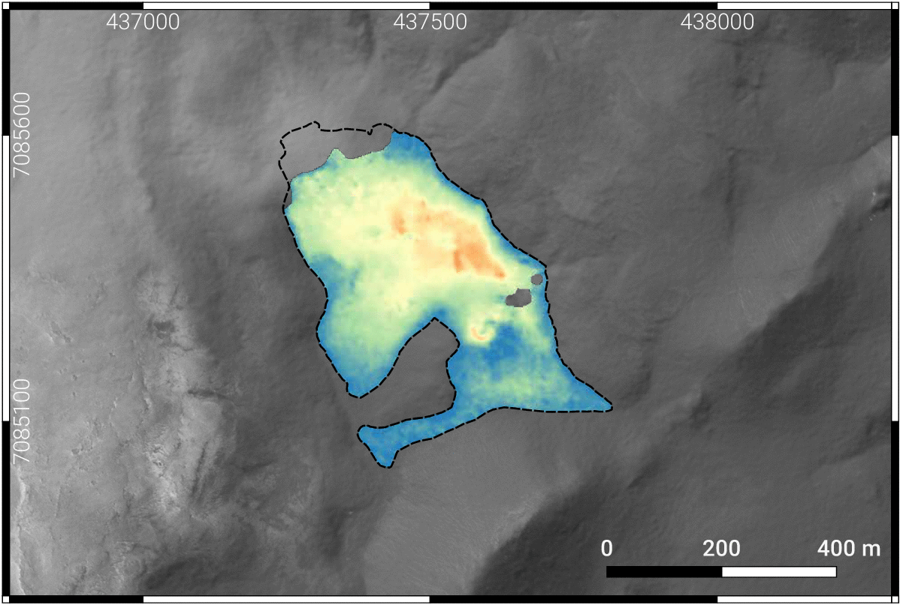
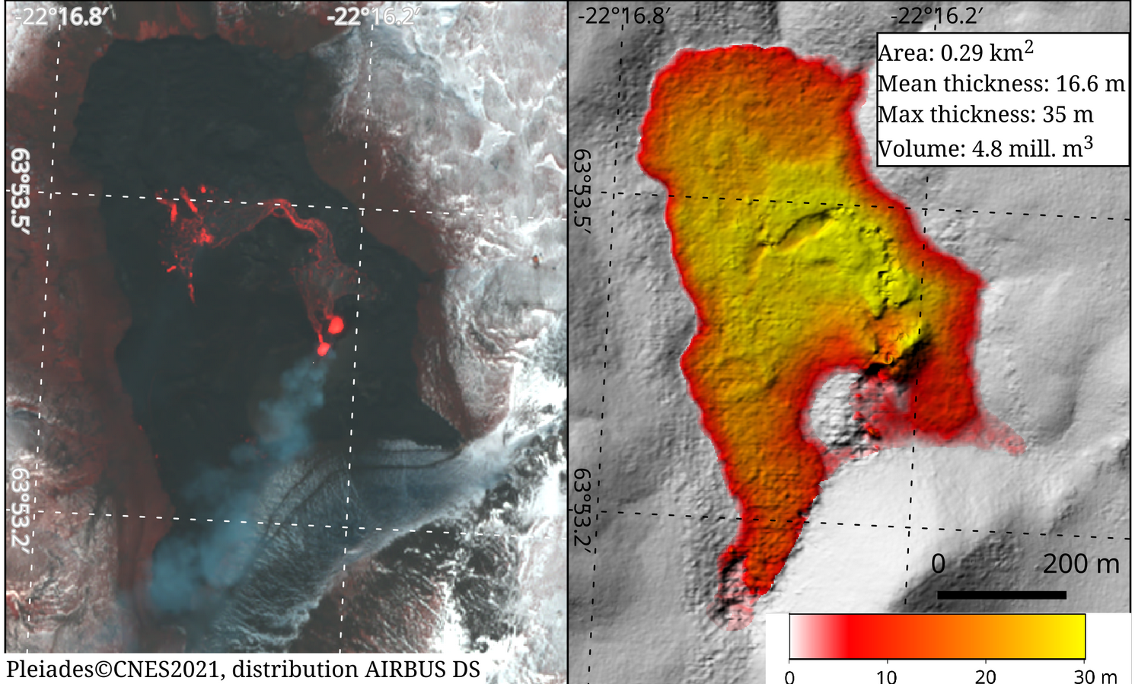
Near-real time Monitoring - CIEST²
First time Pléiades is used in near-real time for volcano monitoring
These data provided crucial information for the evolution of the eruption during the first 10 days
Repeated in La Palma (Sep – Oct 2021) and in Fagradalsfjall/Meradalir (Aug 2022) eruptions.
Gouhier et al., 2022. Journal of Applied Volcanology

Slide 13
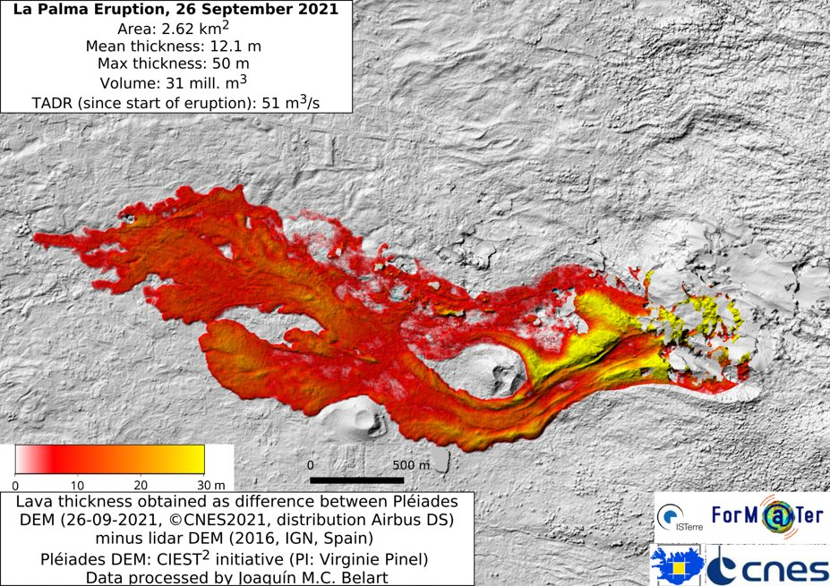
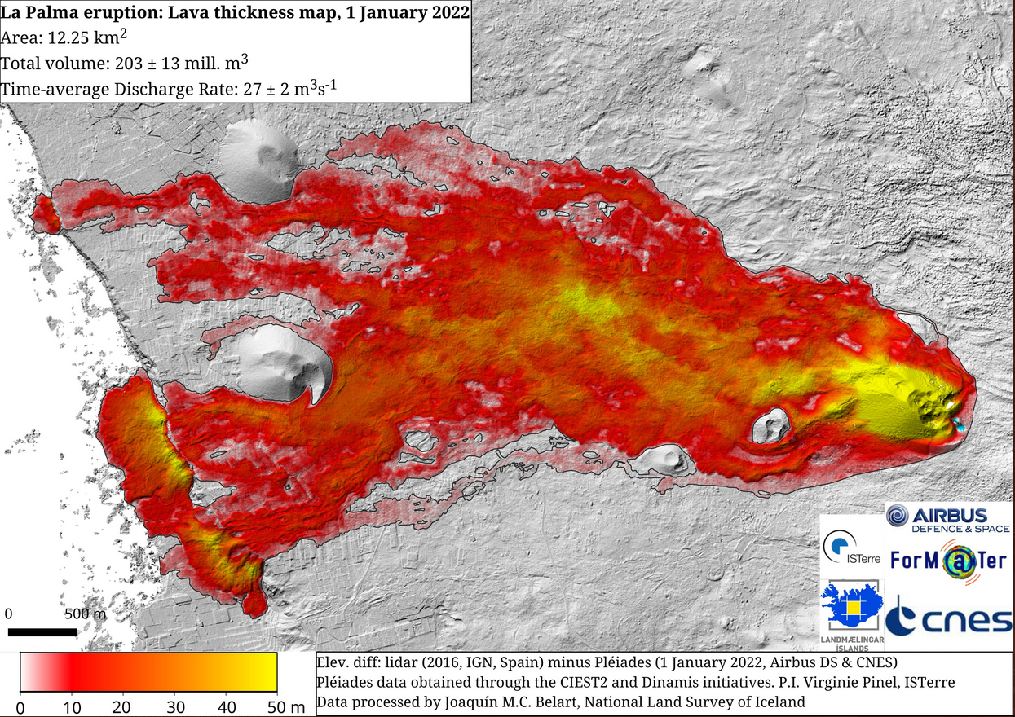
La palma monitoring from Pléiades

Slide 14
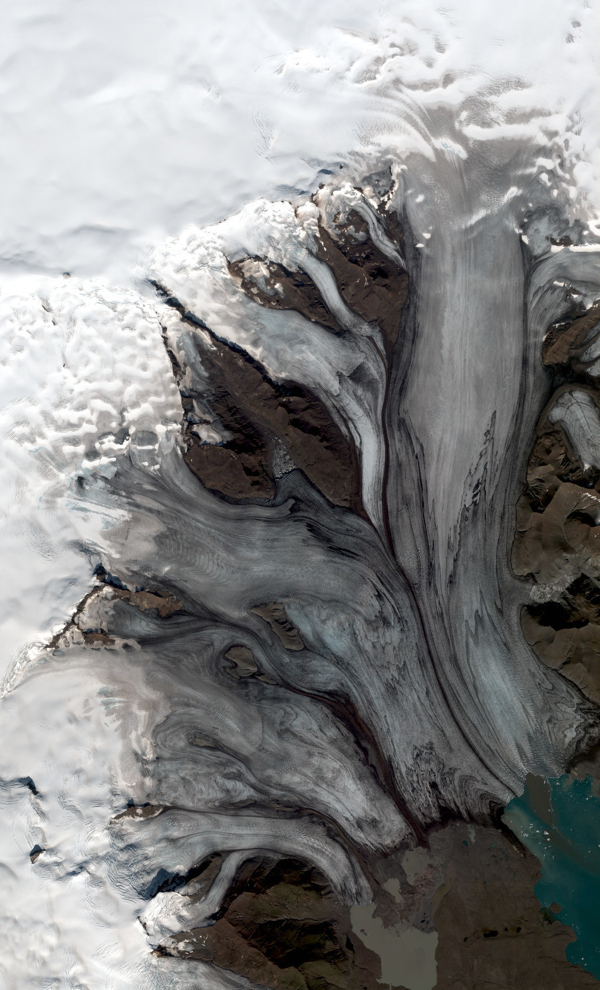
Outlook
Pléiades will continue active until end of 2024. Follow-up: CO3D (https://co3d.cnes.fr/en/co3d-0)
Other sensors currently available with similar characteristics are also limited and privately run: WorldView, SPOT6/7, SkySat
Some ideas for publicly available satellite stereoimages are being discussed: Sentinel HR, Landsat 10. Unfortunately not very optimistic
Optical stereoimages are cloud-dependent. This is a challenge in Iceland. Radar-based DEMs can overcome this problem (e.g. TDX)
© CNES. Distribution Airbus DS

