Slide 1
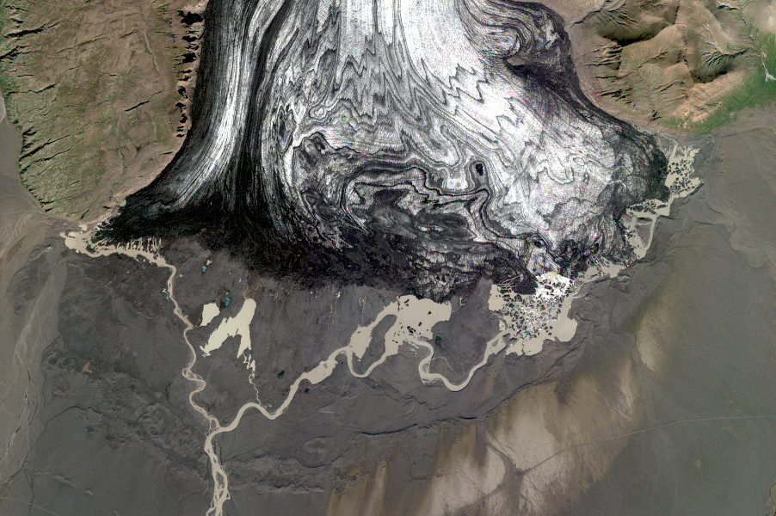
Mapping and monitoring of Iceland using Pléiades satellite stereoimages
Joaquín M.C. Belart
Veðurstofa Íslands, 12 Dec 2022
Notes:
<number>

Slide 2
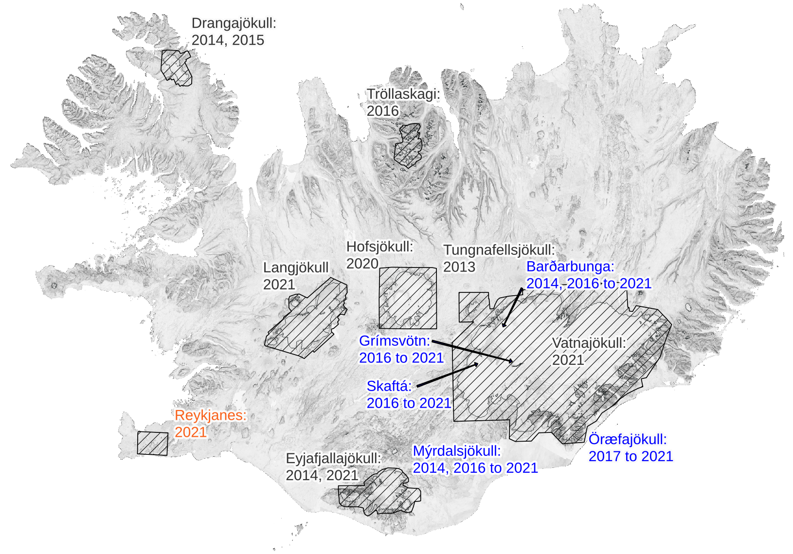
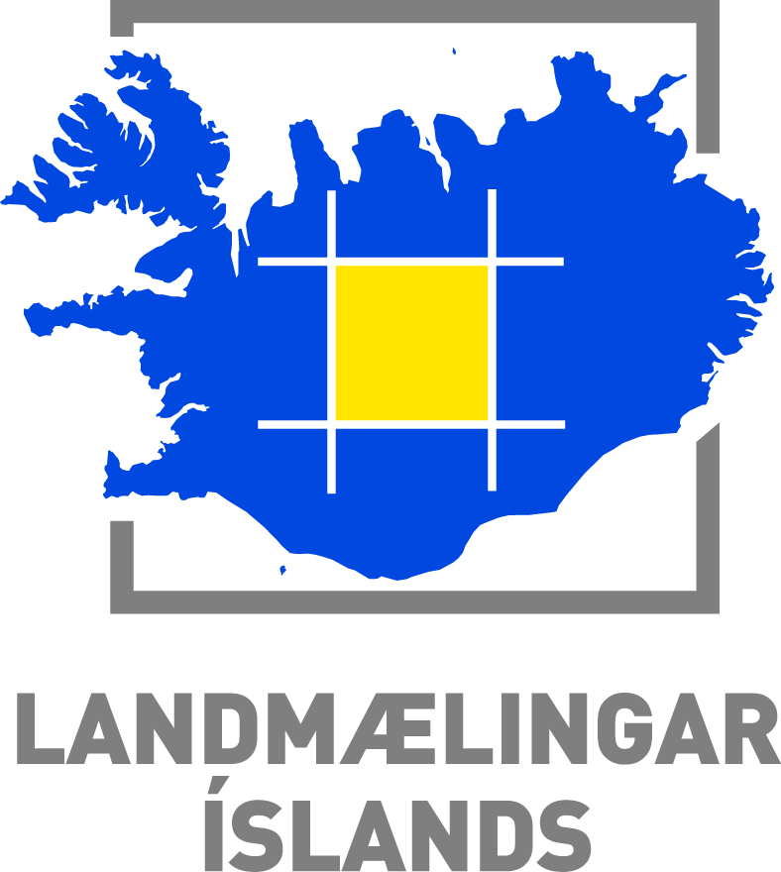
Pléiades surveys in Iceland since launch of satellites
Main mapping initiatives:
CIEST² Initiative
Dinamis & Geosud
CEOS-Volcano Supersite

Slide 3
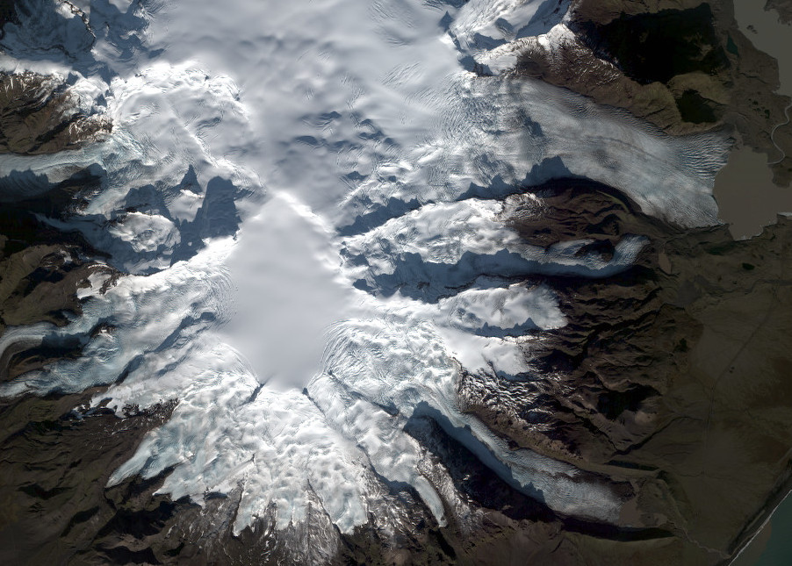
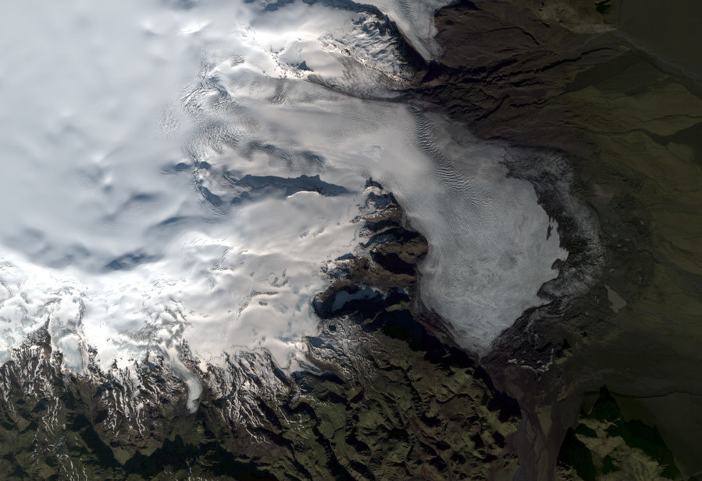
© CNES. Distribution Airbus DS
© CNES. Distribution Airbus DS
Glacier mapping from Pléiades stereo images:
2020: ~2,000 km²
2021: ~15,000 km²
2022: ~4,000 km²
© CNES. Distribution Airbus DS

Slide 4
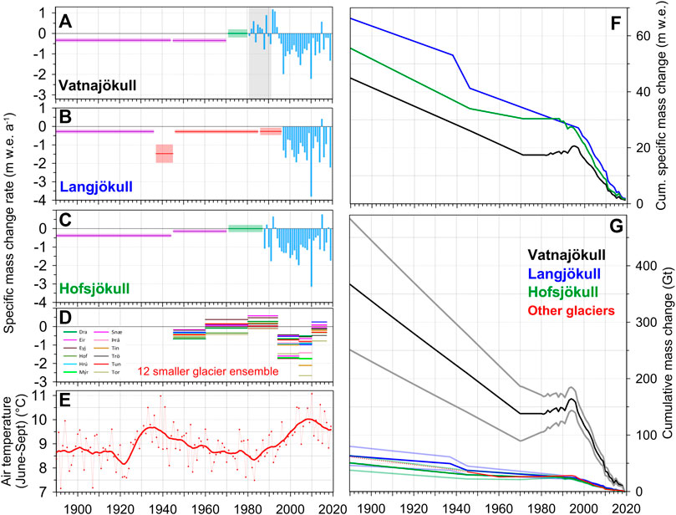
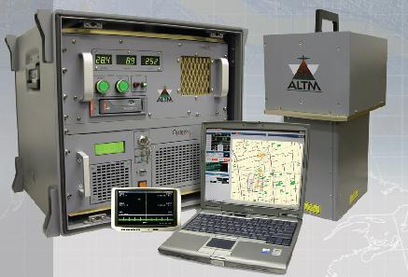
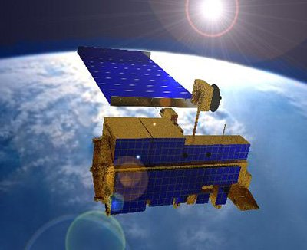
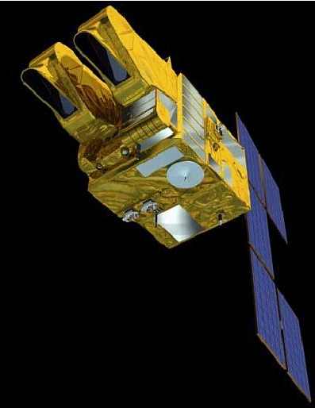
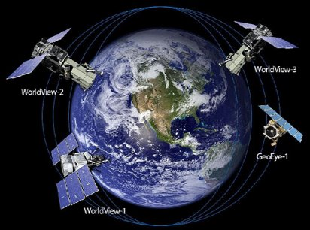
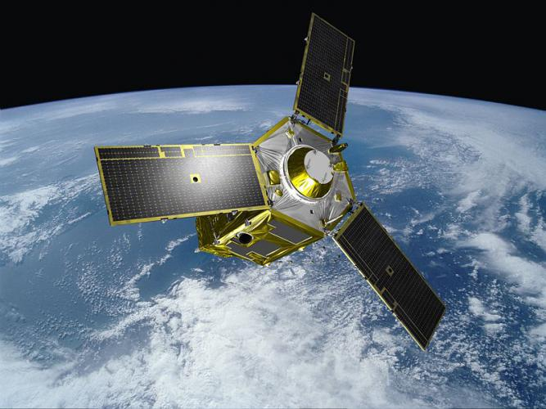
Glacier mass balance in Iceland: geodetic observations
Lidar
Jóhannesson et al., 2013
ASTER
SPOT5
WV01-03 & GE01
Pléiades
Aðalgeirsdóttir et al., 2020
Porter et al., 2018

Slide 5
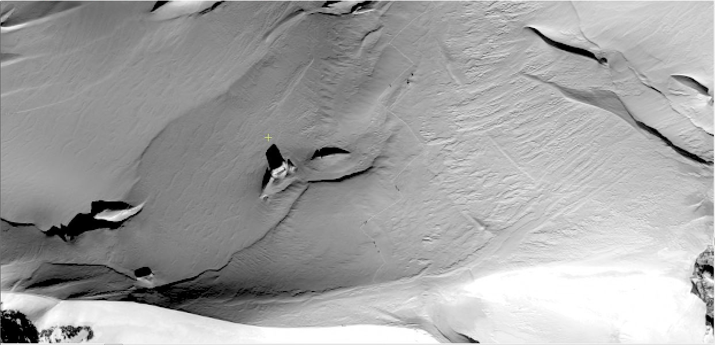
Pléiades 1A (CNES & Airbus D&S)
t
Berthier et al., The Cryosphere, 2014

Slide 6
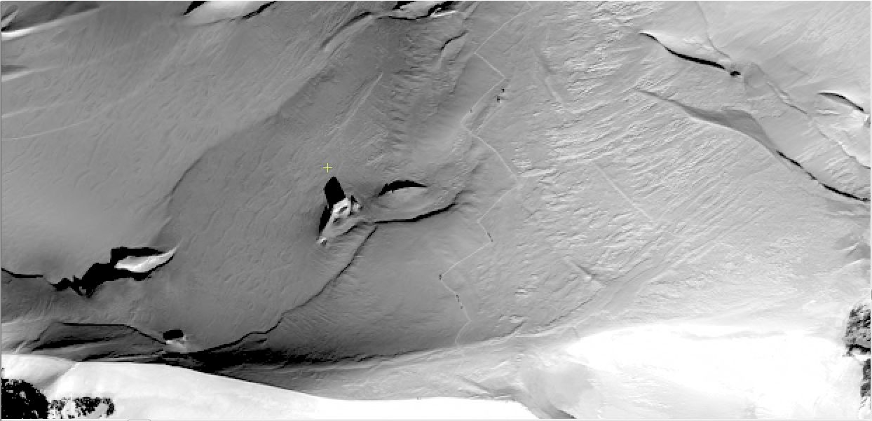
Pléiades 1A (CNES & Airbus D&S)
t + 27 sec
Berthier et al., The Cryosphere, 2014

Slide 7
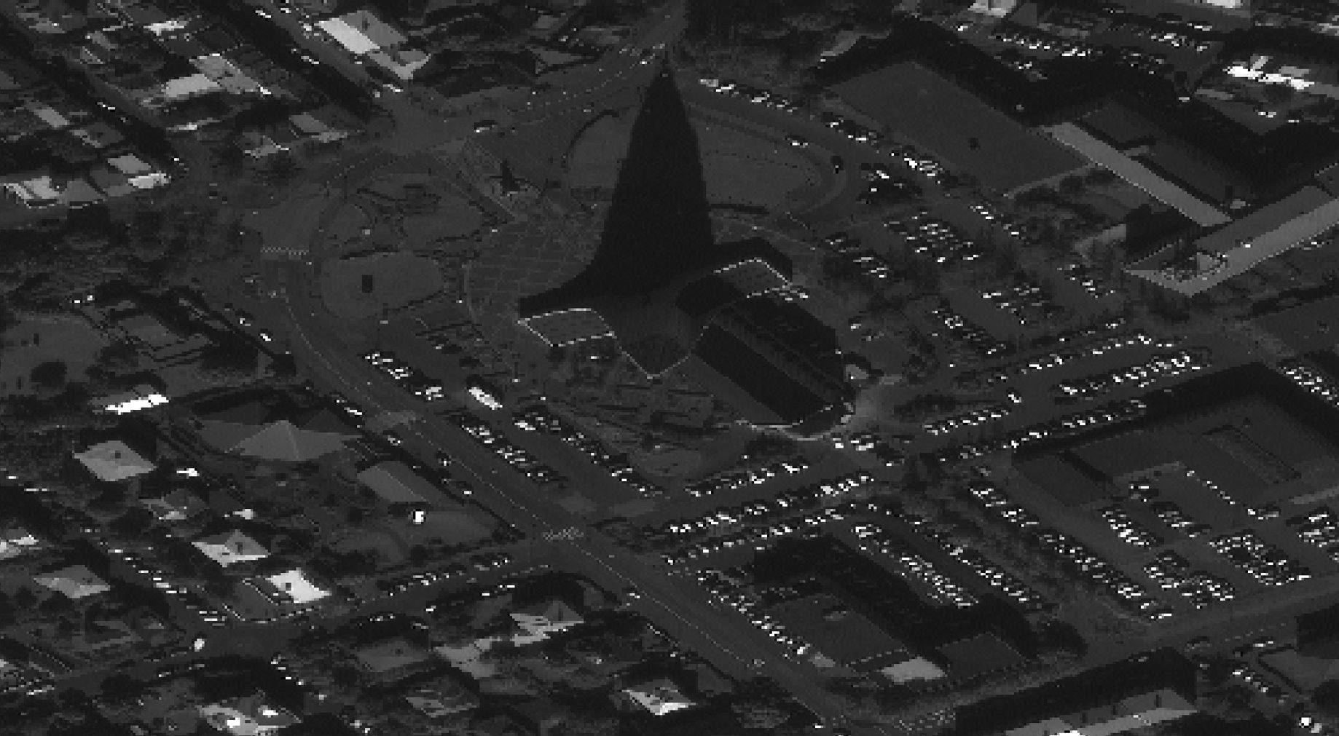
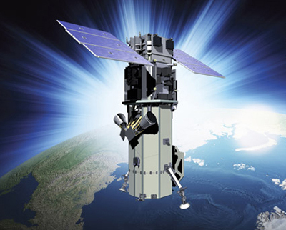
WorldView3 (DG & Maxar)
© Maxar

Slide 8
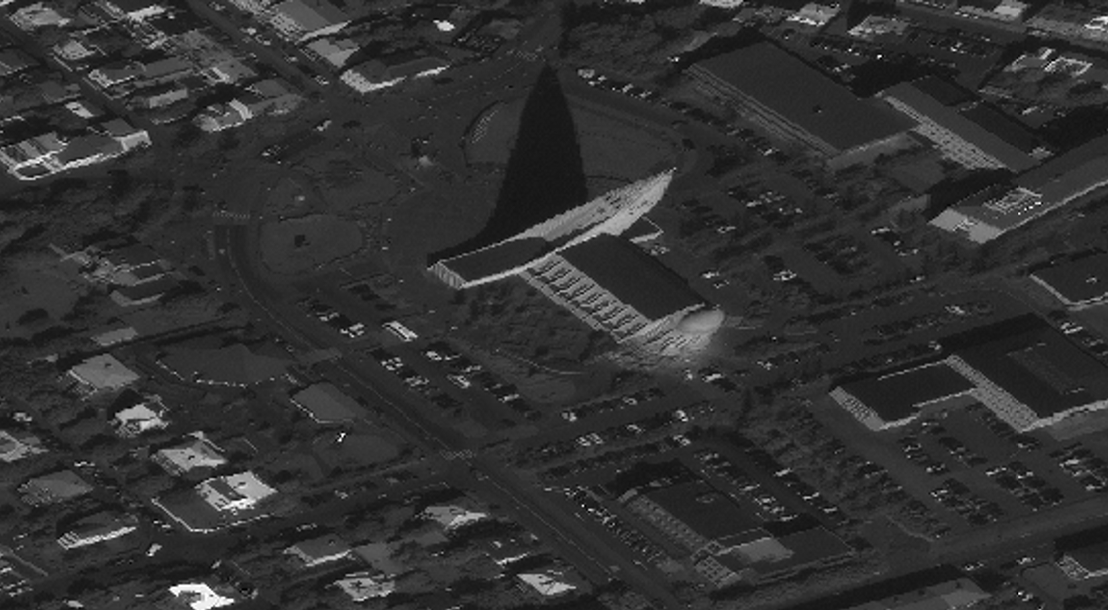
WorldView3 (DG & Maxar)
© Maxar

Slide 9
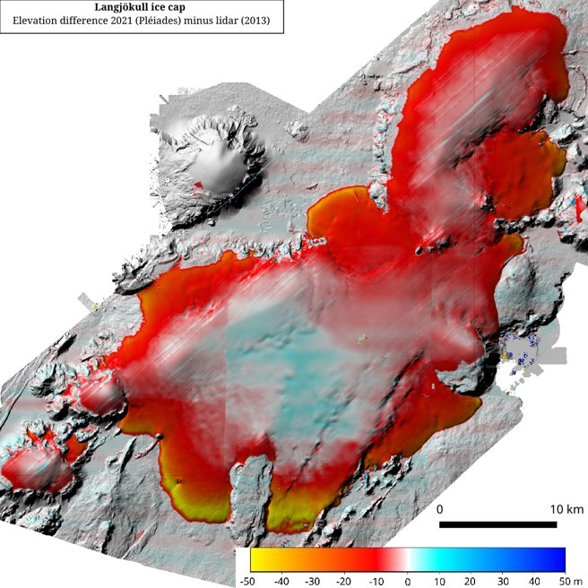
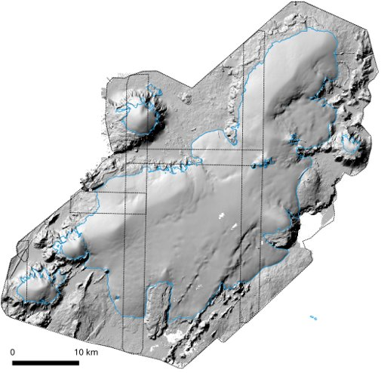
Langjökull Pléiades 2021 surveys:
September: 9th
October: 6th, 11th

Slide 10
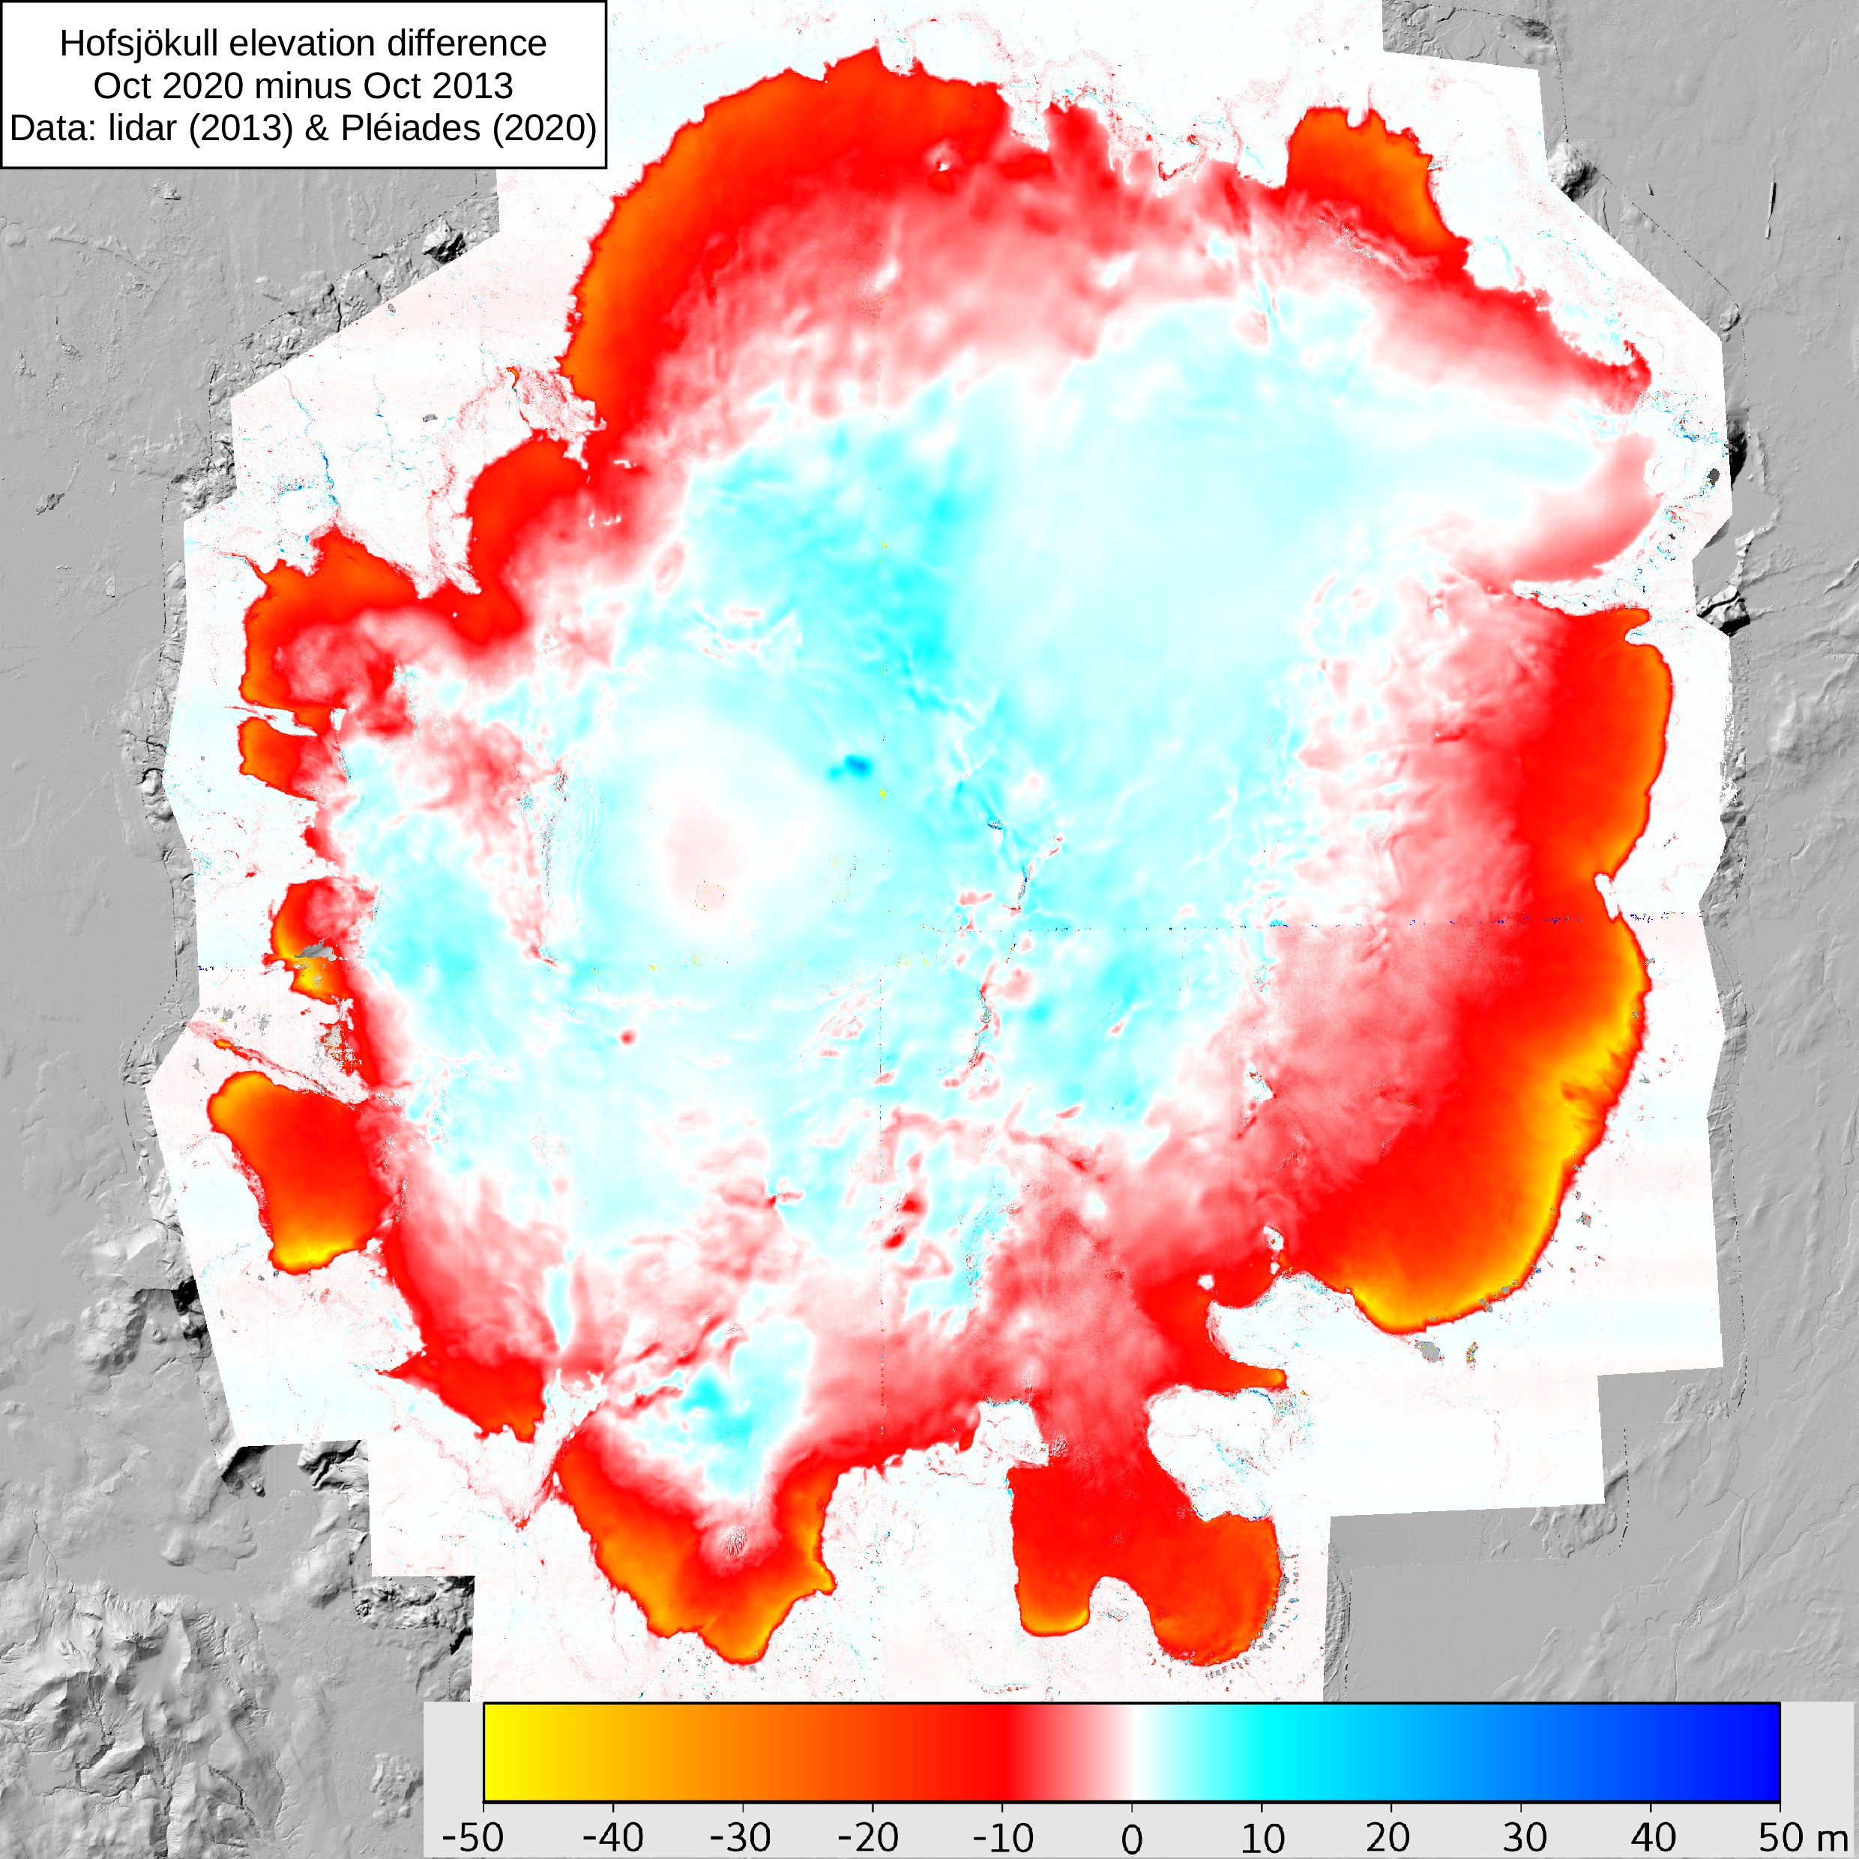
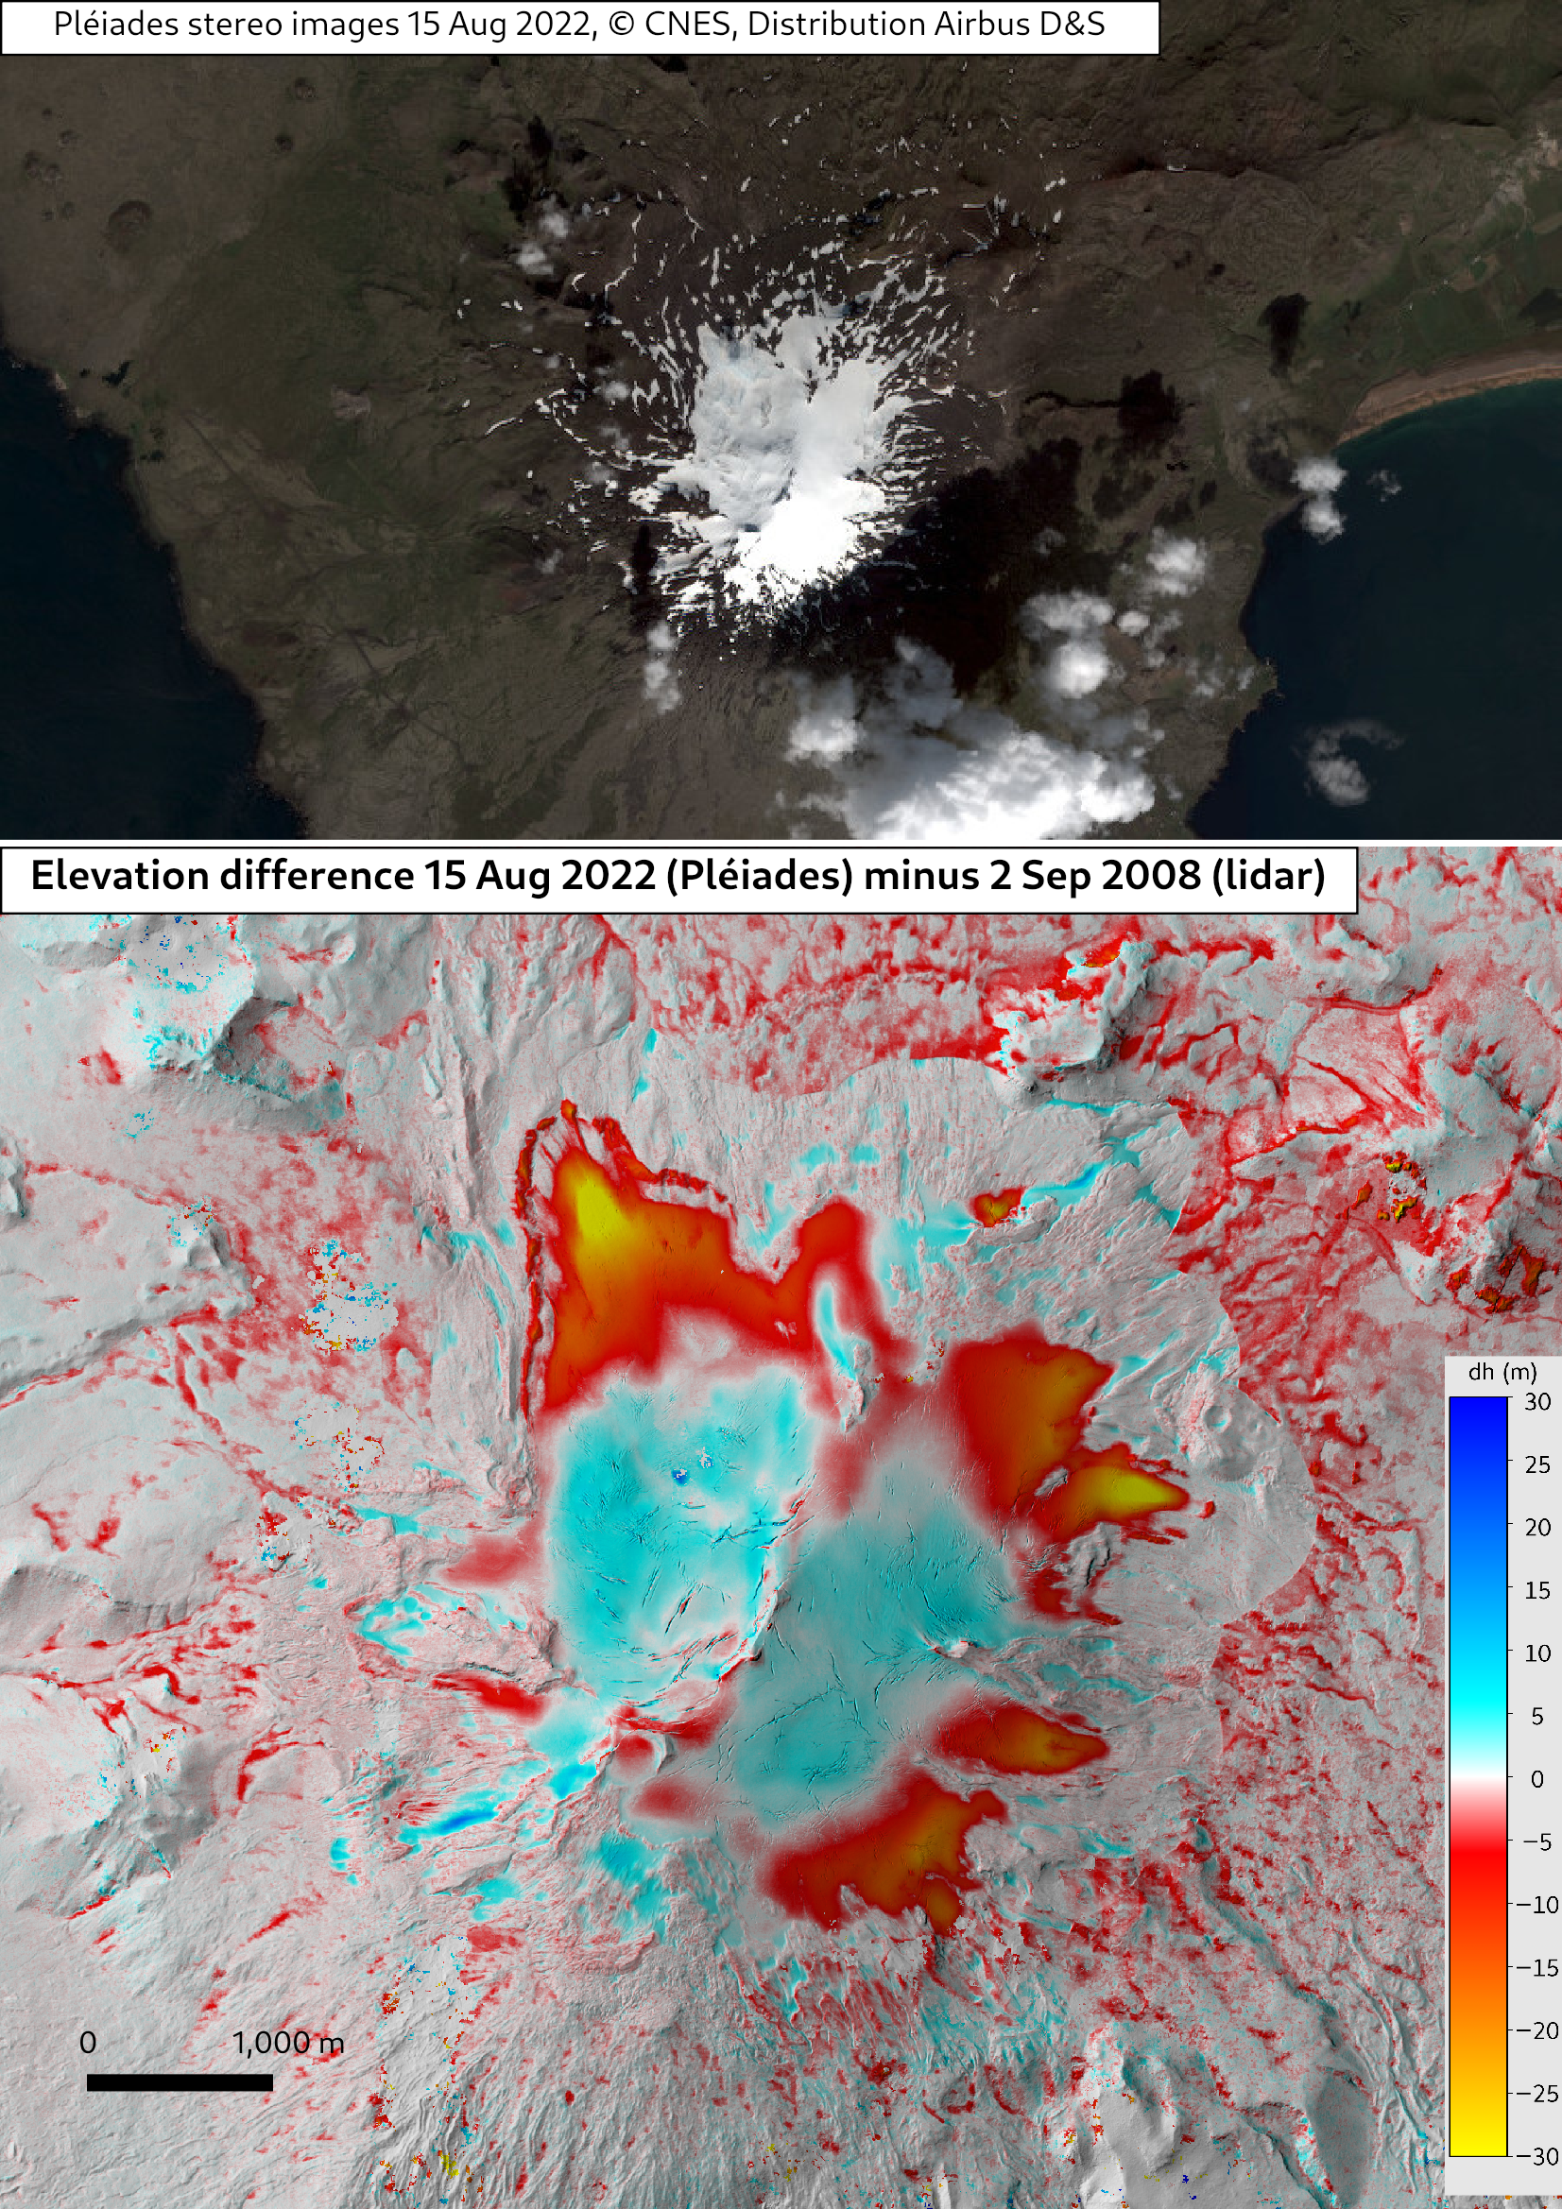

Slide 11
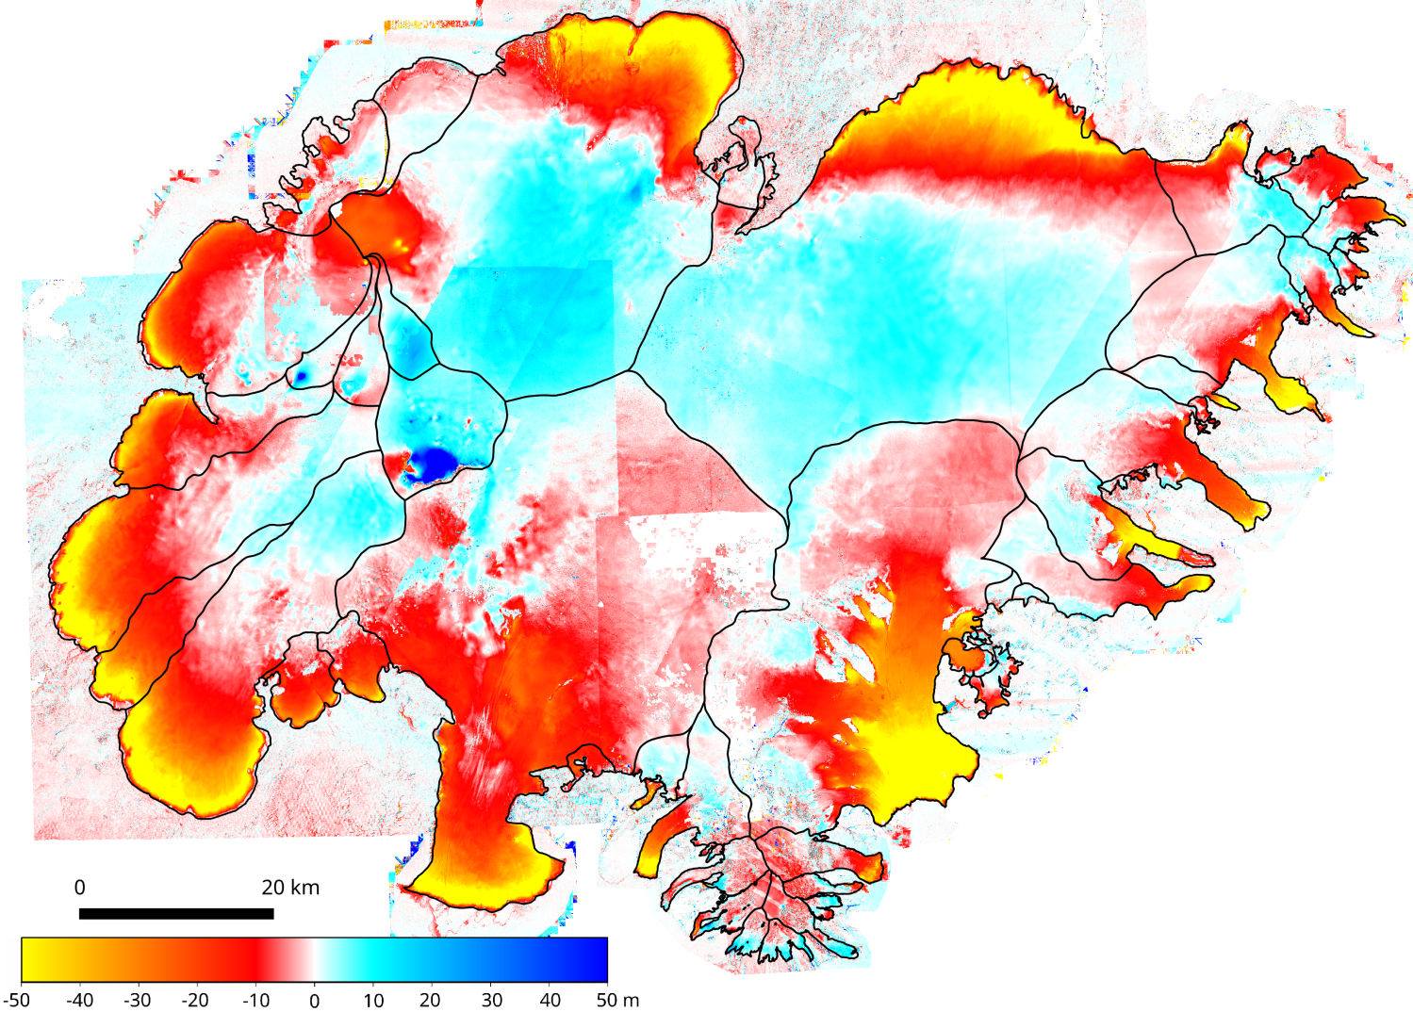
Vatnajökull: SPOT7 & Pléiades 2021
Vatnajökull: SPOT7 & Pléiades 2021
minus lidar (2010-2012)

Slide 12
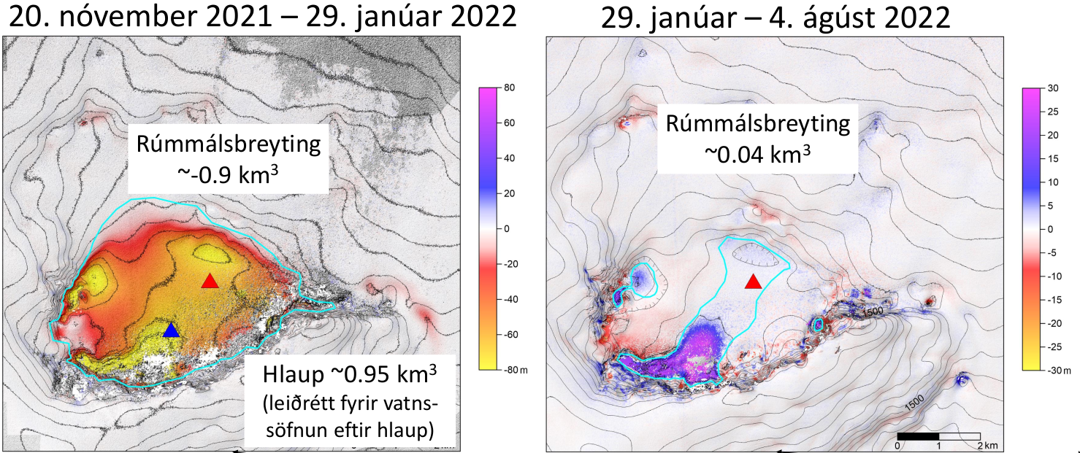
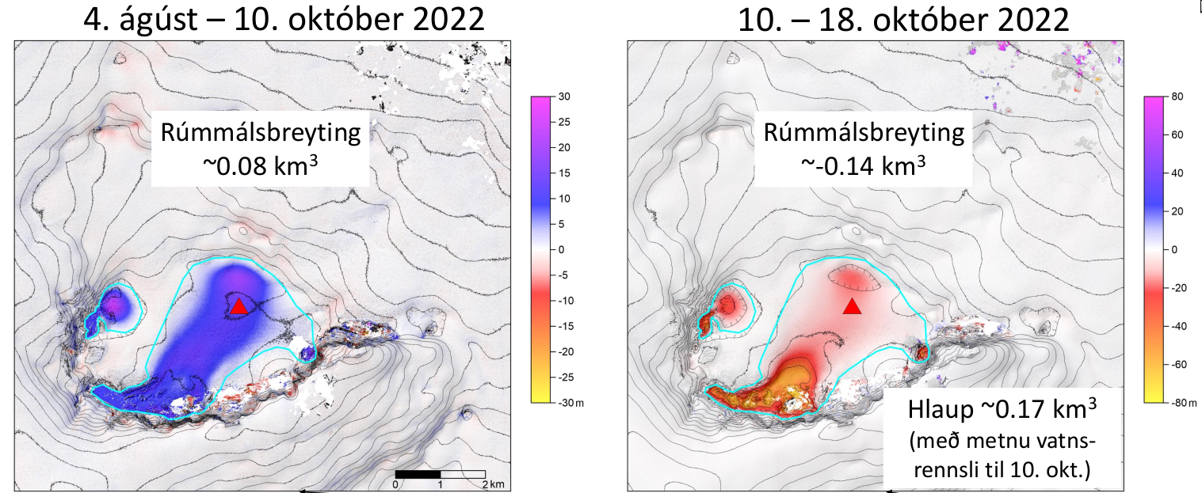
Monitoring of geothermal areas:
Grímsvötn
Eyjólfur Magnússon, JHÍ

Slide 13
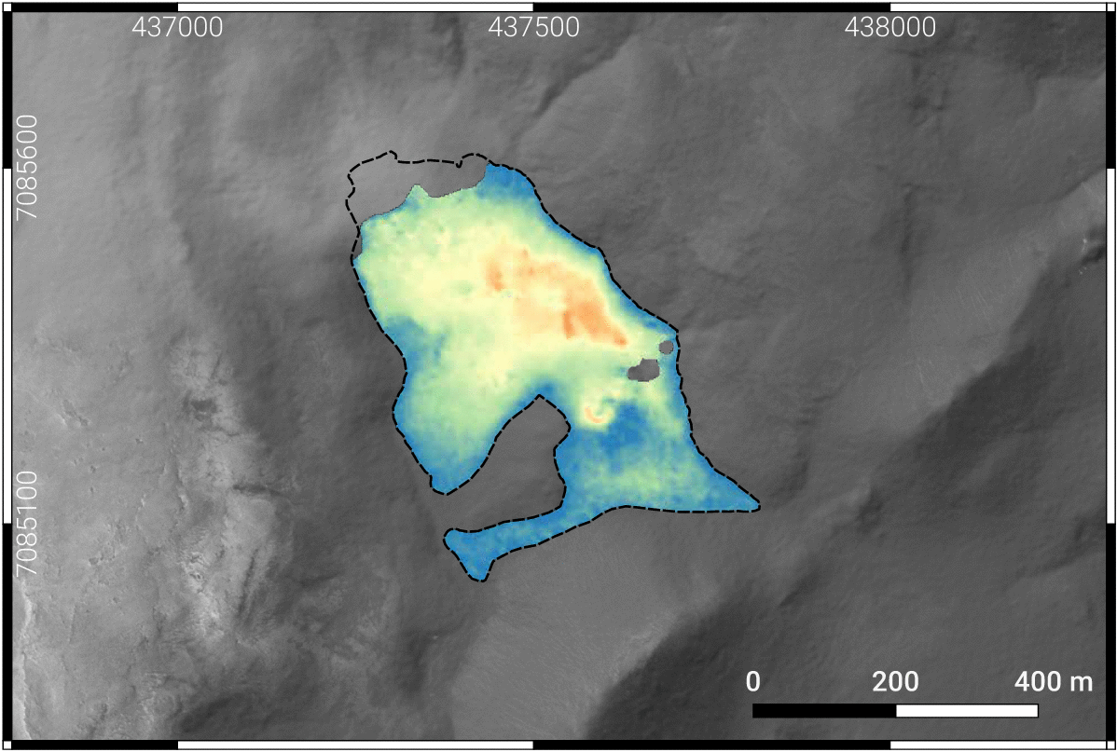
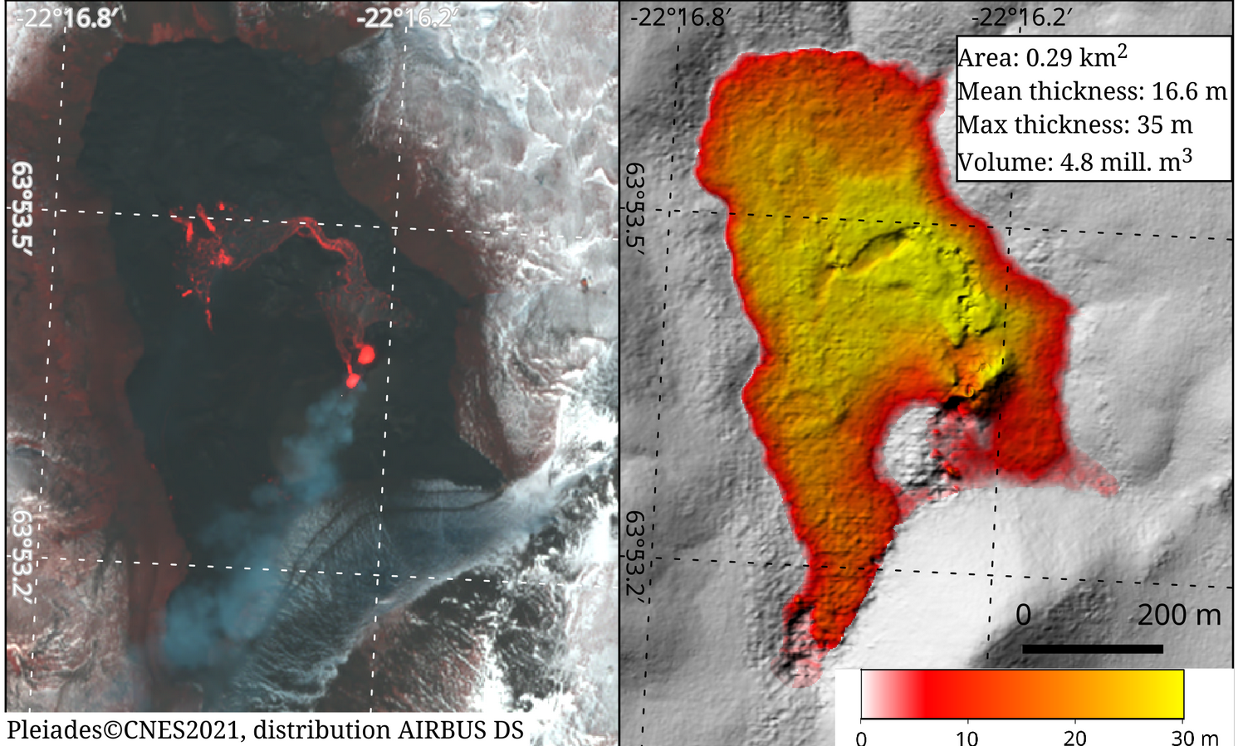
Near-real time Monitoring - CIEST²
First time Pléiades is used in near-real time for volcano monitoring
These data provided crucial information for the evolution of the eruption during the first 10 days
Repeated in La Palma (Sep – Oct 2021) and in Fagradalsfjall/Meradalir (Aug 2022) eruptions.
Gouhier et al., 2022. Journal of Applied Volcanology

Slide 14
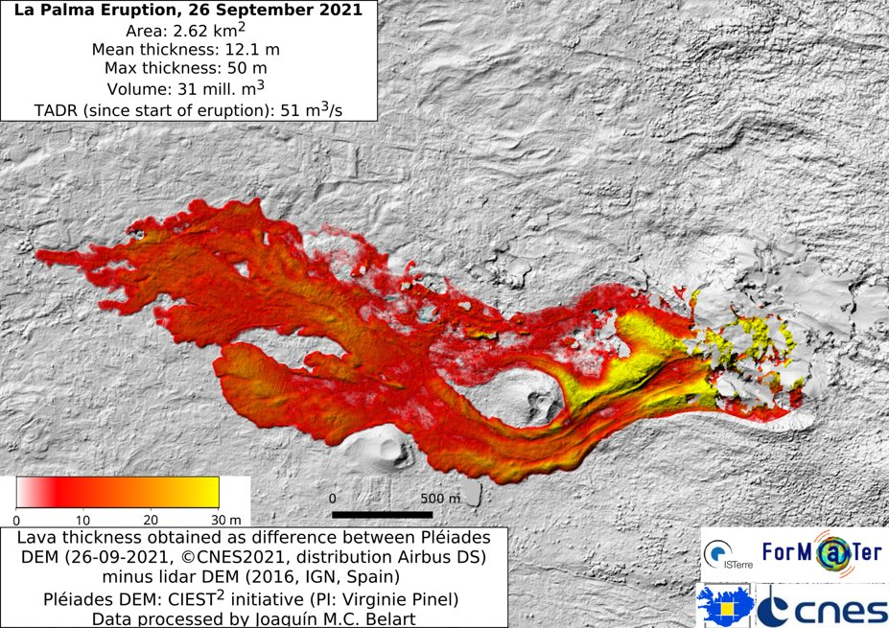
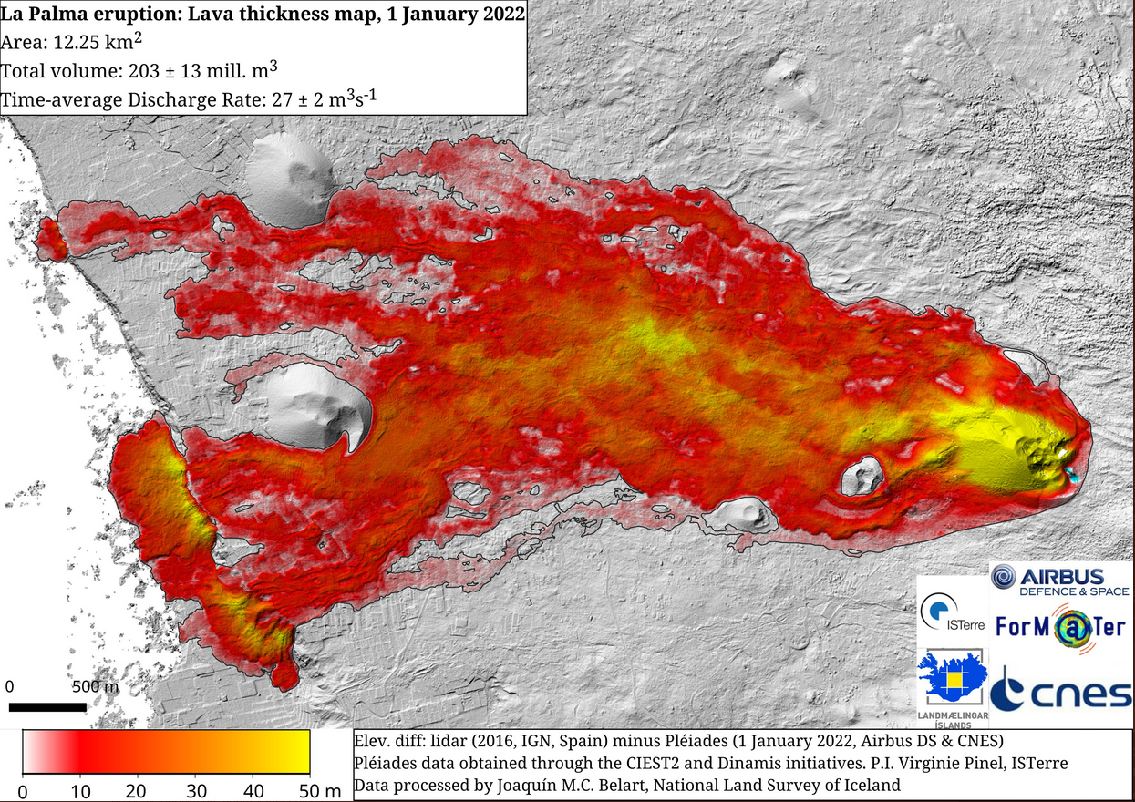
La palma monitoring from Pléiades

Slide 15
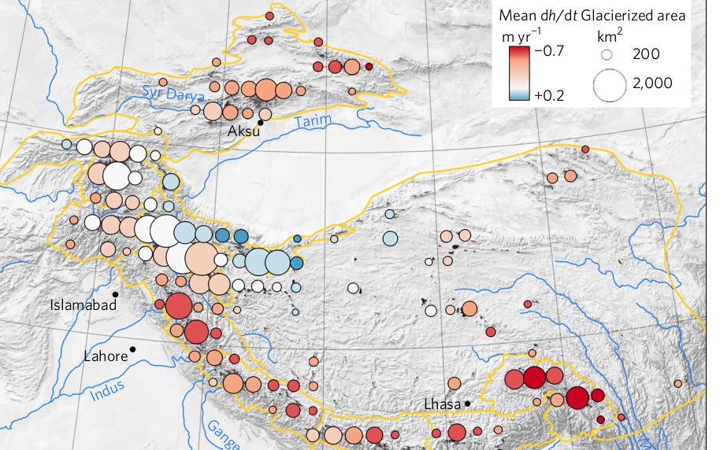
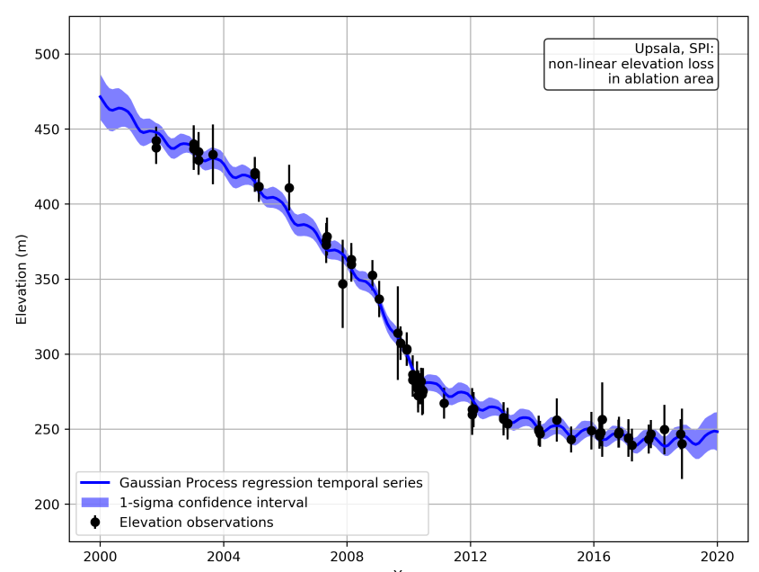
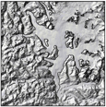
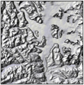
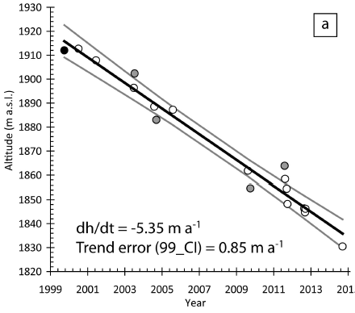
ASTER DEM
stacks
Gaussian processes
Start
Brun et al., 2017
End
Hugonnet et al., 2021.
https://github.com/iamdonovan/
https://github.com/rhugonnet/
Berthier et al., Frontiers, 2016
Dussaillant et al., 2019

Slide 16
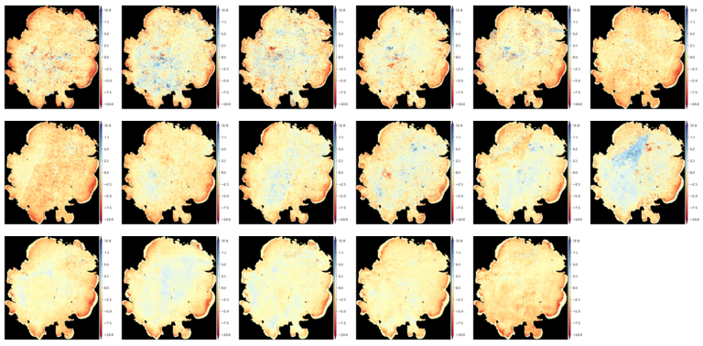
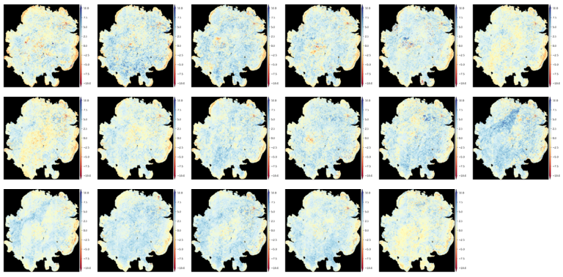
1 Oct – 1 Oct
1 Oct – 1 Jun

Slide 17
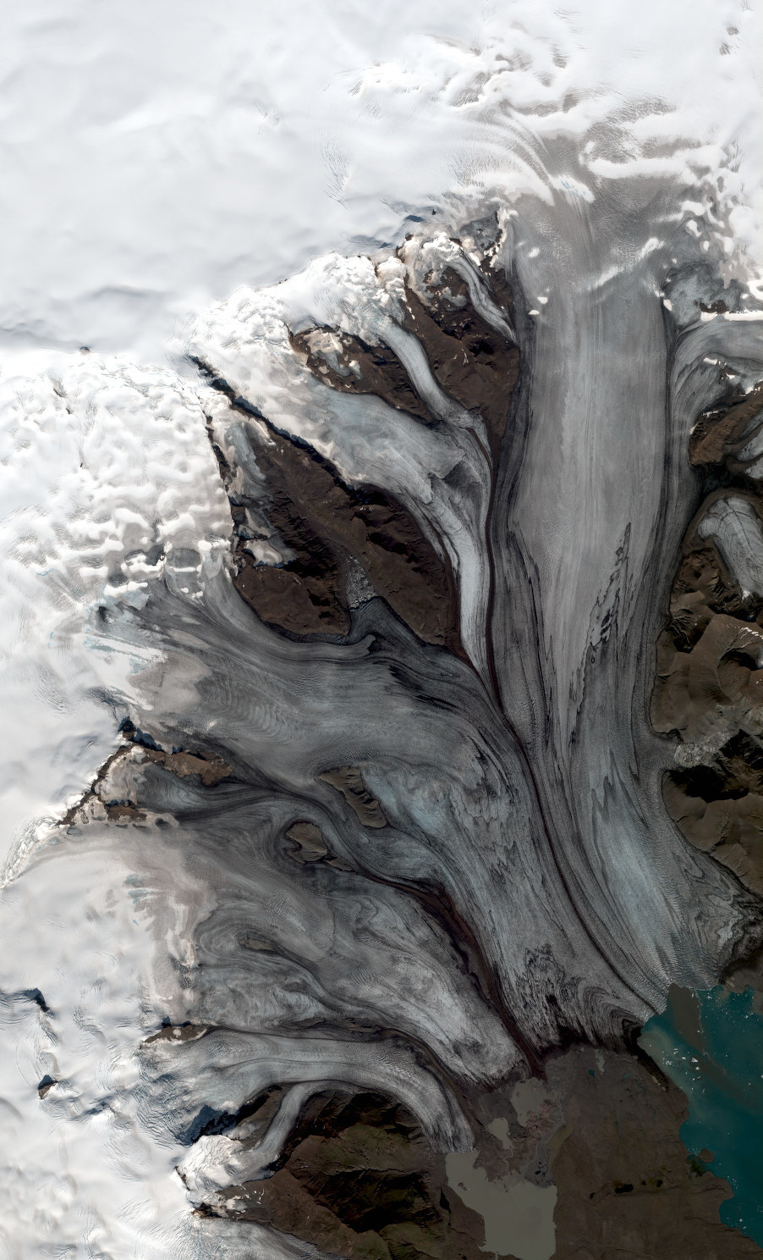
Outlook
Pléiades will continue active until end of 2024. Follow-up: CO3D (https://co3d.cnes.fr/en/co3d-0)
Other sensors currently available with similar characteristics are limited and privately run: WorldView, SPOT6/7, SkySat
Some ideas for publicly available satellite stereoimages are being discussed: Sentinel HR, Landsat 10. Unfortunately not very optimistic
Optical stereoimages are cloud-dependent. This is a challenge in Iceland. Radar-based DEMs can overcome this problem (e.g. TDX)
© CNES. Distribution Airbus DS

