Slide 1
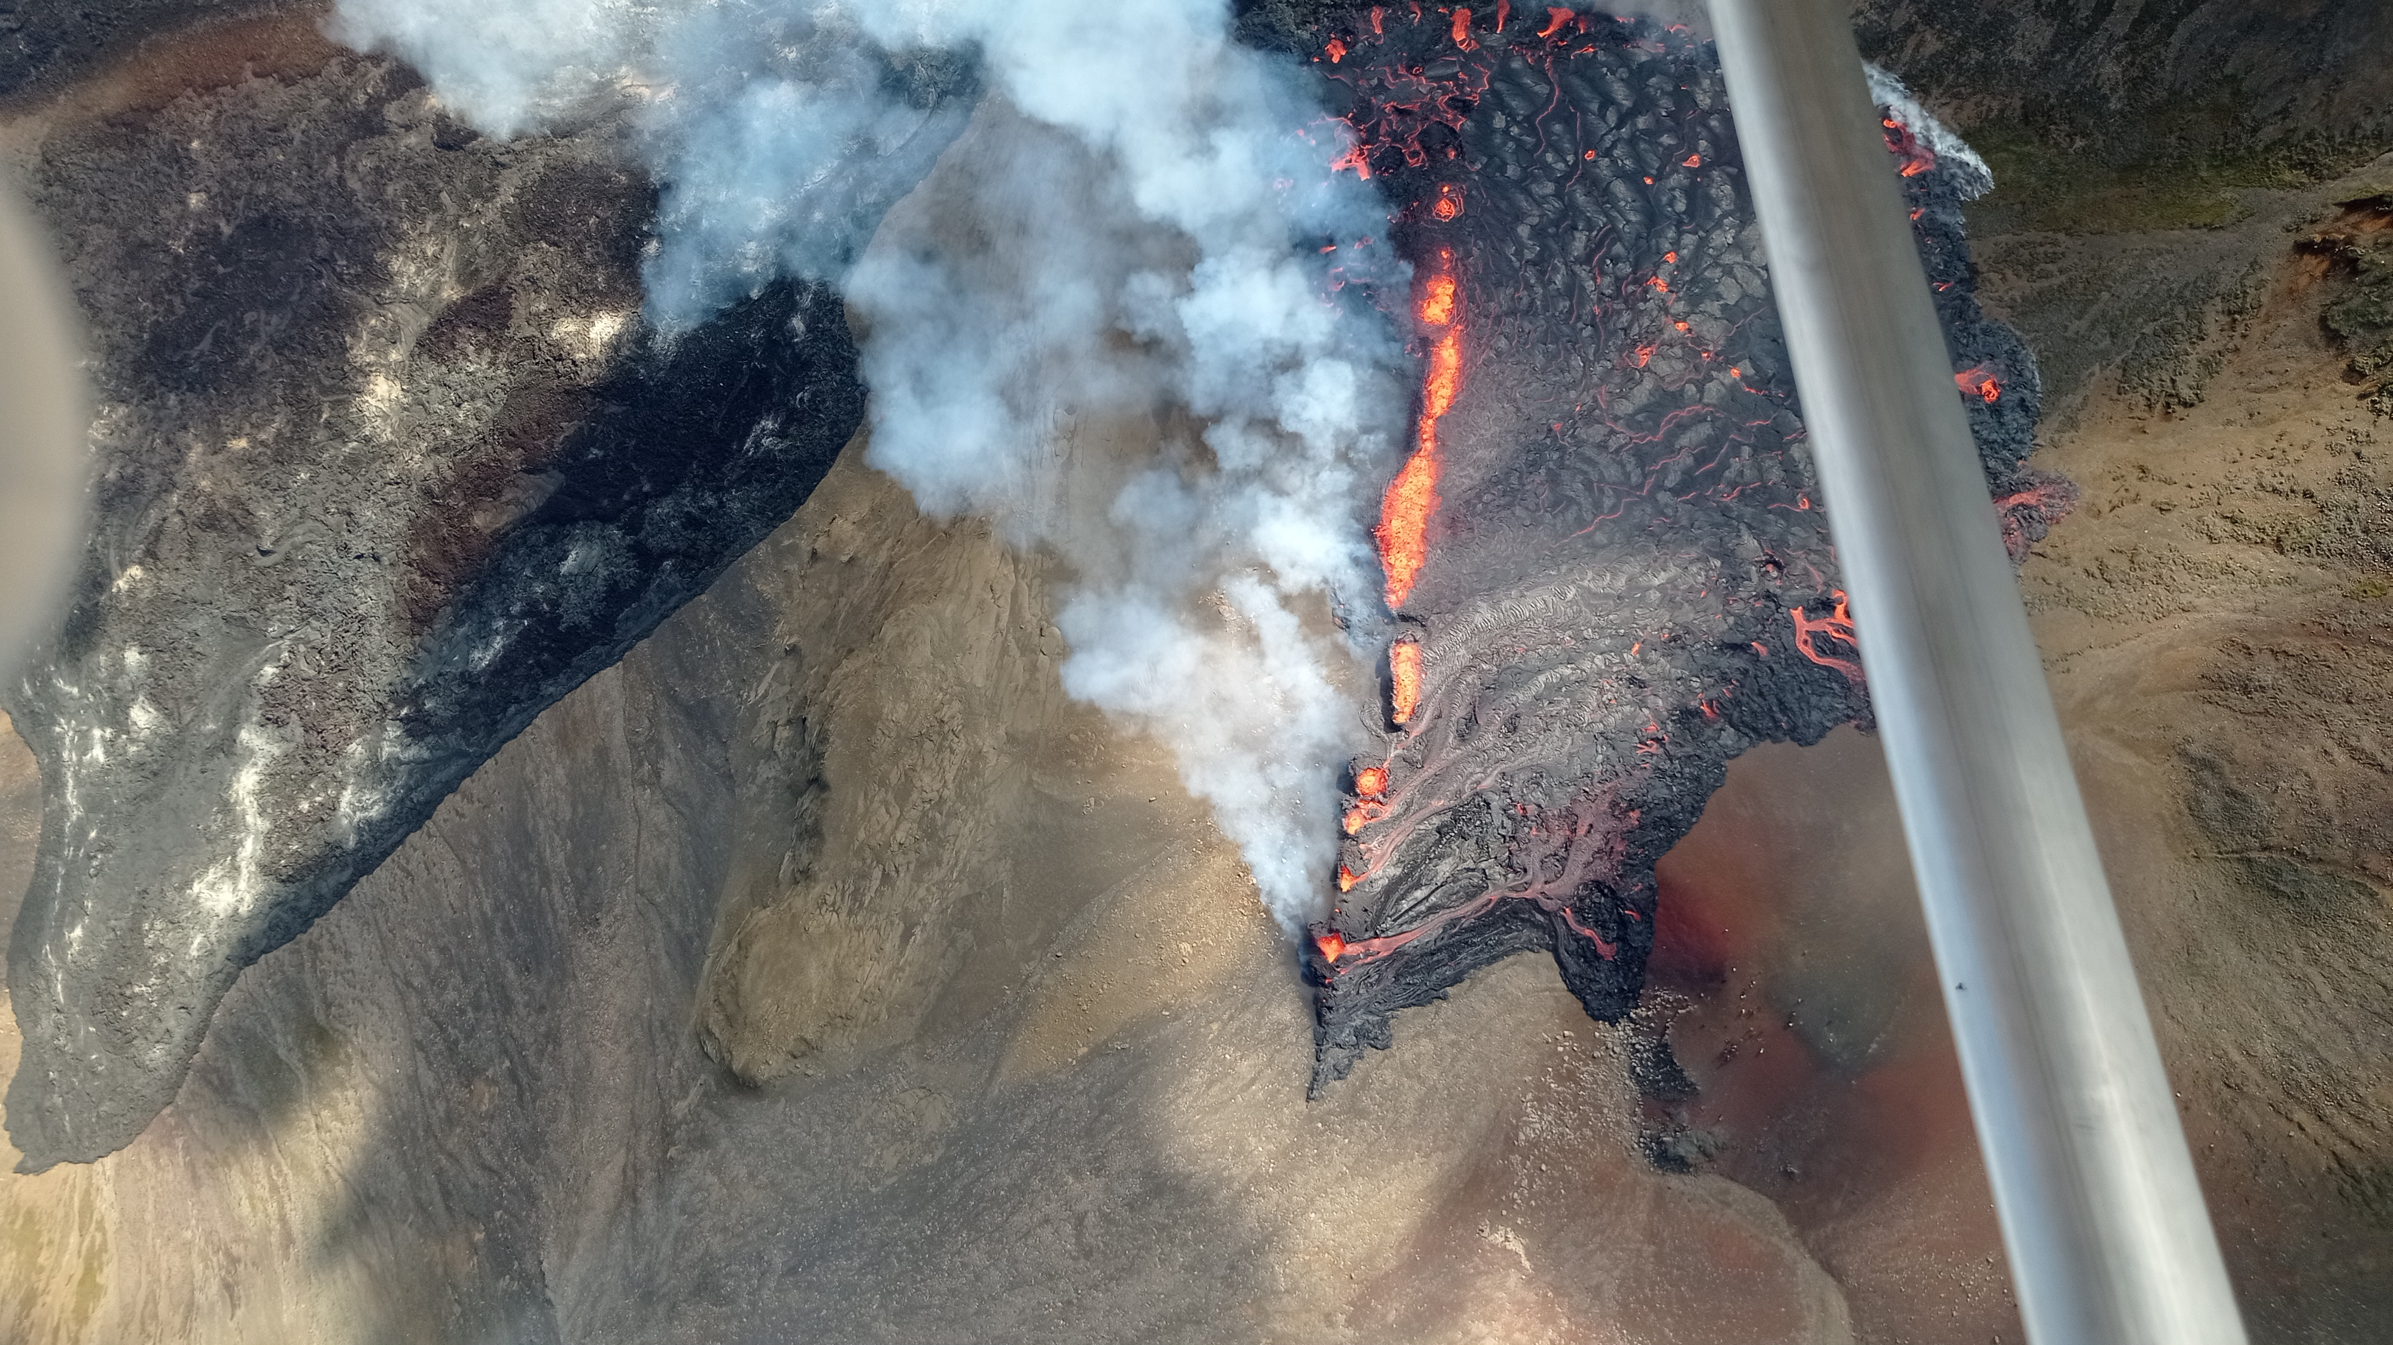
Near Real-Time Photogrammetric Monitoring of the 2021 Fagradalsfjall and 2022 Meradalir eruptions, SW-Iceland
Joaquín M.C. Belart, National Land Survey of Iceland
Notes:
<number>

Slide 2
Near Real-Time Photogrammetric Monitoring of the 2021 Fagradalsfjall and 2022 Meradalir eruptions, SW-Iceland
Joaquín M.C. Belart, National Land Survey of Iceland
Notes:
<number>

Slide 3
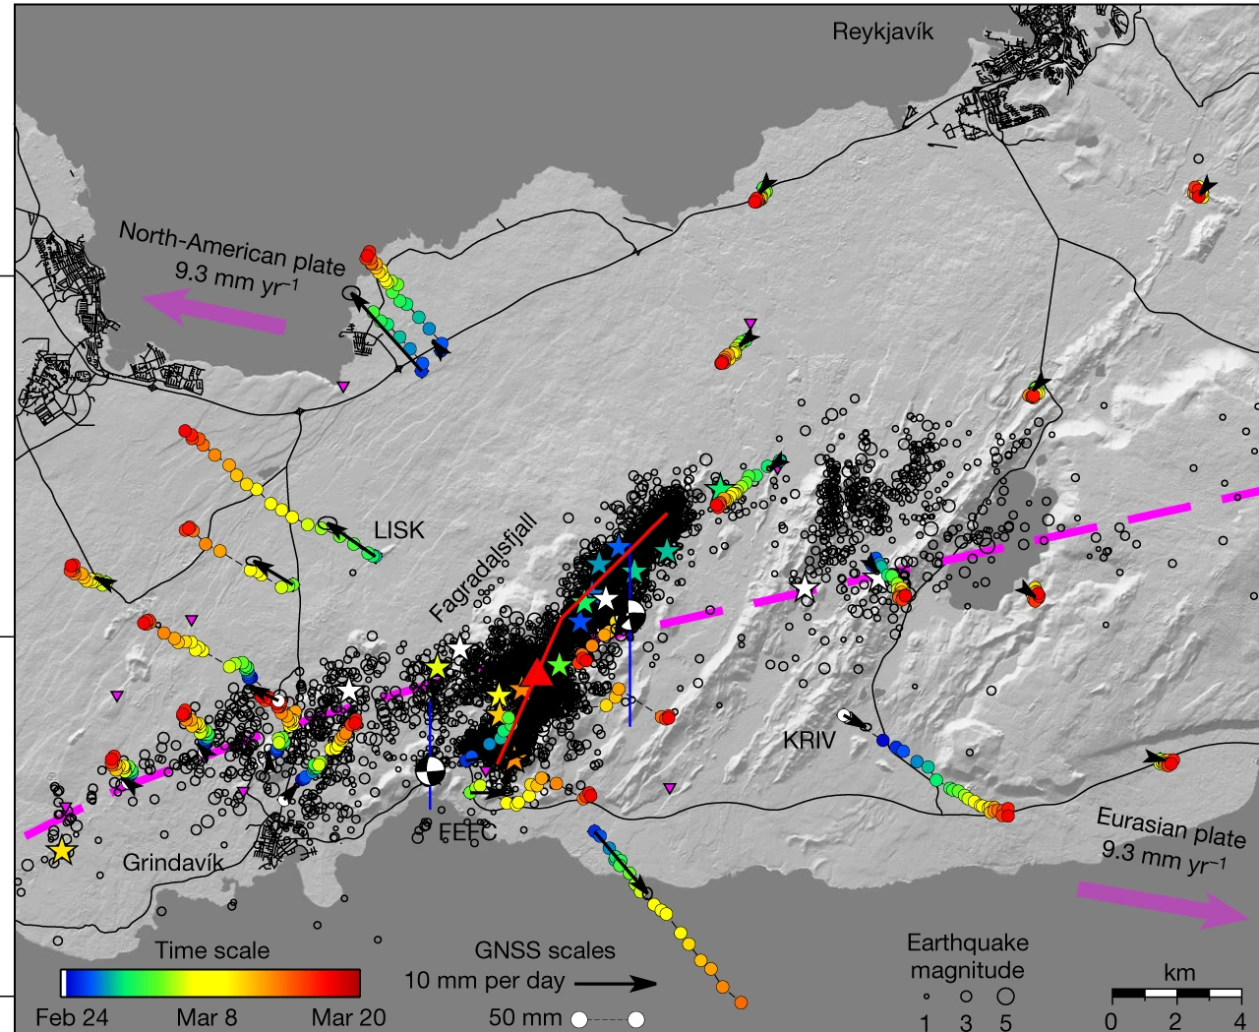
Volcanic unrest of Reykjanes
Unrest started in 2019, affecting three volcanic zones in Reykjanes (10 – 40 km away from Reykjavík)
19 Mar – 18 Sep 2021: Eruption in Fagradalsfjall
3 Aug – 21 Aug 2022: Eruption in Meradalir
Earthquakes & GPS deformation 24 Feb – 20 Mar 2021
InSAR deformation 23 Feb – 1 Mar 2021
(Sigmundsson et al., 2022, Nature)

Slide 4
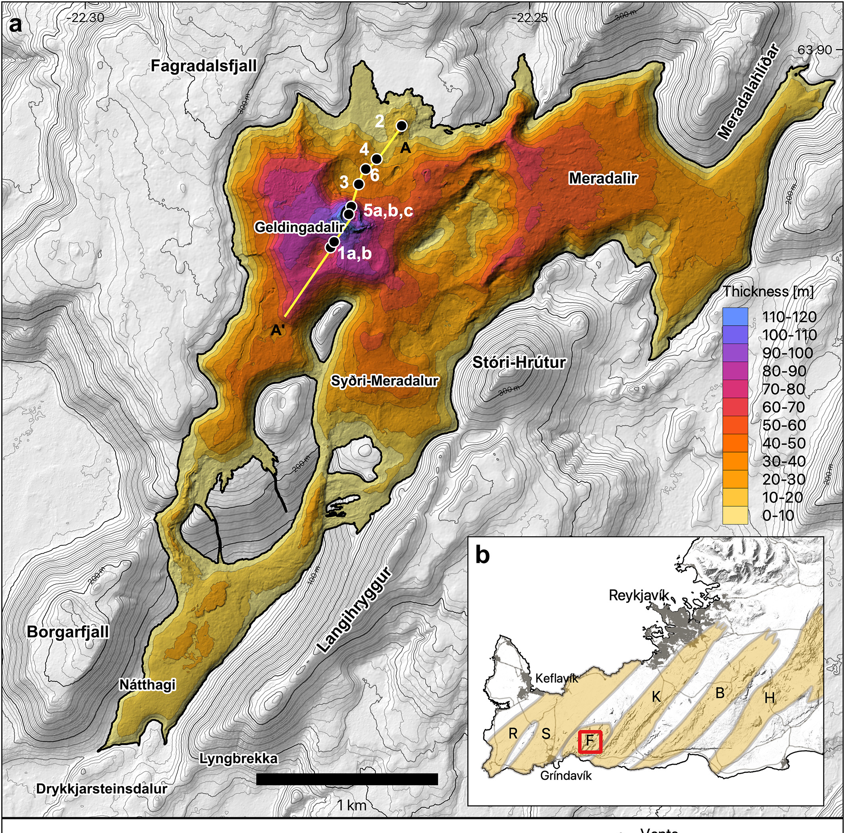
Photogrammetric surveys of volcanic eruptions
Comparison of Digital Elevation Models (DEMs) pre- and co-eruption allow measurement of lava thickness and volumes
Rate of volume change over time provides an accurate Time-Average Discharge Rate (TADR)
Lava thickness: DEM minus pre-eruption DEM
Volume: Mean thickness * area
TADR: Volume/Time

Slide 5
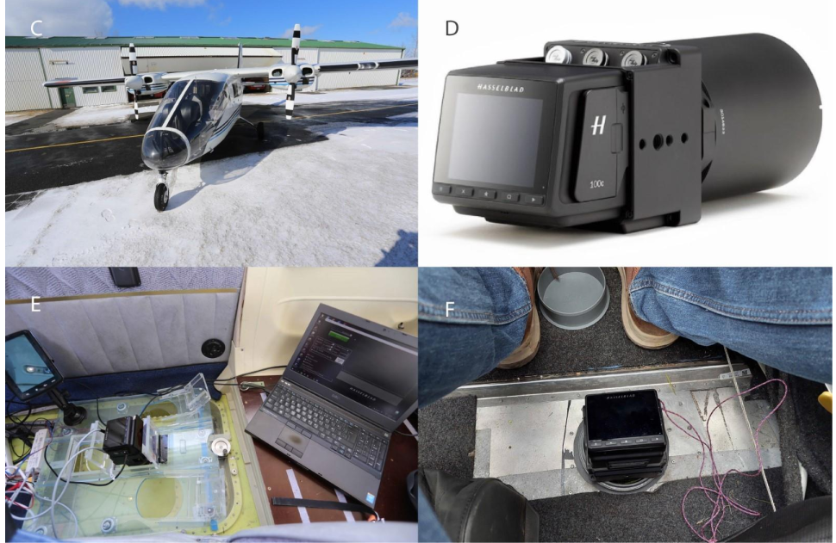
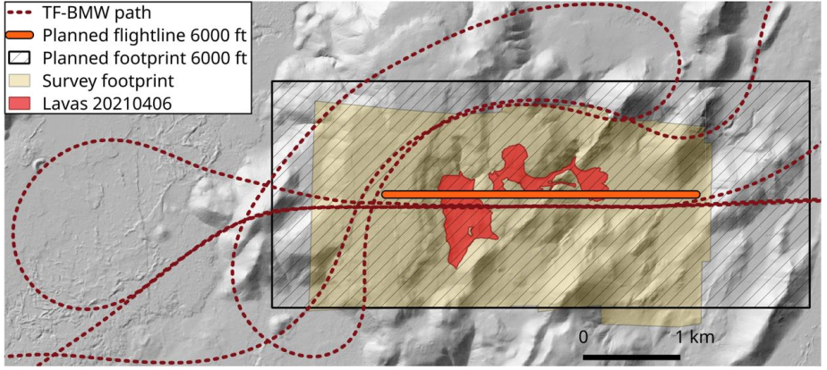
Near-real time monitoring
Fast and efficient creation and delivery of DEMs, orthomosaics, lava thickness, area, volume and TADR as part of the response plan. Resources:
Funding from Civil Defense
Hasselblad medium-format (100mp) camera
Access to 4 airplanes
Pléiades satellites

Slide 6
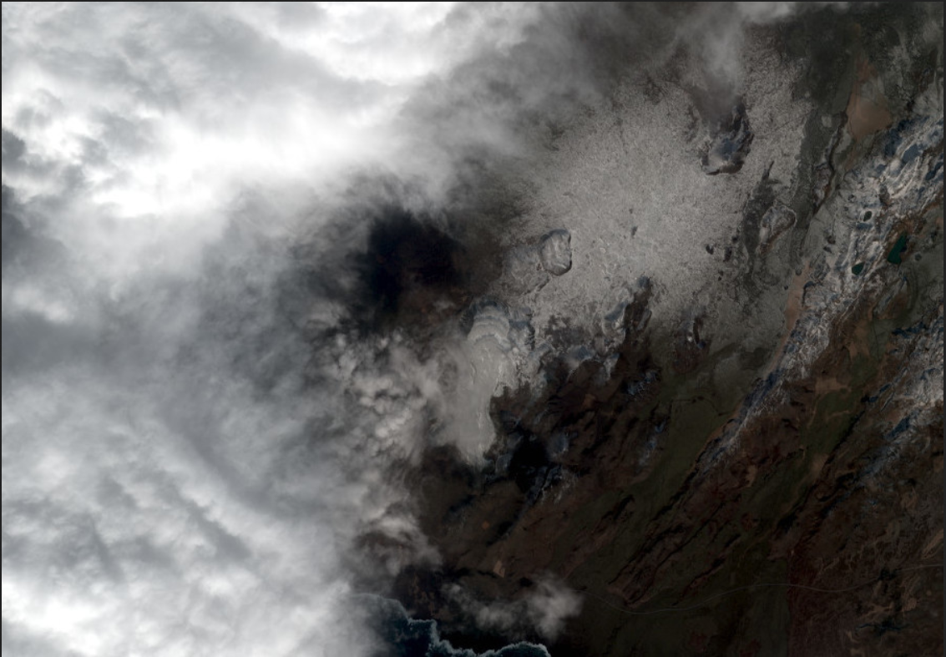
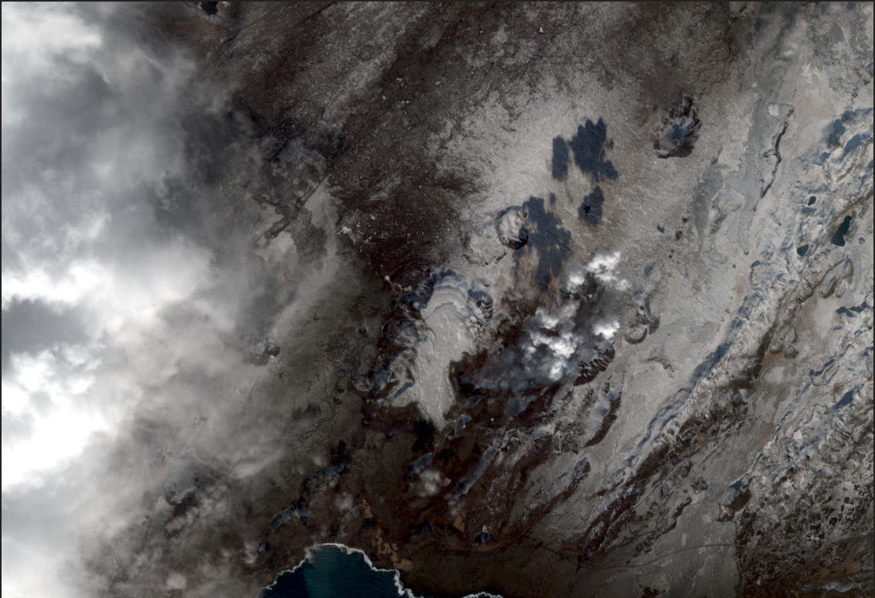
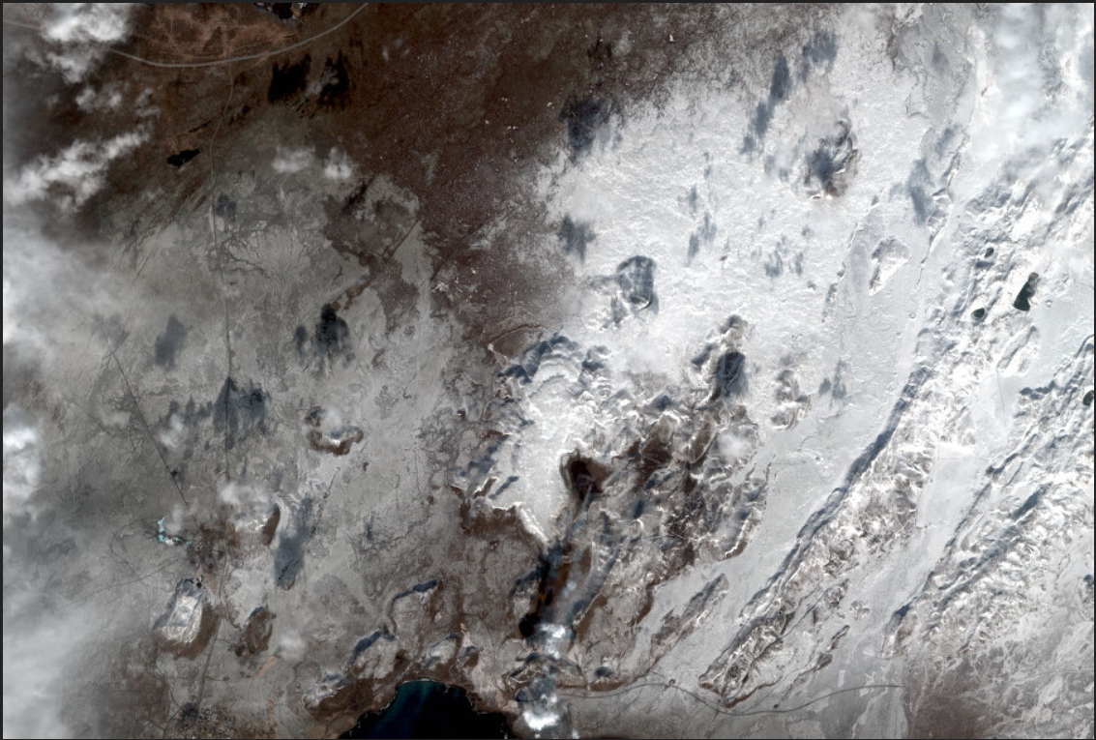
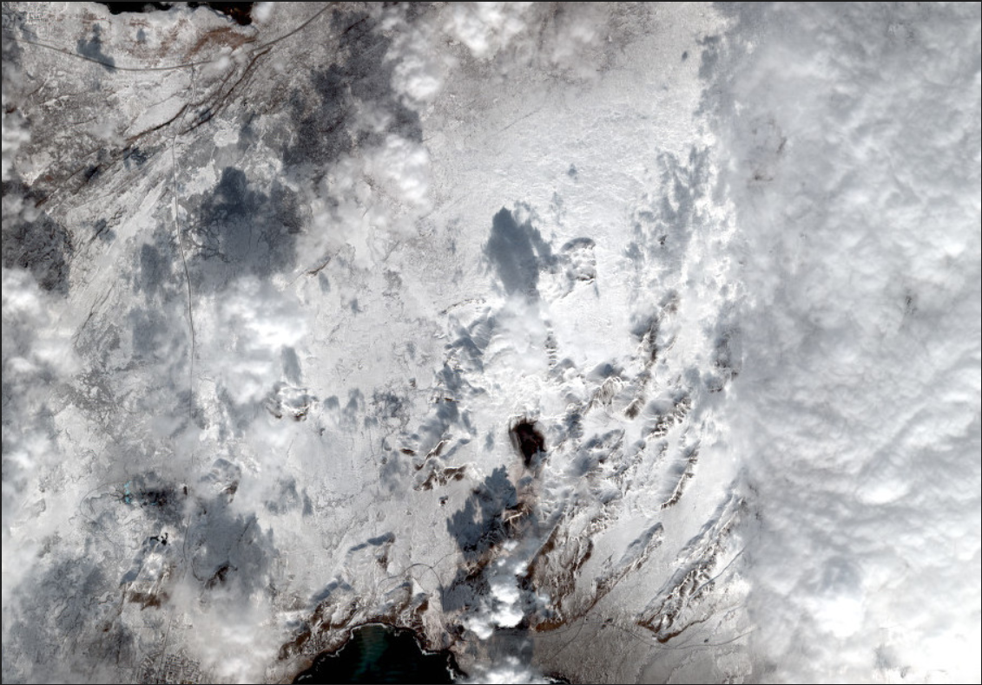
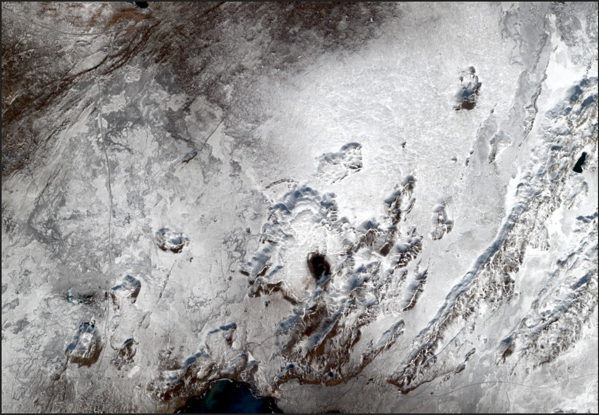
Near-real time monitoring - Fagradalsfjall 2021
22/03/2021
23/03/2021
26/03/2021
29/03/2021
30/03/2021
Pléiades
12:45 h:
Image
acquisition
14:00 h:
Quickview notification
15:00 h:
Data available in ftp
15:00-17:00 h:
ASP Processing
17:00 h: Area, volume, effusion rate for Civil Protection
Aerial photographs
18:00 h: Area, volume, effusion rate for Civil Protection
08:00 h:
Flight plan preparation
11:00 h:
Standby with pilot
12:00 h:
Image acquisition
14:00 h:
Data delivery
14:00- 18:00 h:
MicMac processing

Slide 7
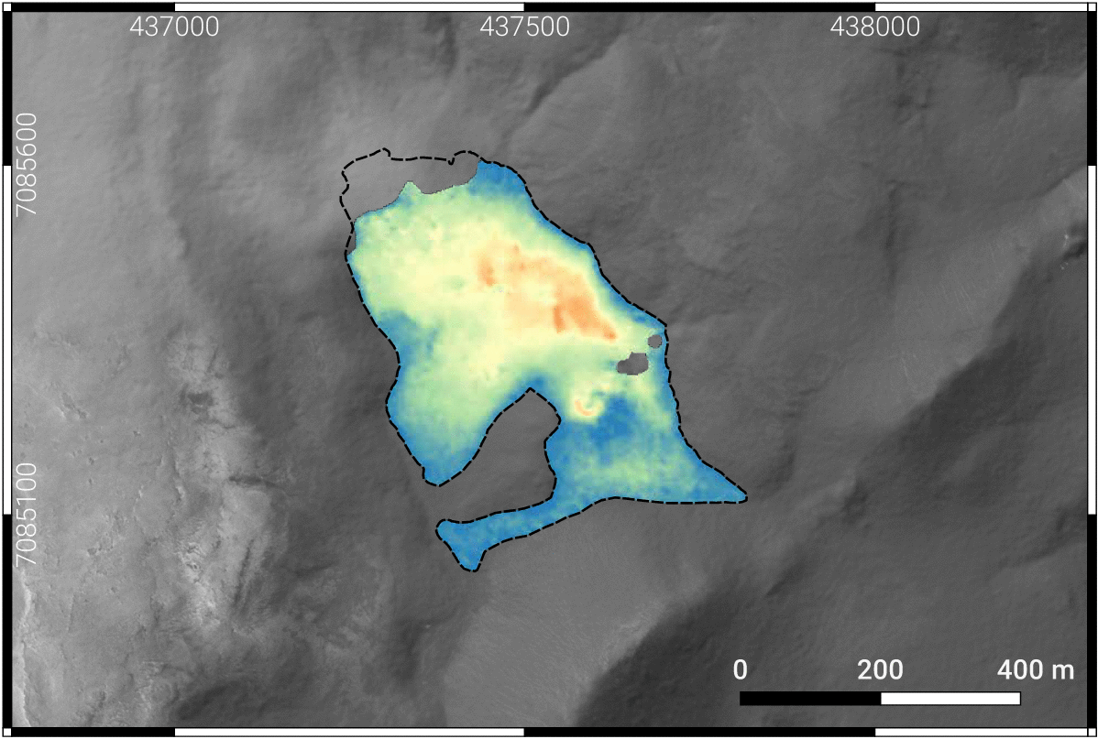
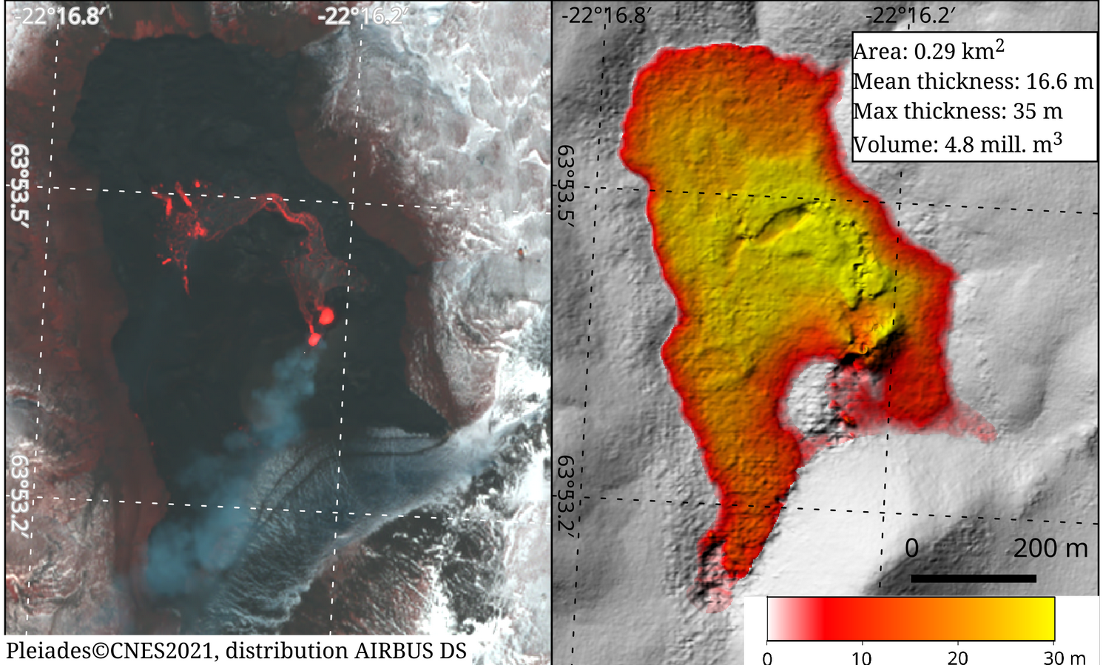
Near-real time Monitoring - CIEST²
First time Pléiades is used in near-real time for volcano monitoring
These data provided crucial information for the evolution of the eruption during the first 10 days
Repeated in La Palma (Sep – Oct 2021) and in Fagradalsfjall/Meradalir (Aug 2022) eruptions.
Gouhier et al., 2022. Journal of Applied Volcanology

Slide 8
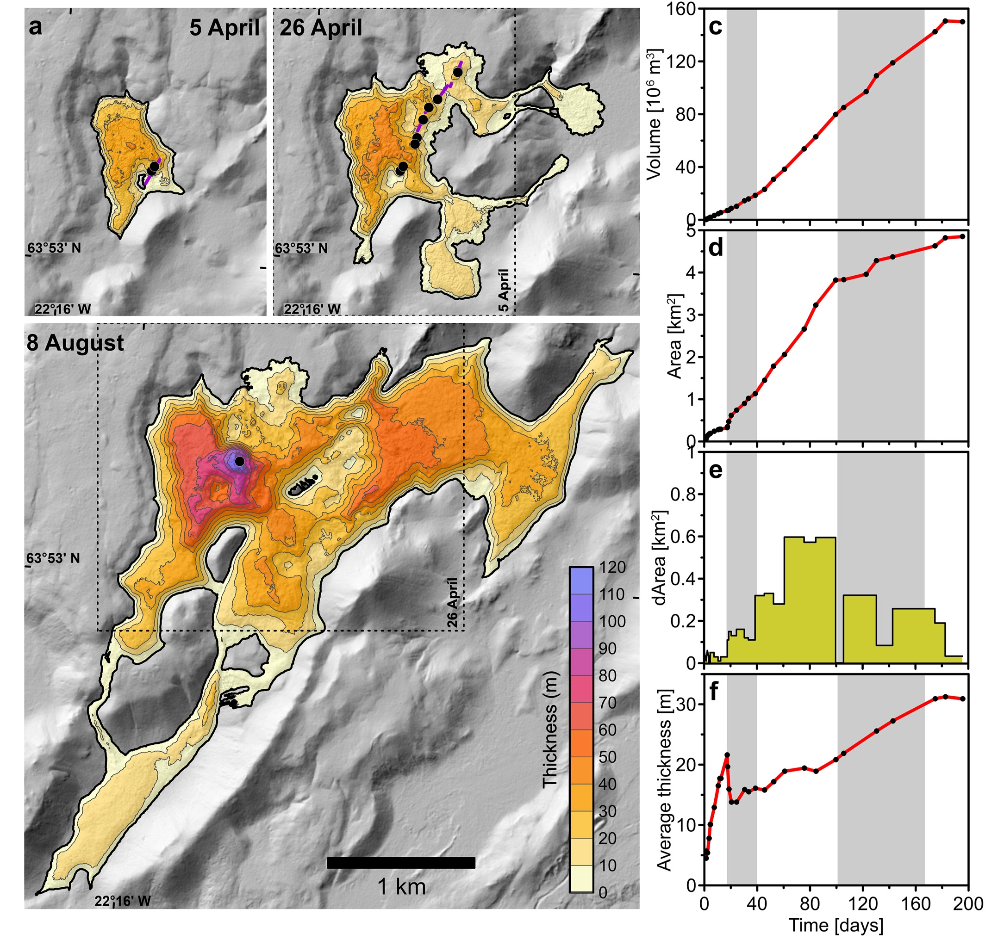
Lava area, volume and effusion rate (2021 eruption)
Phase 1: 19 Mar – 5 April
Phase 2: 5 – 27 April
Phase 3: 27 April – 28 June
Phase 4: 28 June – 2 September
Phase 5: 5 – 18 September

Slide 9
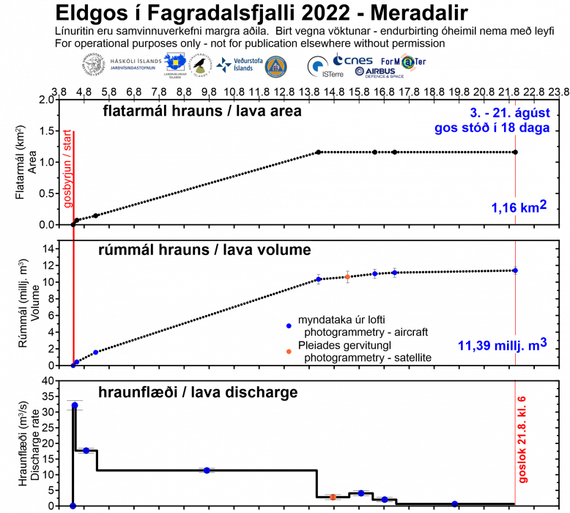
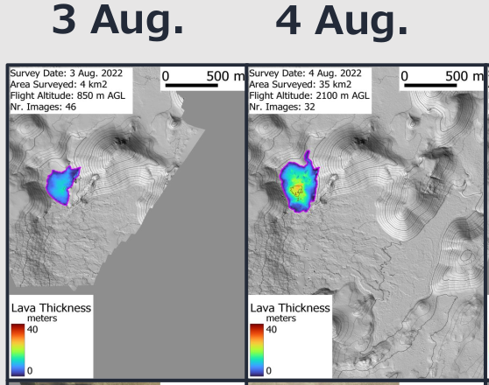
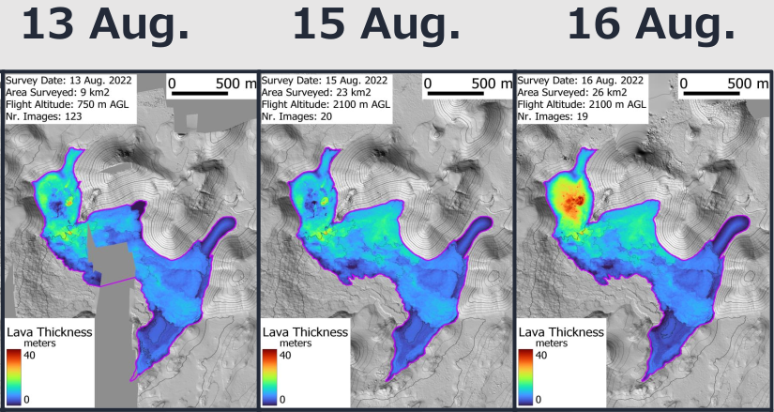
Lava area, volume and effusion rate (2022 eruption)
S. Gunnarson (LMI)

Slide 10
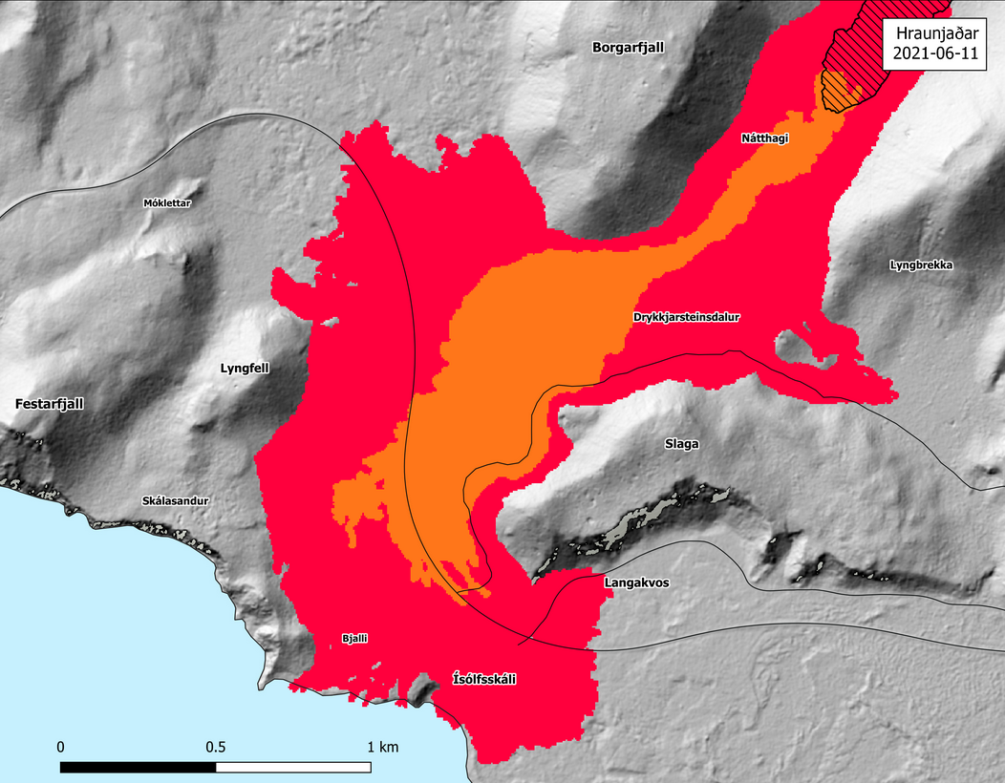
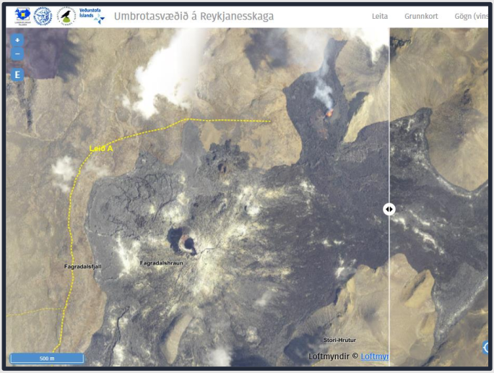
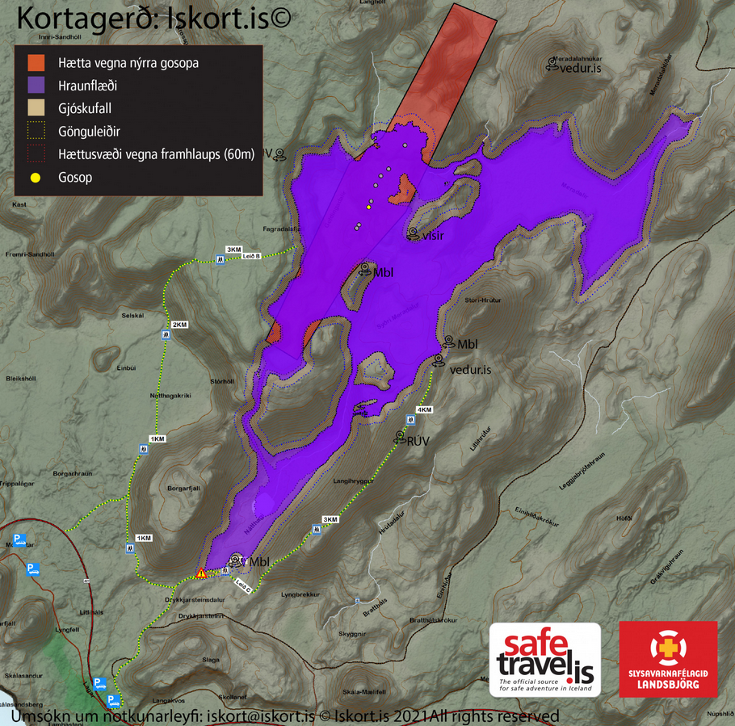
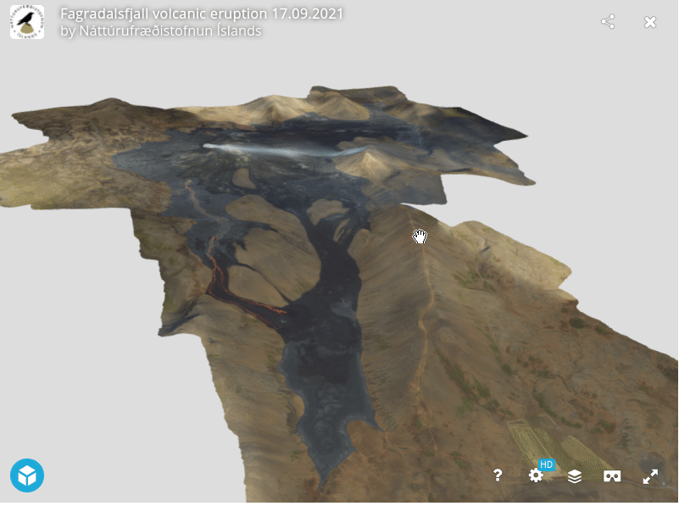
Byproducts
vedur.is
lmi.is
ni.is
safetravel.is

Slide 11
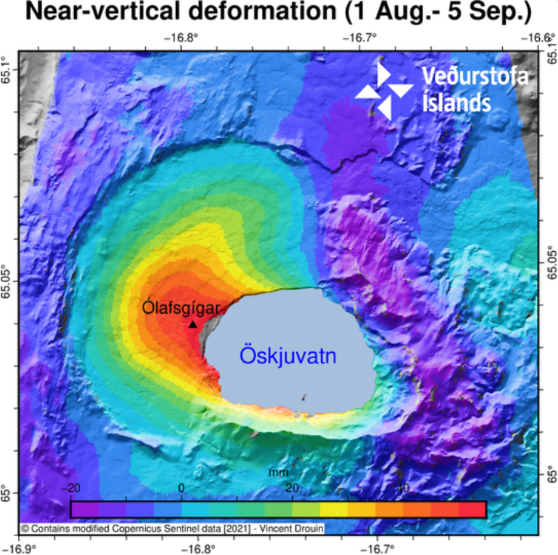
Perspectives and challenges
Volcano precursors are highly monitored and automated. However, no clear procedure is established after an eruption starts
Repeated stereoimages give crucial information to follow the evolution of effusive eruptions.
Challenge: Cloud-dependent. Radar-based DEMs?

Slide 12
Thank you!
Notes:
<number>

