Slide 1
Pléiades surveys Hofsjökull & Langjökull
DEM processing, jitter and uncertainties
Notes:
1

Slide 2
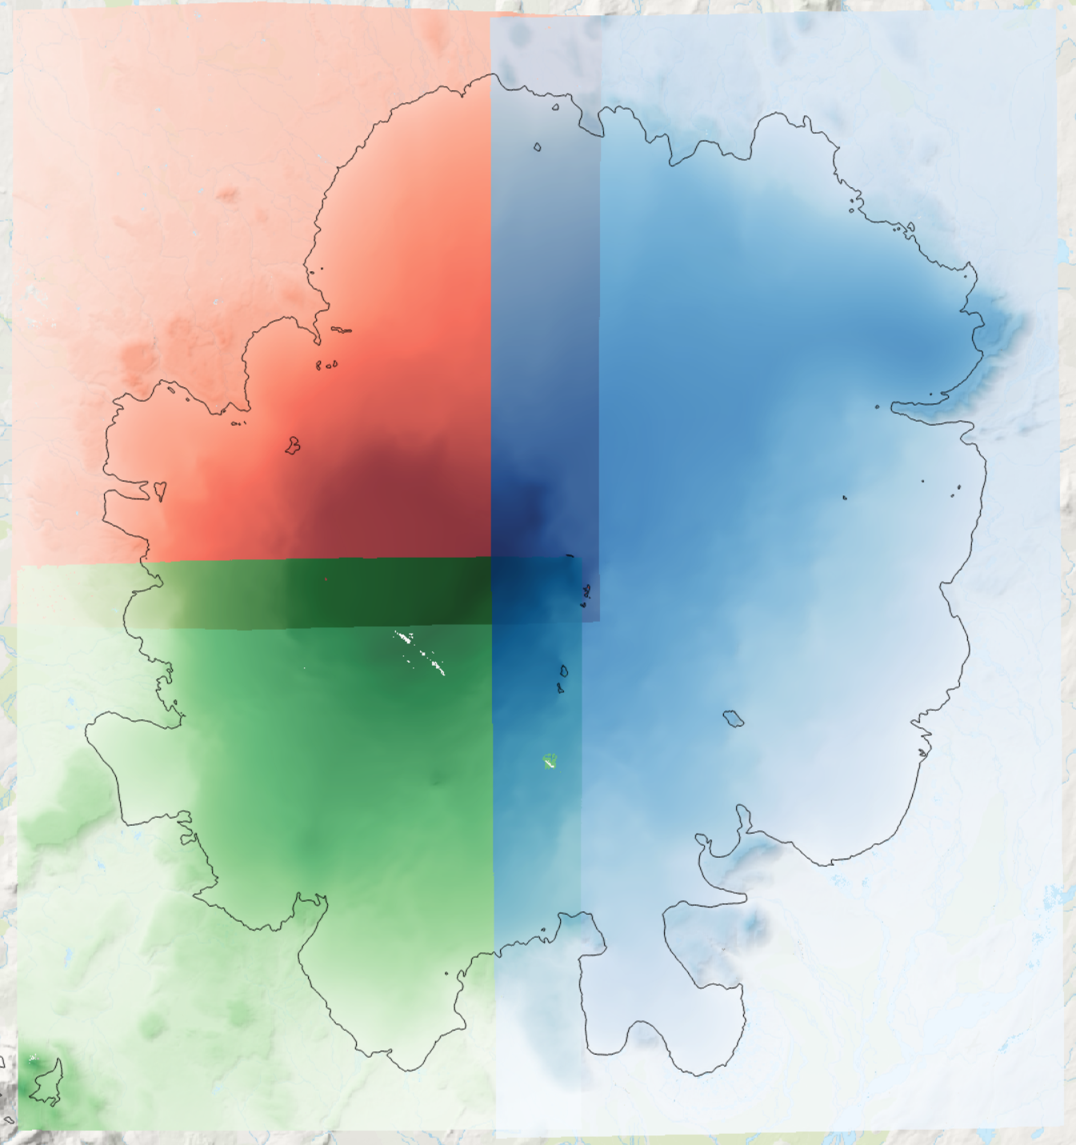
Data overview
2020-08-16
2020-08-14
2020-08-16

Slide 3
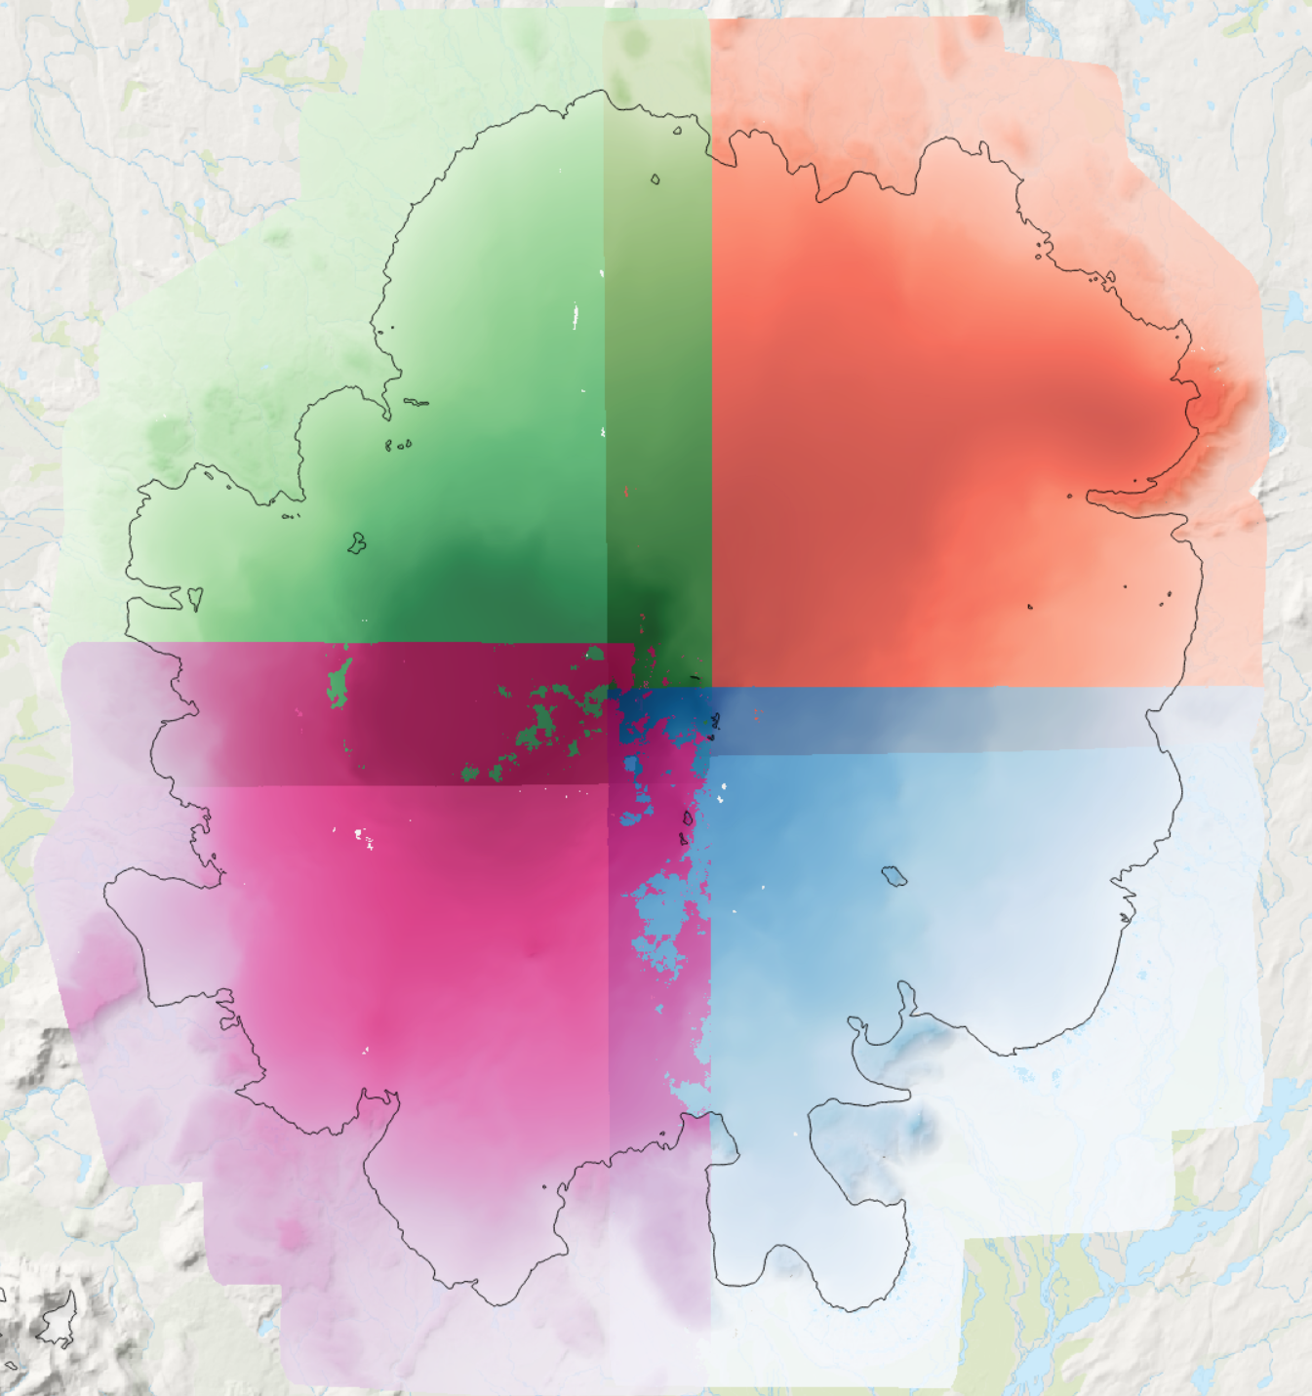
Data overview
2020-10-01
2020-10-02
2020-10-02
2020-10-05

Slide 4
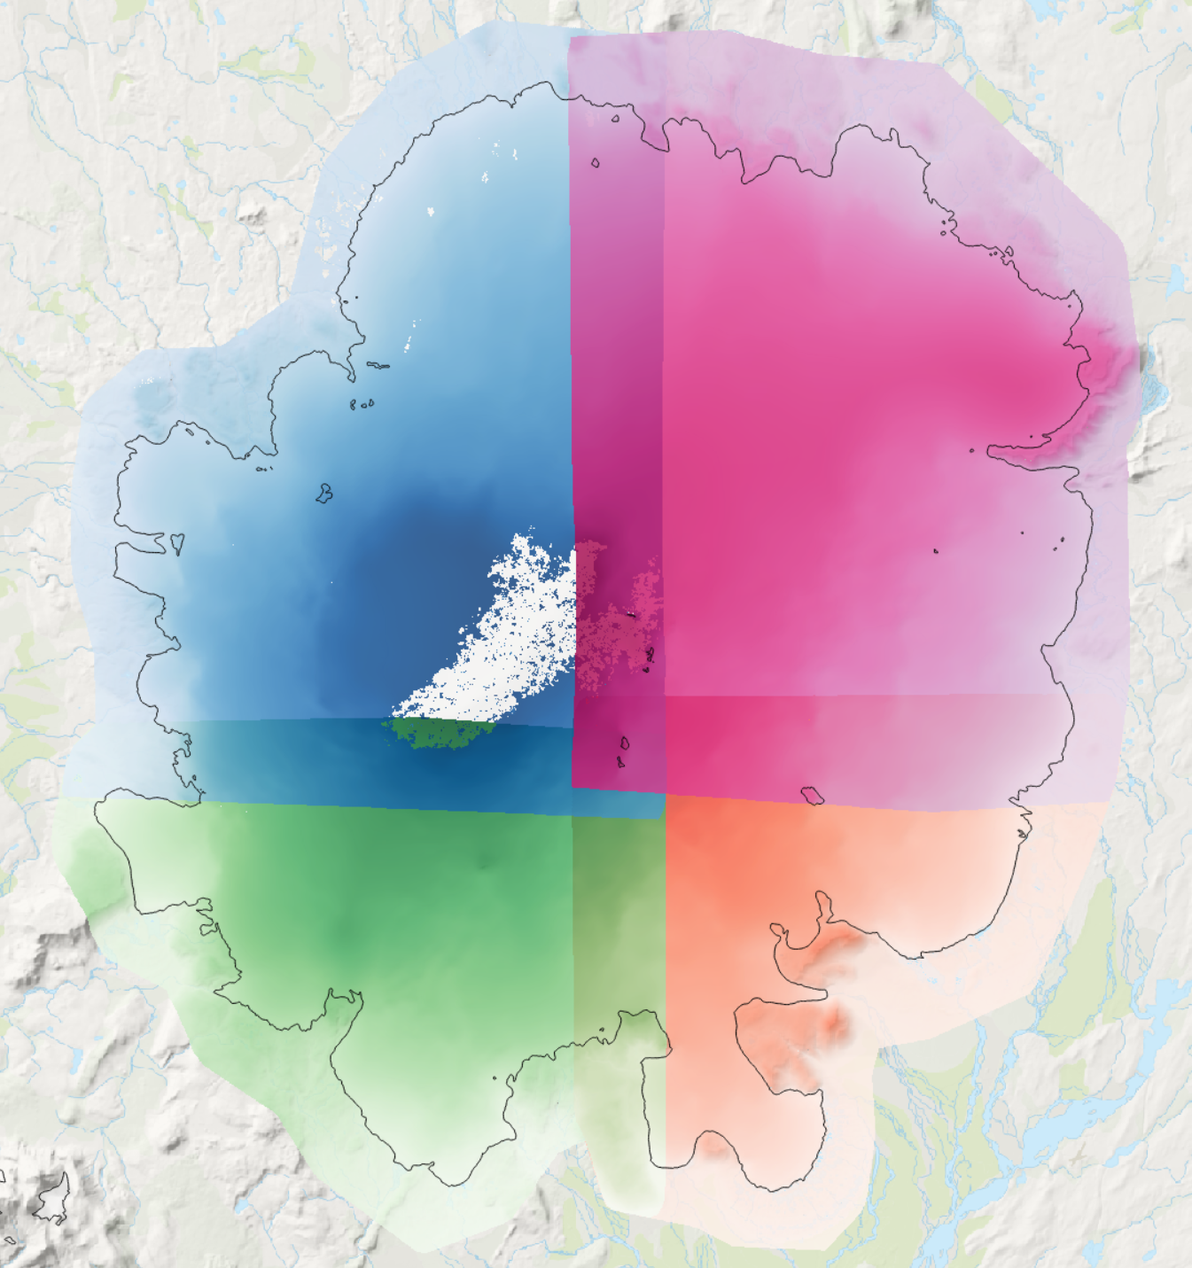
Data overview
2023-09-12
2023-09-11
2023-09-11
2023-09-11

Slide 5
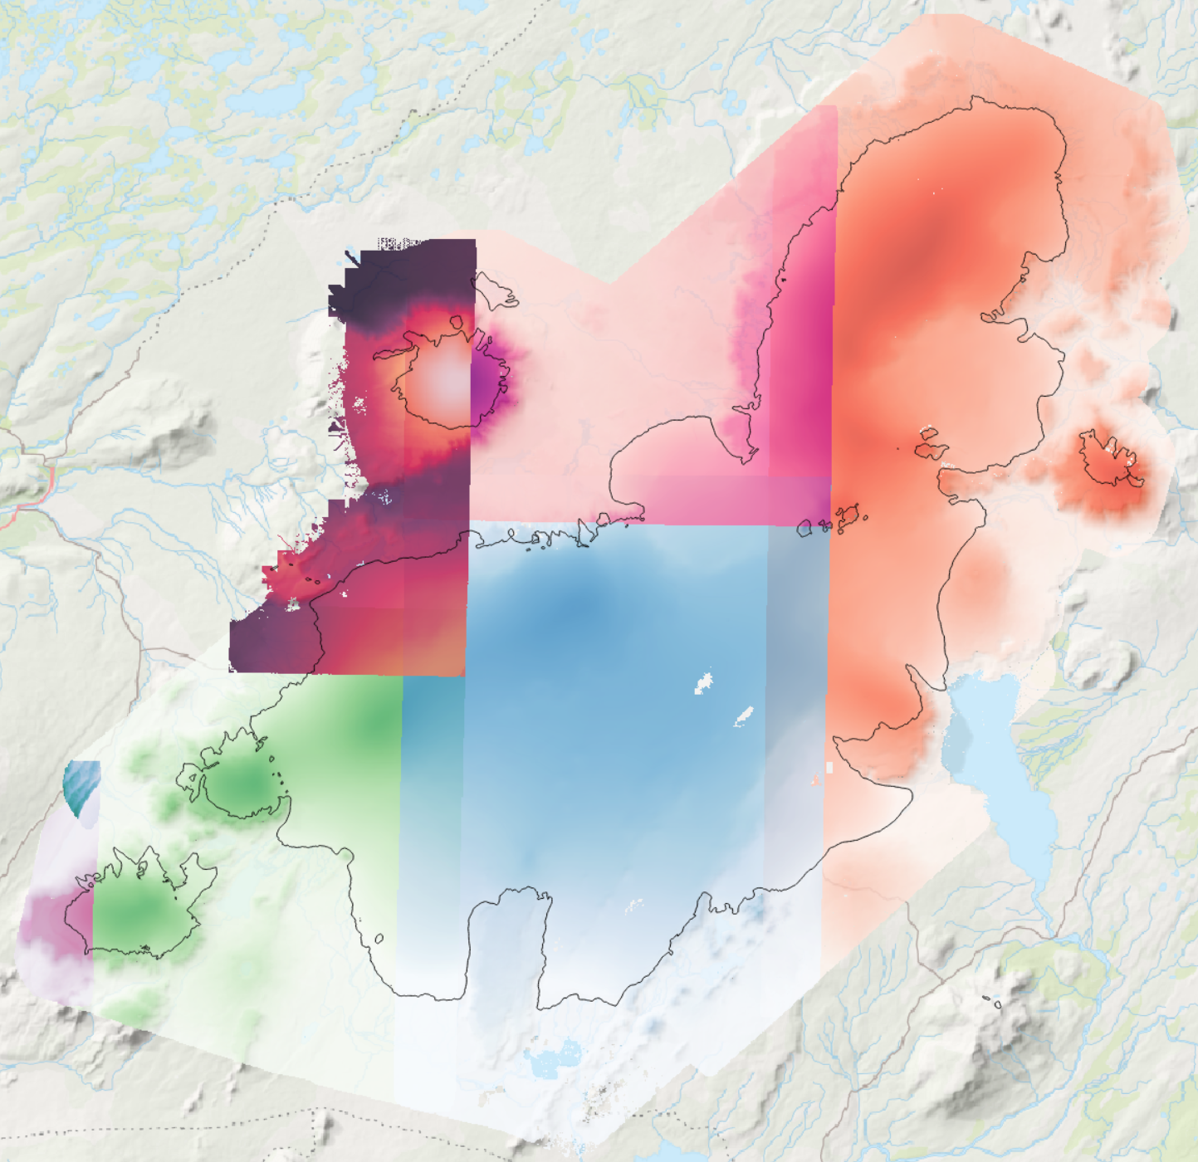
Data overview
2021-10-06
2021-10-11
2021-09-09
2021-10-06
2021-10-11
2021-10-11

Slide 6
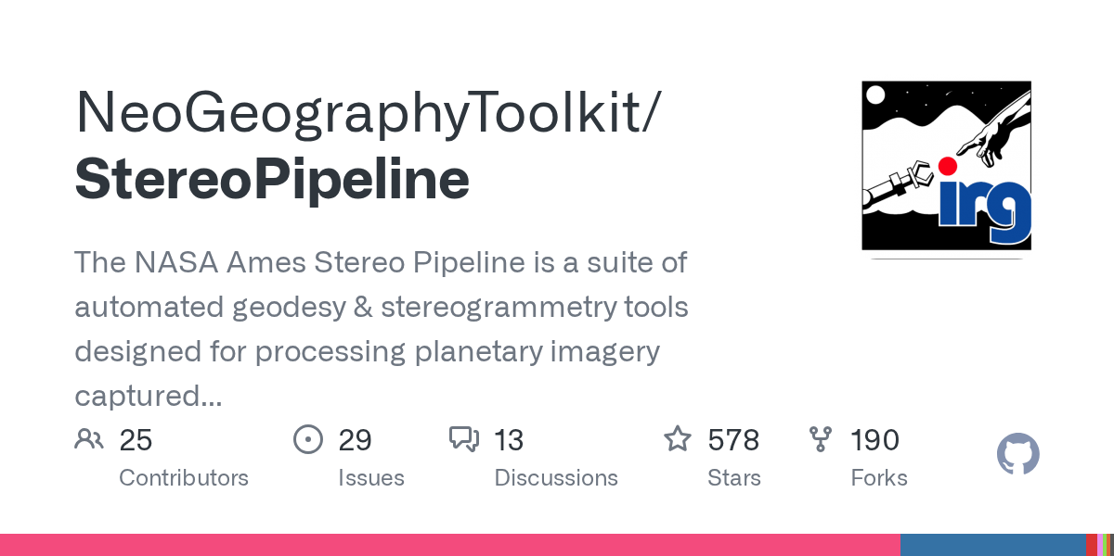
DEM processing
mapproject img1.tif rpc1 --ref lidar.tif
parallel_stereo img1mp.tif img2mp.tif rpc1 rpc2 lidar.tif
point2dem hofsj-PC.tif hofsj-DEM.tif
dem_align.py -tiltcorr –mask "glaciers" dem.tif lidar.tif

Slide 7

Jitter correction: explanation
Phase 1 – Per-slave spline correction
Along-track spline
Across-track polynomial
Phase 2 – Global simultaneous adjustment. Lidar + synchronous overlaps as reference
Phase 2.1 - Across-track correction: Degree 3 polynomial per slave -> LSQR
Phase 2.2 - Along-track correction: Substracts Phase 2.1, then Degree-6 polynomial per slave. -> LSQR
"Sweep" of all the parameters that can affect the results
https://ftp.lmi.is/.stm/joaquin/tmp/sweep_animation.webm

Slide 8
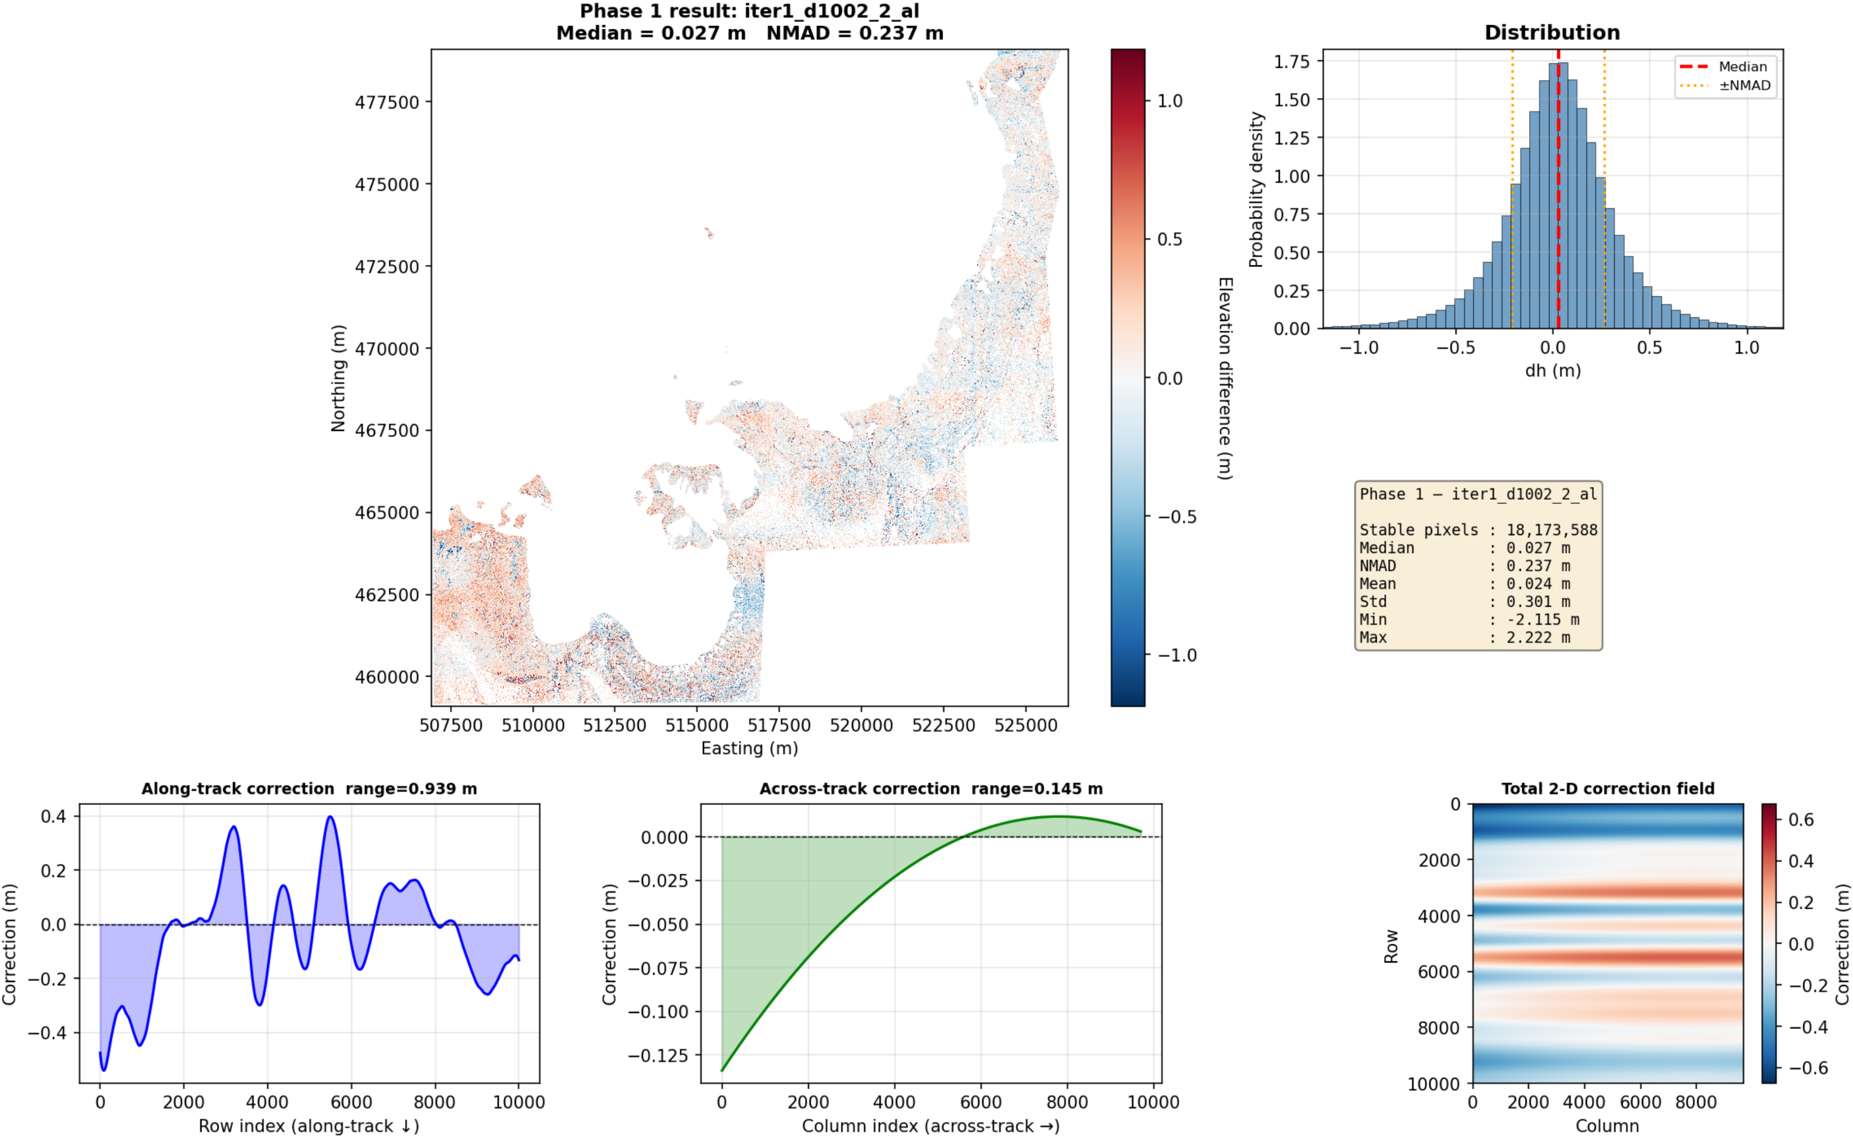
Jitter correction: Phase 1 (example)

Slide 9
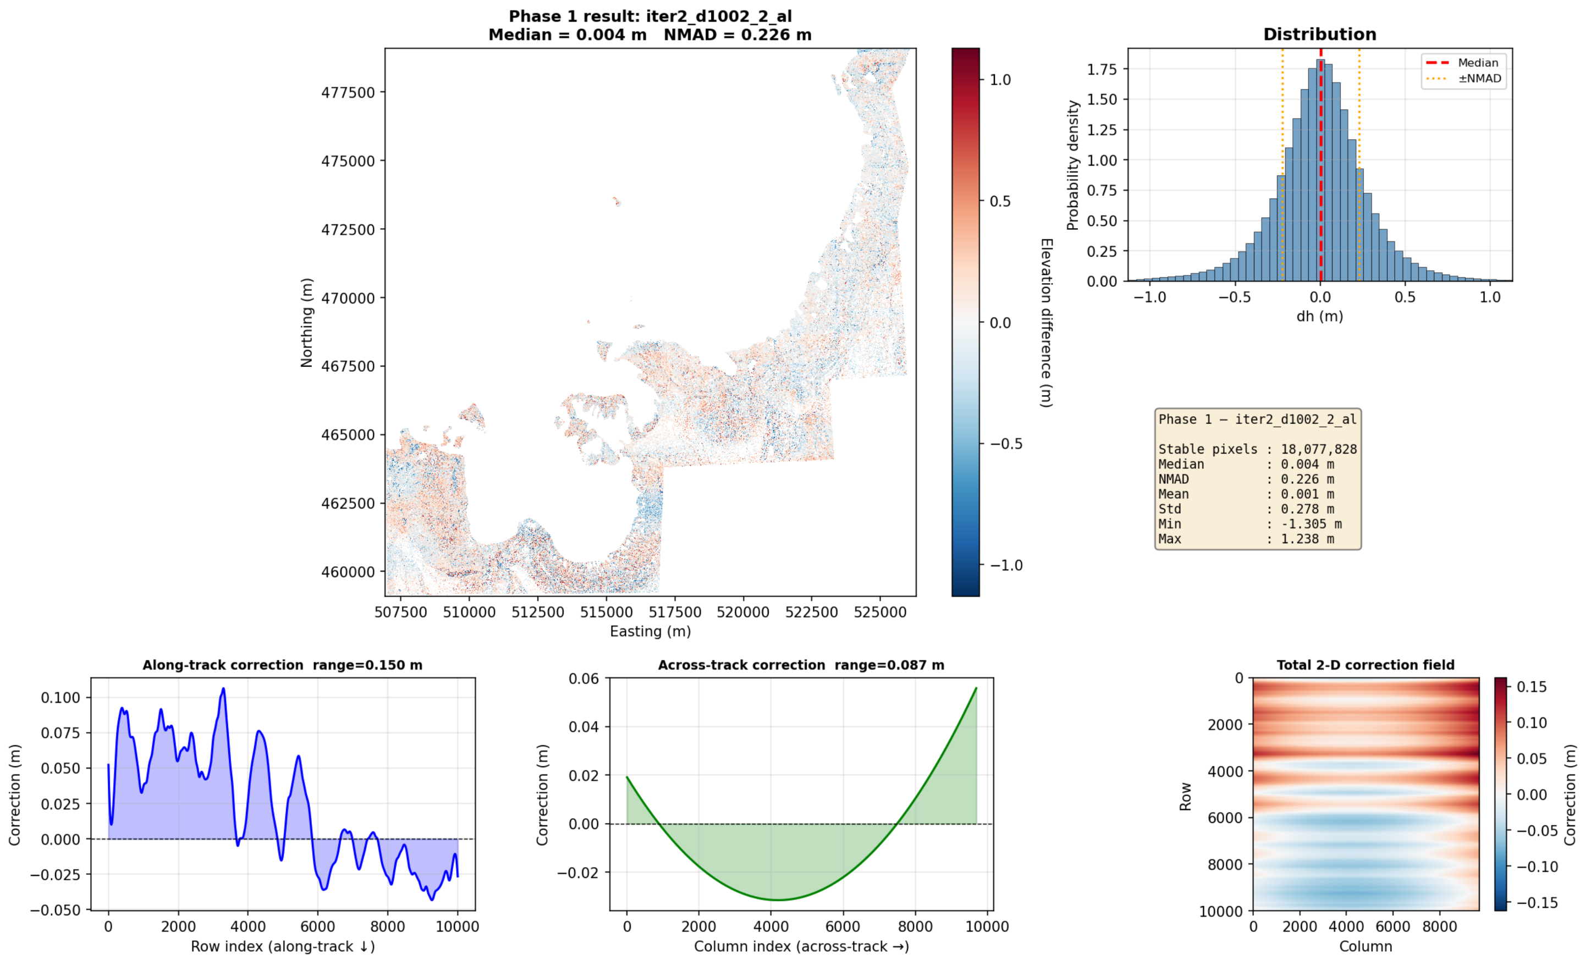
Jitter correction: Phase 1 (example)

Slide 10
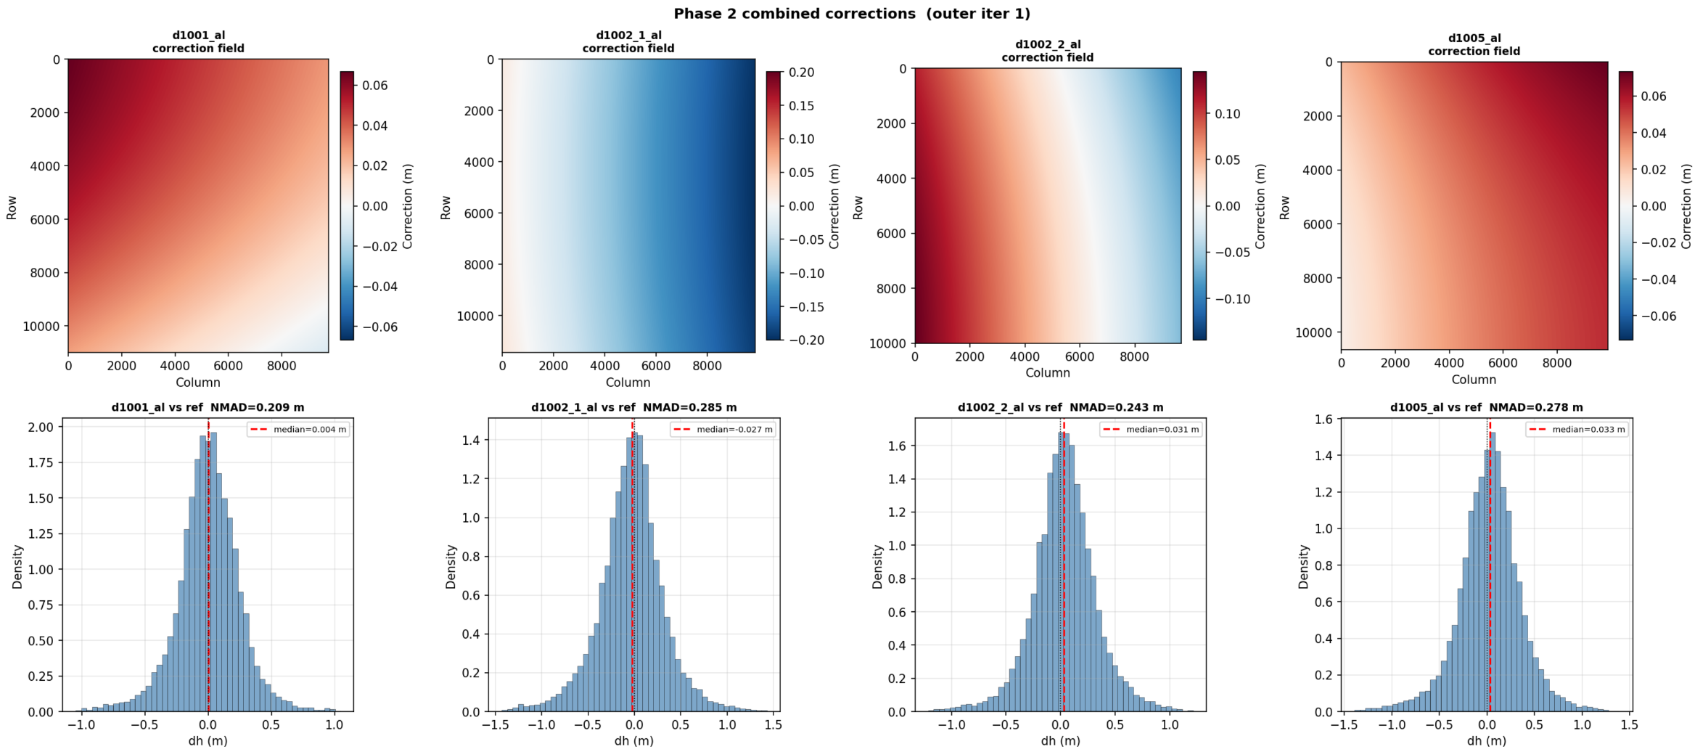
Jitter correction: Phase 2 (combined)

Slide 11
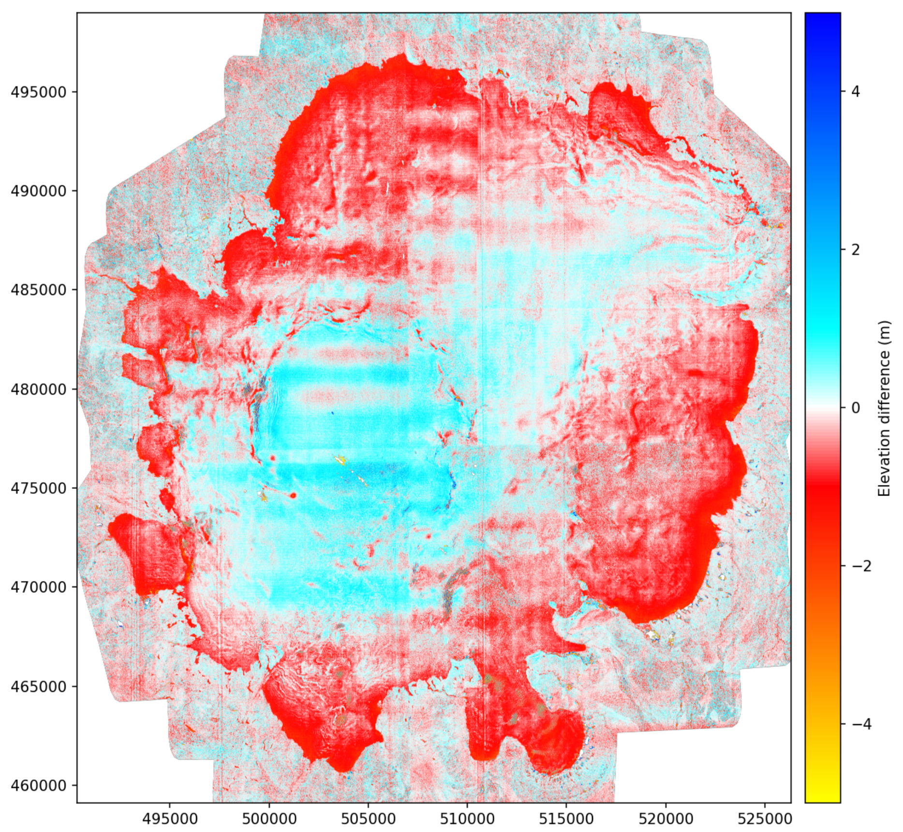
Best results Aug – Oct 2020 (1 month apart, ~1 m dh)

Slide 12
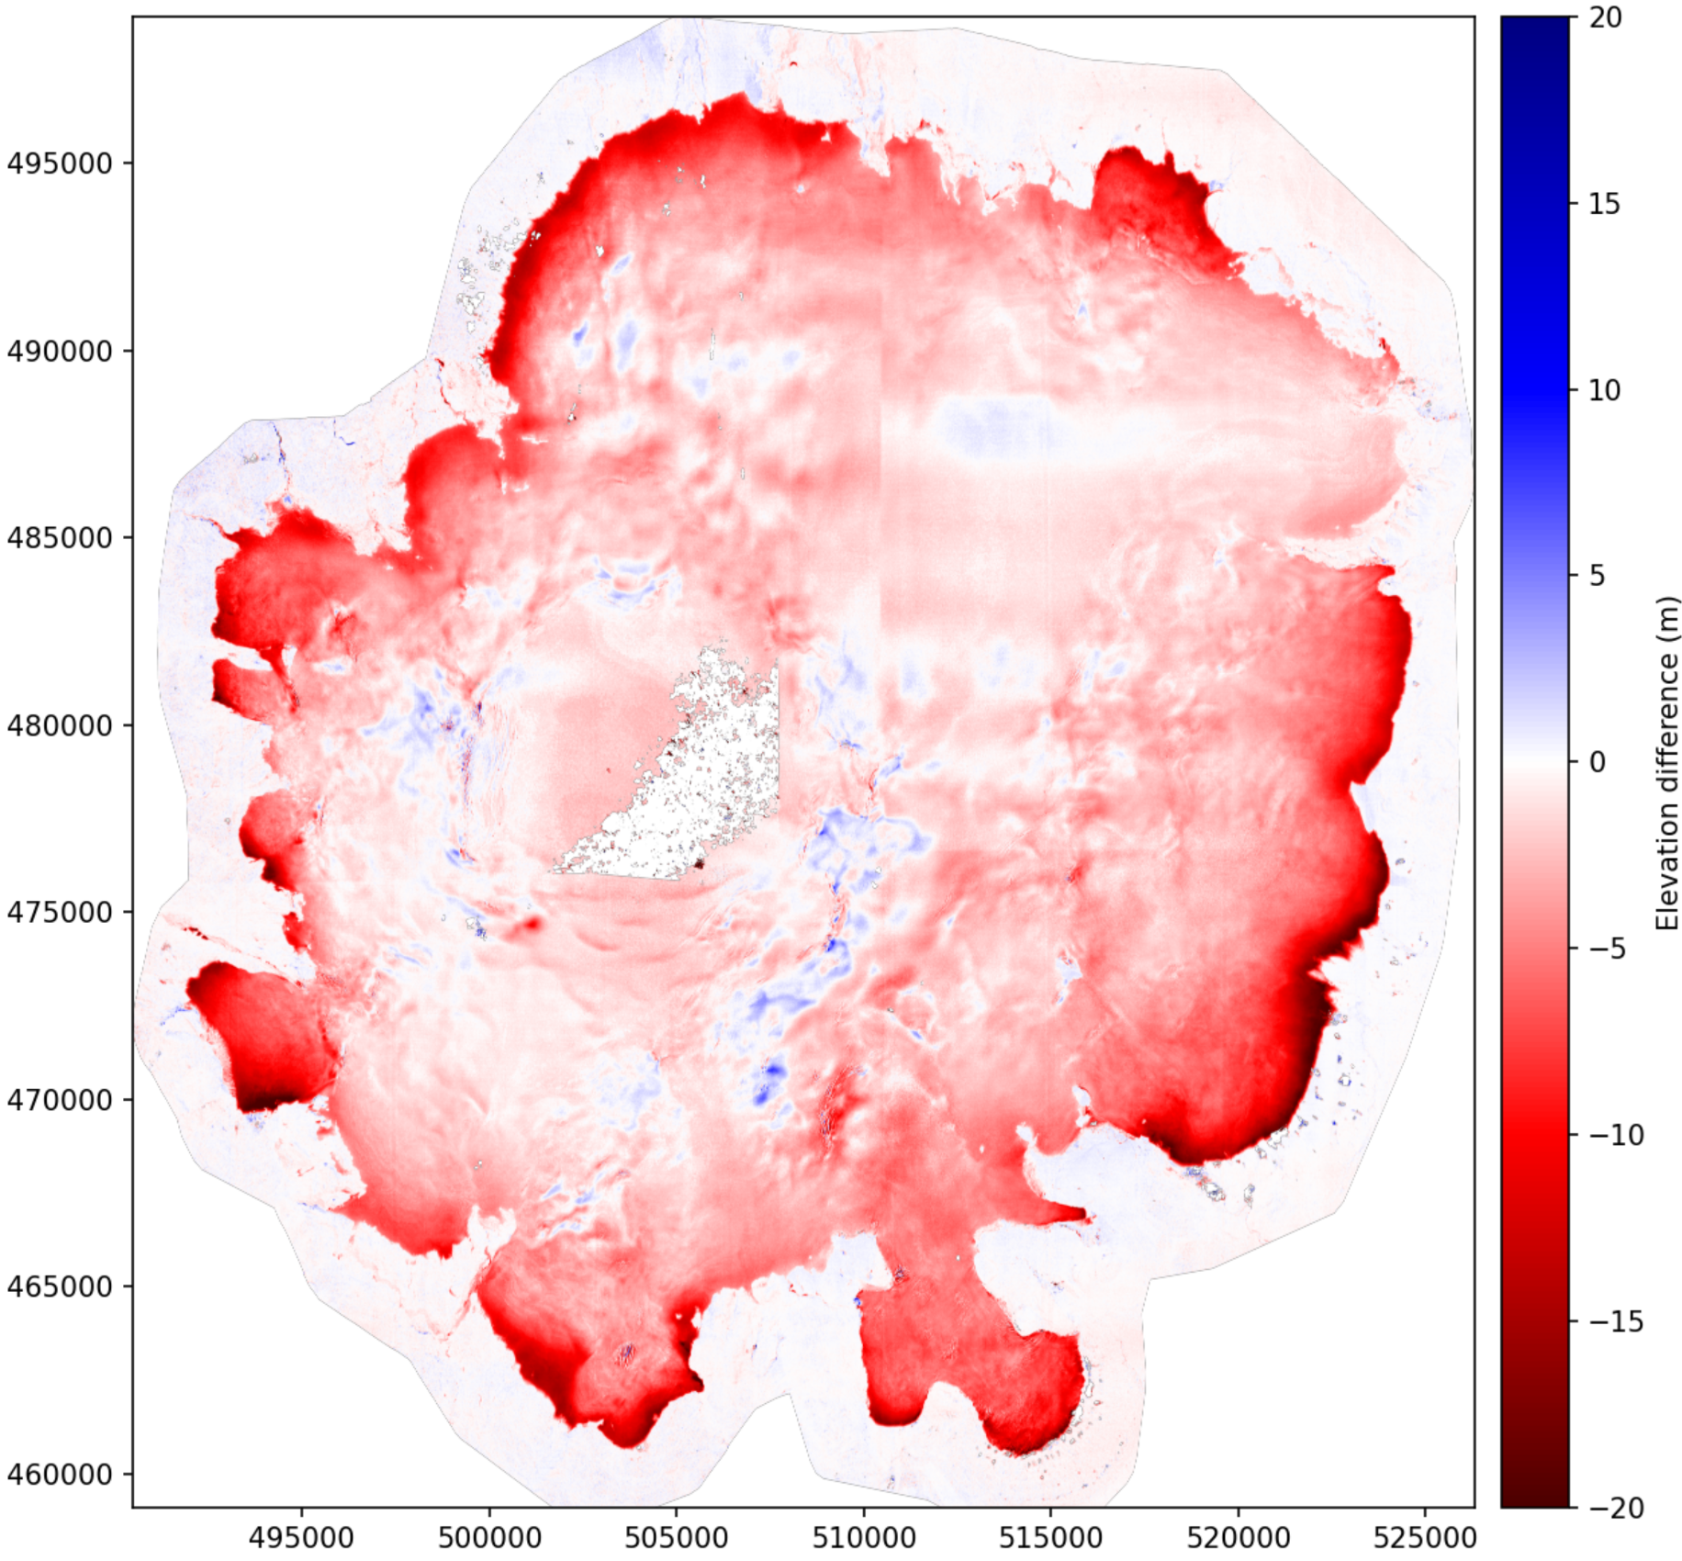
Best results Oct 2020 – Sep 2023

Slide 13
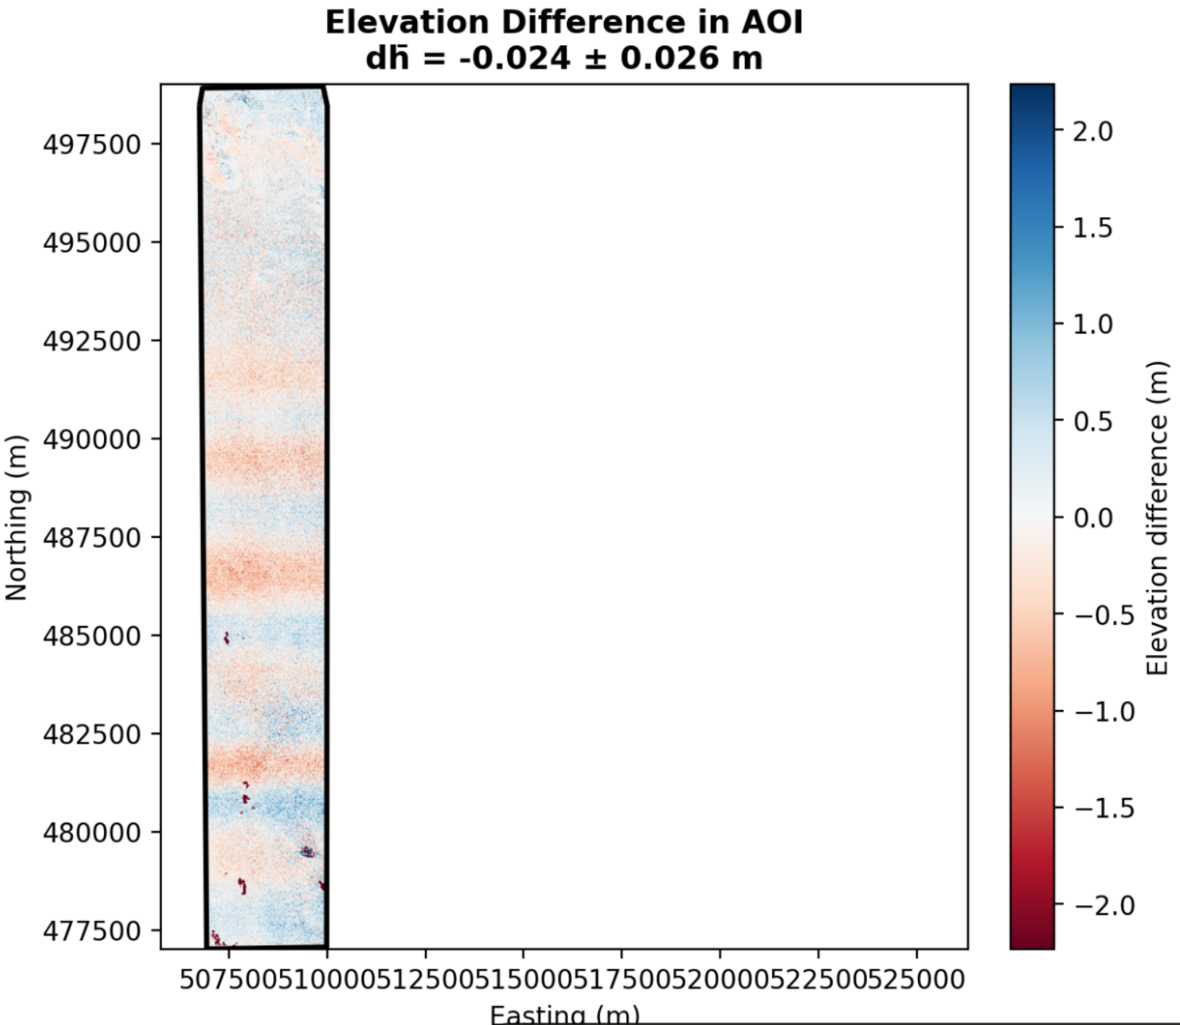
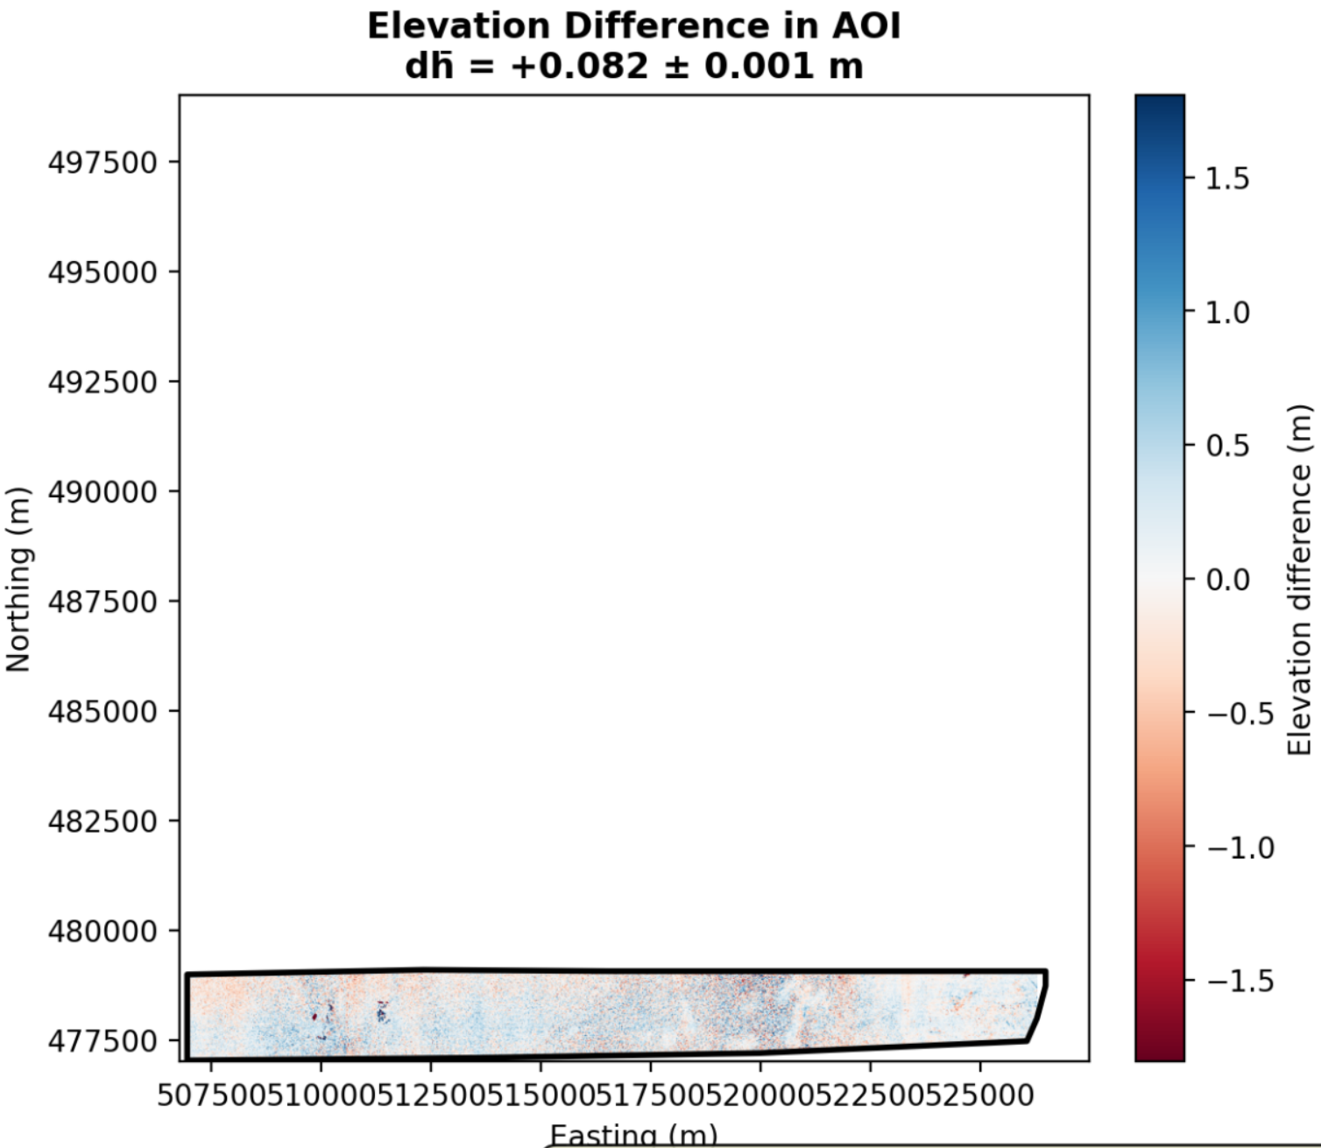
Uncertainty RH2022

Slide 14
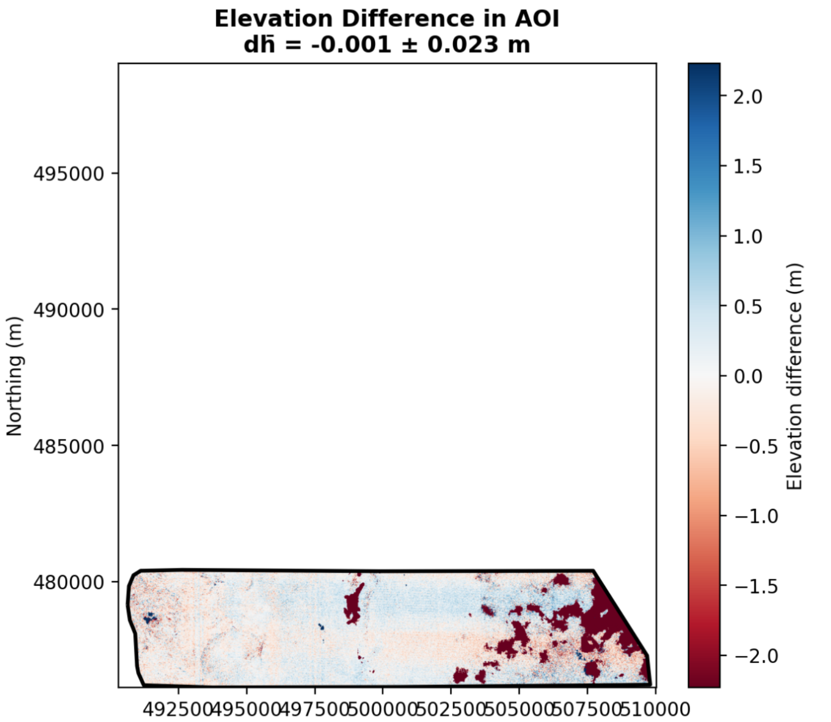
Uncertainties RH2022

Slide 15
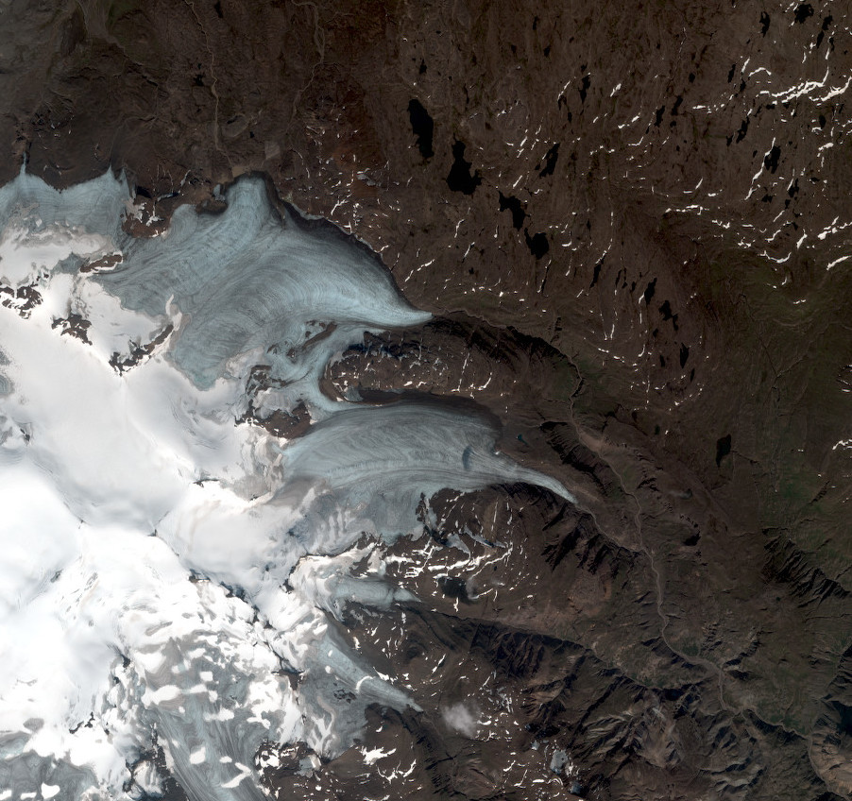
Thank you
Notes:
15

